Slide 1
Pre-Request for Proposal (RFP) Meeting
CEI Services for SL 1853
Madisonville Relief Route
Bryan District
FY 27 Wave 1
Solicitation No. 601CT0000006543; RFP No. 17-7SDP5001
Notes:
Welcome, everyone, to today's Pre-RFP meeting.
My name is Allison Kurwitz. I am the Procurement Engineer with the PEPS Central Service Center assigned to this Bryan SL 1853 CEI (Madisonville Relief Route) procurement.
This procurement will follow the federal with interview process.
It is part of the PEPS FY 27 Wave 1 procurements.

Slide 2
Housekeeping
Thanks for joining our virtual meeting!
Be sure your full name is showing up correctly to provide your information on the attendee list.
Please ensure your audio is muted and video turned off.
Note that all correspondence will be muted throughout this presentation.
The meeting will not be recorded, and attendees may not use any form of audio or video recording, photography, automated transcription services, or AI-based analysis tools.
There will not be an opportunity to ask questions during the Pre-RFP presentation.
You will be given an opportunity to ask questions after the presentation via an email request.
Notes:
You may provide teaming information in the chat, such as name, firm representing, prime or sub, specialty, whether looking to team, etc.
Teaming information will not be posted. Only attendance list with email addresses of attendees.

Slide 3
Meeting Agenda
1
Safety Moment
2
Introductions & Ground Rules
3
Procurement Overview & Process
4
Preclusions & Core Team Restrictions
5
Project Overview
6
Procurement Timeline (Tentative)
Wrap Up & Next Steps
7

Slide 4

Drive like a Texan English
Notes:
We can do our part by designing and building safer roadways and by being responsible drivers.
Drive with kindness and courtesy to make every mile a safe one.

Slide 5
Introductions
Professional Engineering Procurement Services (PEPS)
PEPS Central Service Center Manager (PEPS-Laredo): Jaime A. Vela, Jr., P.E.
PEPS Central Procurement Engineer (PEPS-Bryan): Allison Kurwitz, P.E.
PEPS Central Contract Administrator (PEPS): Cindy Barajas
Bryan District (BRY)
Consultant Selection Team (CST) Members: Bryan District Employees
Project Overview Presenter: Joe Seago, P.E. – BRY Construction Section
PLEASE - Do NOT Contact the Bryan District regarding this Contract.
Notes:
Now to introduce the PEPS Staff and Presenter for this procurement.
These are the individuals with the PEPS Central service center that will be assisting with procuring this contract for the Bryan District.
I will be overseeing the overall procurement process. Cindy Barajas will process the contract once it’s awarded.
There are three Consultant Selection Team (CST) members who are from the Bryan District.
If you need information, please contact me or Jaime Vela.

Slide 6
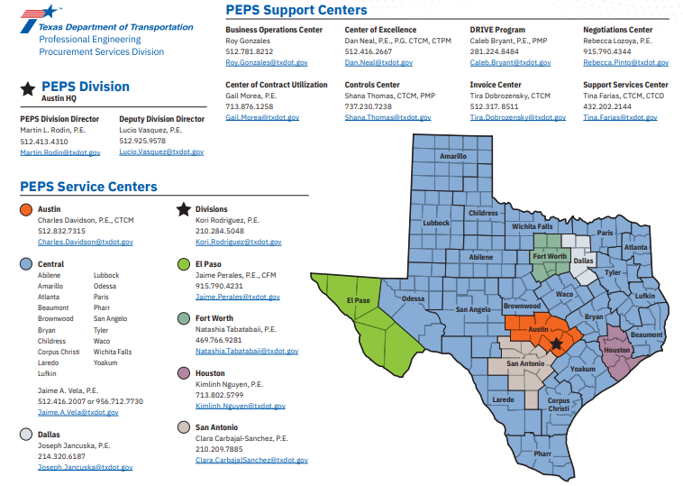
PEPS Information and Contacts
Notes:
The urban and rural districts highlighted in blue are those supported by the Central PEPS Service Center.
To serve the contracting needs of the department, PEPS has eight service centers located across the state. The service centers works with the districts and divisions to provide advice and oversight throughout the planning, selection, negotiation and contract management processes. Meanwhile the support centers provide specific functions in support of the service centers and of PEPS Division.

Slide 7
Ground Rules
Do not contact the Bryan District during the procurement process.
Communication is one-way during this presentation.
Brief Presentation – Information Purposes Only
All questions must be emailed to Allison.Kurwitz@txdot.gov by 5:00 p.m. on Friday, September 4, 2026.
Subject line: 6543 Pre-RFP Meeting Question
Notes:
Do not contact the Bryan District during the procurement process, but you may contact PEPS with questions.
Communication is one-way during this presentation.
This meeting will include a brief overview of the procurement process and the SL 1853 project as applicable to the procurement.
This meeting is for informational purposes only. The advertised RFP will provide the requirements that will dictate this contract procurement process.
This presentation, list of attendees, questions and responses will be posted online.
You can contact me with questions after this meeting, and I’ll respond to your emails.

Slide 8
Procurement Overview: Bryan District SL 1853 CEI
One procurement - One Specific Deliverable Contract
  Federal with Interviews, Disadvantaged Business Enterprise (DBE)
  Construction Engineering and Inspection (CEI)
  With Work Authorizations (WA)
Amount – To be determined through negotiations
Duration: Approx. 5-6 years

Slide 9
Procurement Process: Overview
One Specific Deliverable Contract with Work Authorizations
Contract Duration: Approx. 5-6 Years
FEDERAL PROCESS WITH INTERVIEWS
FEDERAL FUNDS
Solicitation – The Request for Proposal (RFP)
Response – Proposal submitted in Procurement Portal
Short List – Based on proposal scores
Interviews – Provider presentation
Selection – Based on the interview scores
DBE GOAL
0%
Refer to RFP for final %
Notes:
This Solicitation is for one specific deliverable contract with work authorizations. It will follow the Federal Process with Interviews.
The Disadvantage Business Enterprise (DBE) Goal is 0% and information will be provided in the RFP.
Solicitation will be posted in the TxDOT Procurement Portal (Euna Solutions), and providers will use the TxDOT Procurement Portal to submit responses.
The Proposal Evaluation will be used to make the Short List for interviews.
The Interview Evaluation will be used to make the selection.

Slide 10
Procurement Process: RFP and Submittal
Post Request for Proposal (RFP)
  Electronic State Business Daily (ESBD): Minimum 21-day posting time for RFP.
  Solicitation will be posted in TxDOT Procurement Portal – Euna Solutions (Formerly named Bonfire).
Submit Responses
  Providers will use Euna Solutions to submit responses to the solicitation.
    Euna Procurement Frequently Asked Questions (FAQs)
    Follow the RFP instructions and submit all completed, applicable documents required.
    Use the latest version of all forms.
Notes:
My goal is to post the request for proposal about September 18th. The RFP will be posted in the Procurement Portal. The 95% plans will be available with the RFP.
Euna Solutions is a procurement portal that will allow you to view business opportunities and submit provider response packages digitally.
The RFP will have specific instructions for your submittal. Follow the RFP as outlined in the document to avoid any disqualifications. Please read it carefully.
If you want to review the files that you uploaded as part of your submission, you may use Euna Solutions to navigate to the Submissions page and then use the download button for the document that you want to review. Refer to the FAQ. Can also click “Help” button or email questions to PEPS_COE_Process@txdot.gov

Slide 11
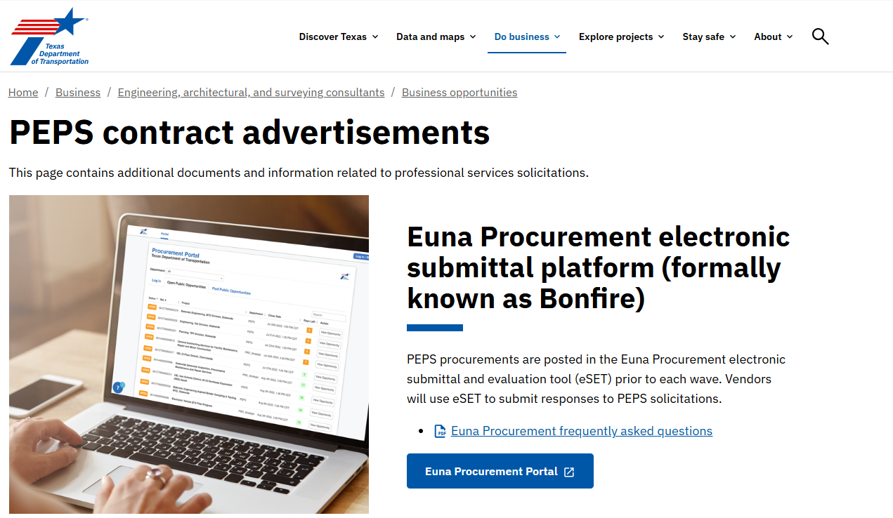
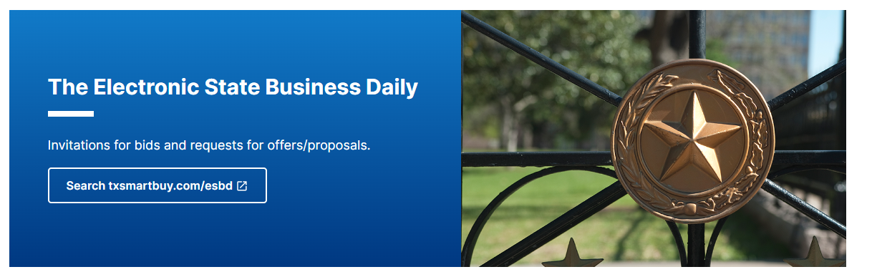
Procurement Process: Advertisement
PEPS Contract Advertisements Link: PEPS contract advertisements (txdot.gov)
Notes:
RFP will be advertised on the Euna Portal (used to be named Bonfire)
Link to the portal is on this page.
Check out the two helpful links put out by PEPS_COE, are included on this page:
Euna Procurement frequently asked questions, as well as the
Electronic submittals presentation presented by PEPS COE

Slide 12
Procurement Process: Screening and Evaluation
RFP Screening
  RFP Screening Checklist Architectural, Engineering and Surveying Consultants (state.tx.us)
  All prime and subs providing engineering and design-related services must be Administratively Qualified (AQ); or be determined eligible by TxDOT’s PEPS Division, Business Operations Center - Administrative Qualification Group to use the federal safe harbor rate, by the RFP deadline specified in this solicitation.
  Primes can look up subs on the TxDOT.gov website to check on AQ status. Firms Eligible to Do Business with TxDOT
Proposal Evaluation
  Short list based on proposal scores
Notes:
RFP Screening
Refer to the Proposal Screening Checklist on txdot.gov .
The RFPs will first be screened.
Proposal Evaluation
The CST members will individually score the proposals.
The proposal scoring will be evaluated on a scale of 1 to 5 per criteria.
The individual scores are consolidated to determine the short-listed consultants.
The three highest scoring providers will be short listed to advance to interviews.

Slide 13
Procurement Process: Interview, Negotiate and Execute
Interview
  Shortlisted firms will receive the Interview Contract Guide (ICG) that outlines the process, presentation topics, and scoring criteria.
  Interviews will consist of Provider presentations, and follow-up questions and answer session.
  Selection based on interview scores.
Negotiations
  Labor Classifications, Hourly Labor Rates, Unit Cost, ODE
  Level of Effort
  Negotiate Scope, budget, and work schedule
Execute Contract
Notes:
Interview:
The shortlisted firms will be interviewed. Those firms will receive an email with instructions and the ICG it will outline the scheduled interview time and date, interview agenda process, interview presentation topics and scoring criteria.
Project Manager and Task Leaders for work categories defined in the RFP are required to attend the interview.
Interviews will consist of Provider presentations and follow-up questions and answer session.
The final selection will be based on interview scores
We are planning for in-person interviews for this procurement. All interviews for a procurement must be held using the same format: if one is virtual, they must all be virtual. If an in-person interview is scheduled, all participants must be in-person.
Negotiations:
For the winning firms, unit costs, ODEs and labor classifications will be coordinated with the Procurement Engineer.
Negotiated rates will be coordinated with PEPS Negotiations Service Center.
Then you will negotiate scope, budget and work schedule with the Procurement Engineer and the Bryan District. The district, with assistance from the Procurement Engineer, will negotiate the level of effort.
Once all negotiations are final and documents are ready then we can execute the contract.

Slide 14
Procurement Process: RFP Requirements
    Project Team Composition (PTC) Form (Parts 1, 2, and 3) must include:
    Task Leads for standard work categories
    DBE firms
    Percentages of work
  Examples of Standard Work Categories
11.1.1 Roadway Construct. Manage. And Inspect.
11.2.1 Bridge Construction Manage. And Inspect.
11.3.1 Construction Superintendent
11.10.1 Construction Record Keeper
12.1.5 Portland Cement Concrete Placement
18.5.1 Utility Const. Manage. And Verification
  Prime provider shall perform at least 30% of the contracted work using its own work force.
  DBE goal is 0%.
Notes:
PTC will be input to CCIS.
Task leaders must be pre-certified before RFP closing.
All firms providing Engineering & Design services must be Administratively Qualified or determined eligible to use the federal safe harbor rate, before RFP closing date.

Slide 15
RFP Work Categories – Part 1(Tentative*)
1.8.1 | Public Involvement
4.5.1 | Constructability Review
11.1.1 | Roadway Construction Management and Inspection
11.2.1 | Bridge Construction Management and Inspection
11.3.1 | Construction Superintendent
11.4.1 | Environmental Inspections
11.6.1 | Construction Schedule Support - General
11.8.1 | Construction Schedule Support – Relating to Construction Management of Projects Including Bridges or Multilevel Interchanges
11.10.1 | Construction Record Keeper
12.1.1 | Asphaltic Concrete Production
12.1.2 | Portland Cement Concrete
12.1.3 | Materials Engineering
* Subject to change. Refer to RFP for list and percentages.
Notes:
Subject to change. Refer to RFP for list and percentages.
The work categories groups:
Transportation Systems Planning – Public Involvement
Roadway Design – Constructability Review
Construction Management

Slide 16
RFP Work Categories – Part 2 (Tentative*)
12.1.4 | Asphaltic Concrete Placement
12.1.5 | Portland Cement Concrete Placement
12.1.6 | Embankment/Subgrade/Backfill/Base Production
12.1.7 | Embankment/Subgrade/Backfill/Base Placement
12.2.1 | Concrete Plant Inspection And Testing
12.2.5 | Hot Mix Asphalt (HMA) Plant Inspection and Testing
14.1.1 | Soil Exploration
14.2.1 | Geotechnical Testing
15.2.1 | Design Survey
15.2.2 | Construction Survey
18.2.1 | Subsurface Utility Engineering (Util Engr. Investigation)
18.3.1 | Utility Adjustment Coordination
18.5.1 | Utility Construction Management and Verification
* Subject to change. Refer to RFP for list and percentages.
Notes:
Subject to change. Refer to RFP for list and percentages.
The work categories groups:
Construction Management
Material Inspection and Testing
Geotechnical Services
Surveying and Mapping
Utility Engineering

Slide 17
Proposal Evaluation Criteria
CST members will independently score Proposals based on the evaluation criteria and relative importance factors (weightings) provided below. The Past Performance Score is only used in Proposal Evaluation.
Evaluation Criteria | Included Elements | Weighting for Evaluation of Proposal
Technical approach | Project understanding, project approach, innovative concepts or alternatives | XX
Project Manager’s relevant experience | Experience with similar or related projects, including both technical and management experience | XX
Project planning and management | Project staffing and resource management (who, how, and why), communication plan, and quality control procedures. The prime firm’s past experience with utilizing subproviders and meeting program goals (HUB or DBE) and/or how it plans to utilize subproviders to meet the goals on this contract. Also, may include project scheduling or phasing for SD projects | XX
Key staff’s relevant experience | Experience with similar projects | XX
Past Performance Score |  | 5 to 15%
Total |  | 100%
Notes:
The proposal scoring will be evaluated on a scale of 1 to 5 per criteria
There will be 4 criteria evaluated: Technical Approach, Project Manager’s Relevant Experience, Project Planning and Management and Key Staff Relevant Experience. Plus, the provider’s Past Performance Score for the proposal phase. The Past Performance Score is not included for interview scoring.
Refer to the RFP for the actual weighting percentages.

Slide 18
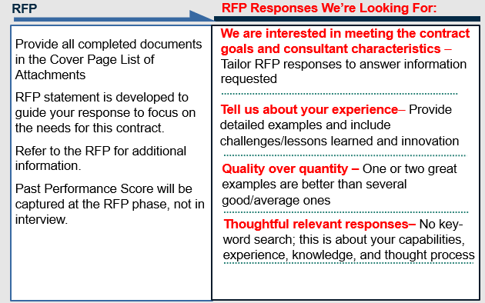
Procurement Process: Proposal
Notes:
TxDOT will provide a clear detailed description of the scope of work, technical requirements and qualifications of consultants necessary for the services to be rendered.
Proposal Statement
Proposal Evaluation Criteria
Proposal Format
Proposal Schedule

Slide 19
Procurement Process: Interview
Interview and Contract Guide (ICG)
Typical Interview process *
TxDOT will provide the following:
Scope of work with technical requirements and qualifications required to provide the services of this contract
Presentation Topics
Identify interview evaluation criteria
Interview format and timetable
Interview schedule date, time and location
TxDOT Introductions/Instructions
Provider presentation based on topics shown in ICG
CST Break
Questions and Answer Session
TxDOT Concluding Remarks
*Interviews in-person: Bryan District
The CST members individually score the interviews and then the scores are consolidated to determine the selected provider.

Slide 20
Preclusions: Precluded Firms*
Contract 36-9IDP5100 WA 2
Prime: Garver, LLC
  Subproviders: Freese and Nichols, Inc.
  LJA Engineering, Inc.
  Poznecki-Camarillo, Inc.
  The Rios Group, Inc.
* List is subject to change – current as of 8/26/2026
Notes:
The listed Primes and Subs that have worked on the PS&E contract for this project, have been identified as precluded from the current Bryan SL 1853 CEI procurement.
A Draft Preclusion Document will be posted with the Pre-RFP presentation.
Refer to the Request for Proposals posting in the TxDOT Procurement Portal for the final precluded list of firms. Some could change.

Slide 21
Core Team Restrictions
Core Team Restrictions: This solicitation does not contain a core team restriction.

Slide 22
Preclusion Appeals Process
Preclusion Appeals Process
  Preclusion document has been developed.
    Email Martin L. Rodin, P.E.
    Include this Solicitation No. 601CT0000006543
    Explain rationale for removal from preclusion list
  After posting procurement
    Formal appeal outlined in Title 43 TAC § 9.7, see for exact details
    Mail letter to Marc D. Williams, P.E., include above info
    CC: Martin L. Rodin
    Procurement process is not paused

Slide 23
Project Overview
Bryan District – SL 1853
Madisonville Relief Route
Joe Seago, P.E.
Transportation Engineer – District Construction
Bryan District

Slide 24
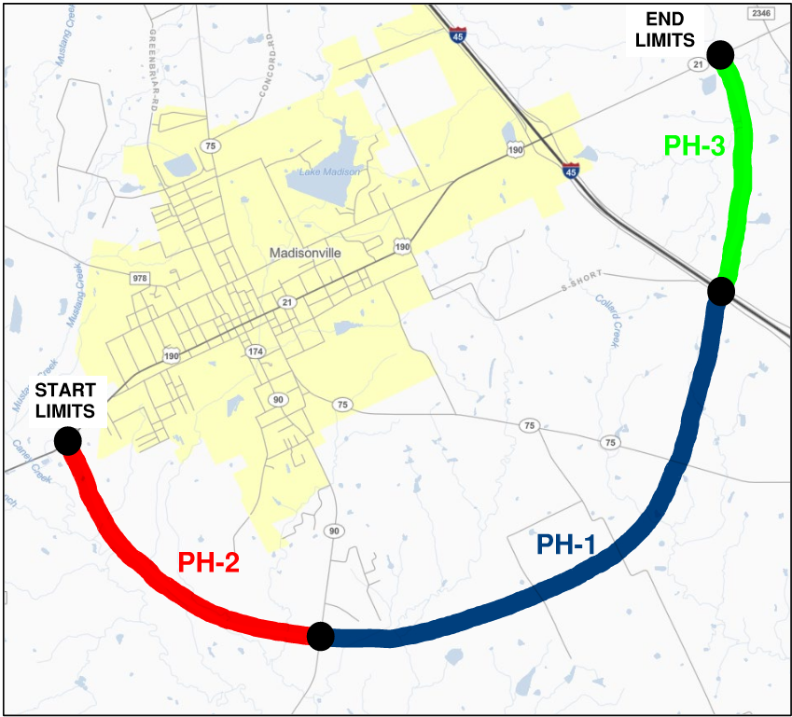
Project Overview: SL 1853 Madisonville Relief Route
County: Madison County
Overall Limits: From US 190 / SH 21 East of FM 1452 To SH 21 West of FM 2346 (Approx.7.5 miles)
Description of Work: New Location Route with 3 new Interchanges. Includes reconstruction on IH 45

Slide 25
Construction Phasing
Phase 1
  Limits: From SH 90 to IH 45
  CSJ: 0171-11-003 / 0675-05-105
  Construction Estimate: $225 M
  Programed Letting Date: 8/4/2027
Phase 2
  Limits: From SH 21 West to SH 90
  CSJ: 0171-11-002
  Construction Estimate: $167 M
  Estimated Letting Date: Fall 2029
  Proposed AVL* Date: Spring 2028
Phase 3
  Limits: From East of IH 45 to SH 21 East
  CSJ: 0171-11-004
  Construction Estimate: $54 M
  Estimated Letting Date: Fall/Winter 2029
  Proposed AVL* Date: Summer 2028
* AVL – Early Available to Let Date

Slide 26
Status: Design & ROW
PS&E:
  PH-1 95% PS&E complete; moving to 100% submittal early November 2026
  PH-2/3 sitting at 90% complete; Final submittal spring 2027
Right-of-way:
  Total of 27 Parcels
  PH-1 has 75% Acquired; PH-2/3 has 45% Acquired
  Anticipate acquisition complete before letting of each phase
Notes:
Schematic and environmental complete. Environmentally cleared July 2023.

Slide 27
Status: Utilities
Utilities:
  Utility Coordination is ongoing.
  Key utilities
    Entergy cross-country transmission line – Long lead materials have been ordered
    Trail Blazer oil pipeline relocation underway
    AT&T within IH 45 ROW has submitted plans for review
  District is committed to letting without a CMP

Slide 28
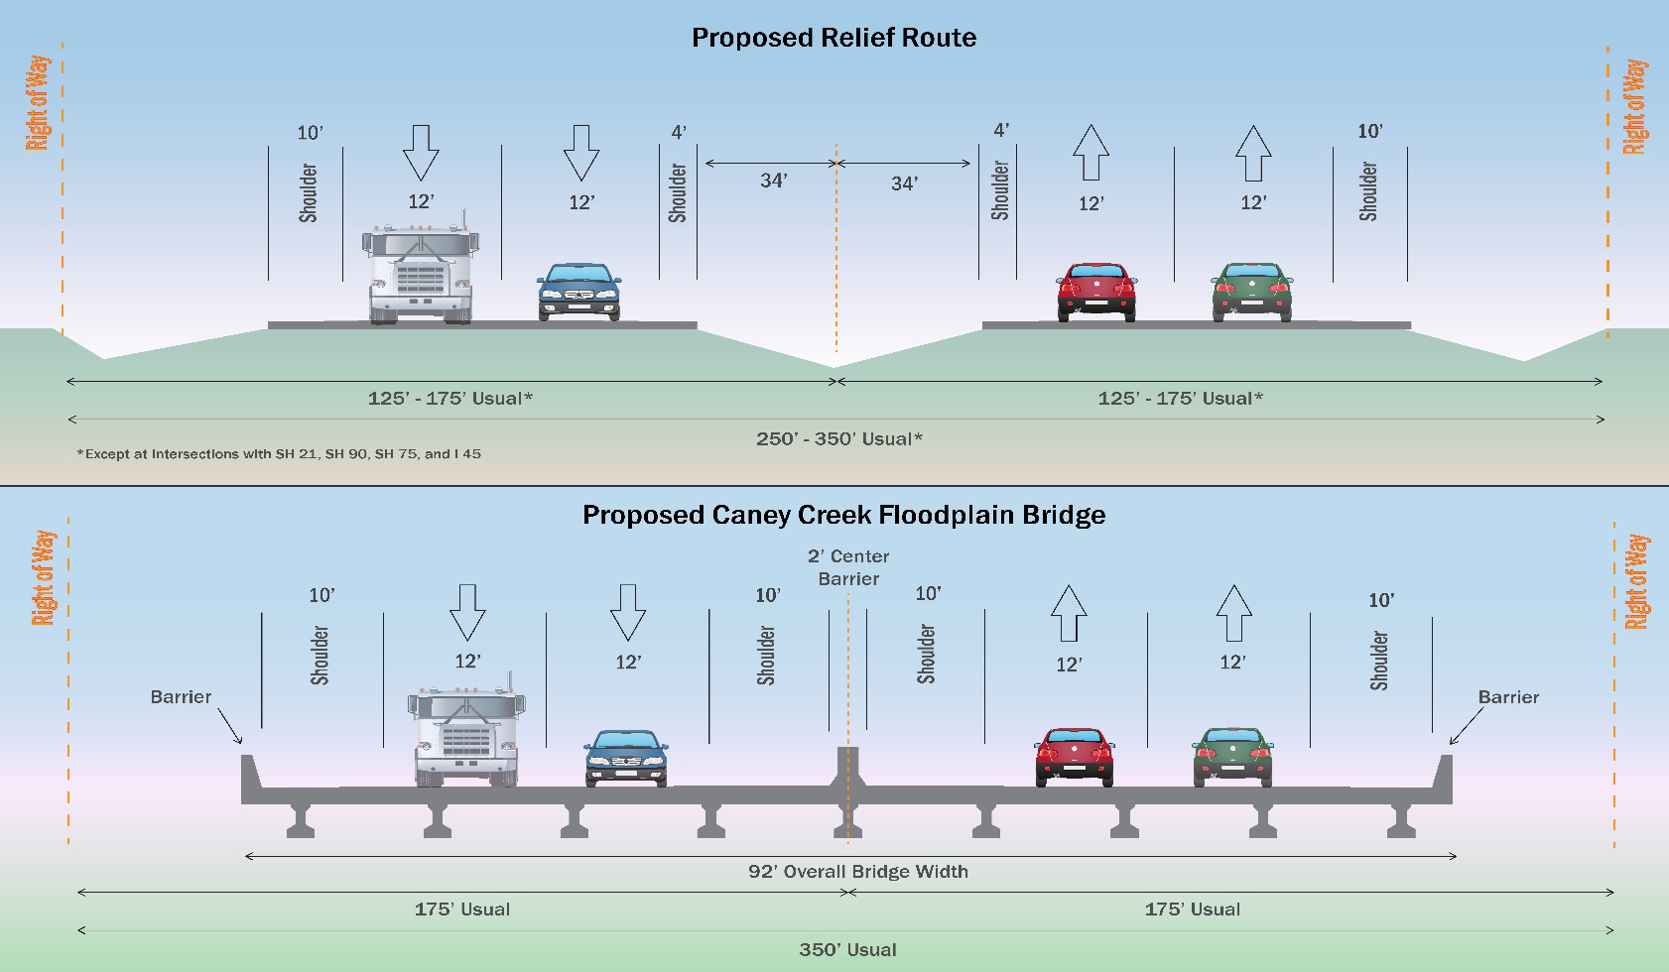
SL 1853 Proposed Typical Sections

Slide 29
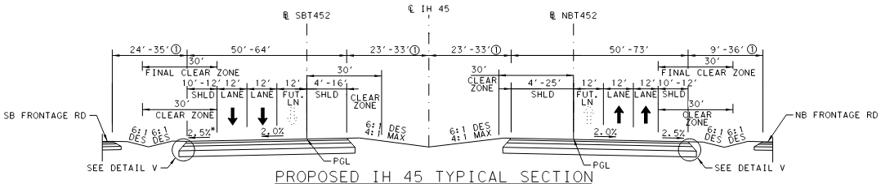
Proposed IH 45 Mainlane Typical Section

Slide 30
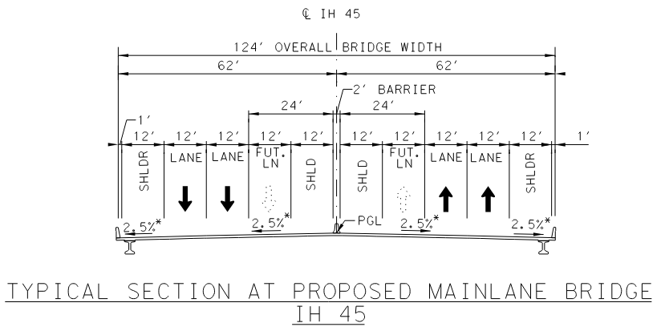
Proposed IH 45 Overpass Typical Section

Slide 31
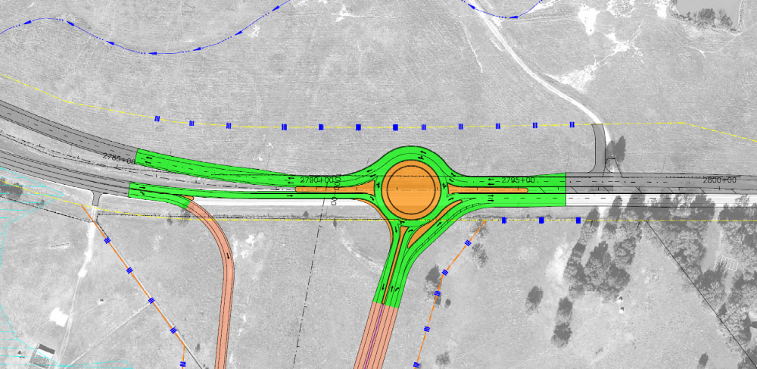
SL 1853 Intersection at SH 21 West
Notes:
Discuss a little about the configuration

Slide 32
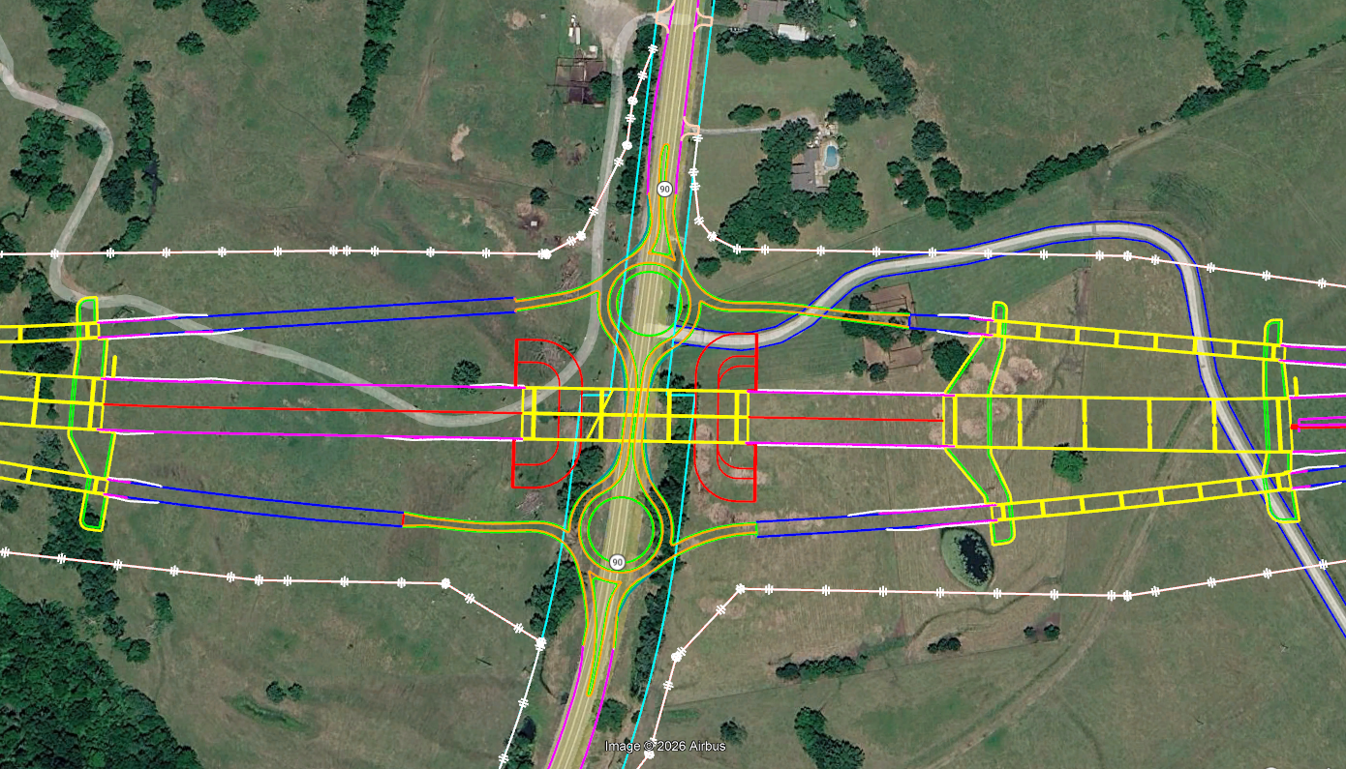
SL 1853 Overpass at SH 90
Notes:
Discuss a little about the configuration

Slide 33
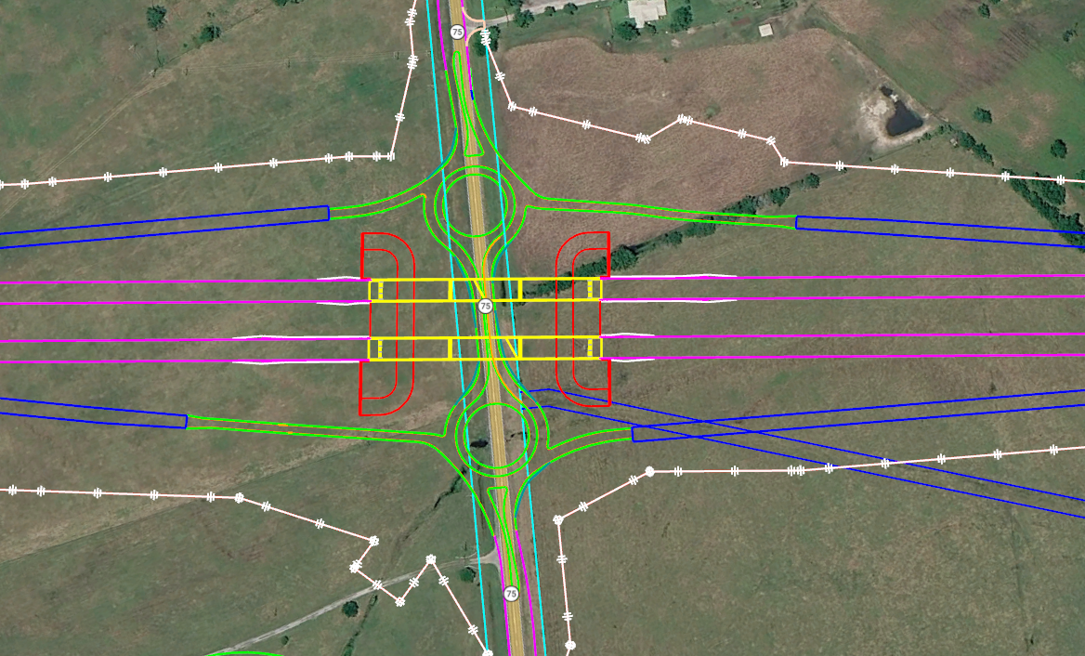
SL 1853 Overpass at SH 75
Notes:
Discuss a little about the configuration

Slide 34
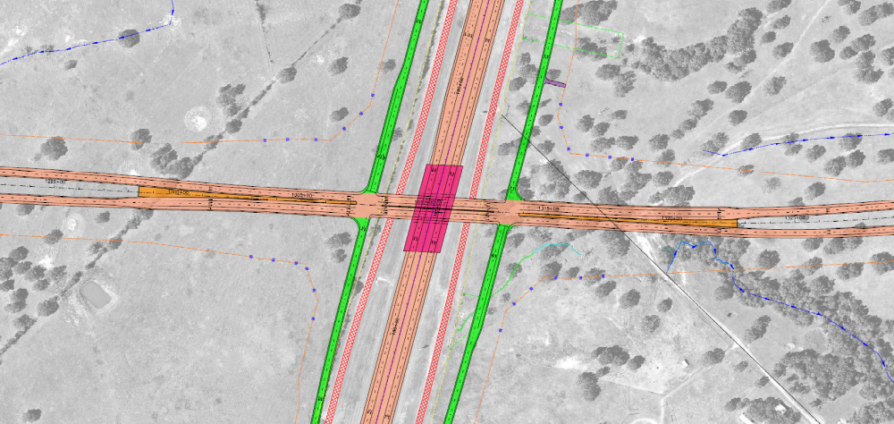
IH 45 Overpass at SL 1853
Notes:
Discuss a little about the configuration

Slide 35
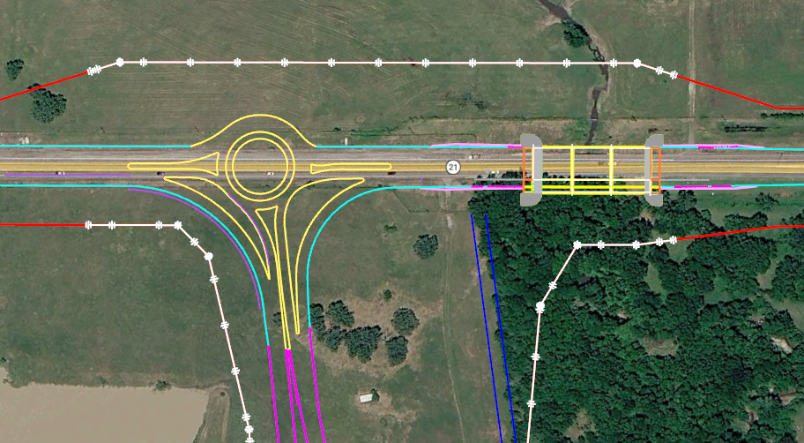
SL 1853 Intersection at SH 21 East
Notes:
Discuss a little about the configuration

Slide 36
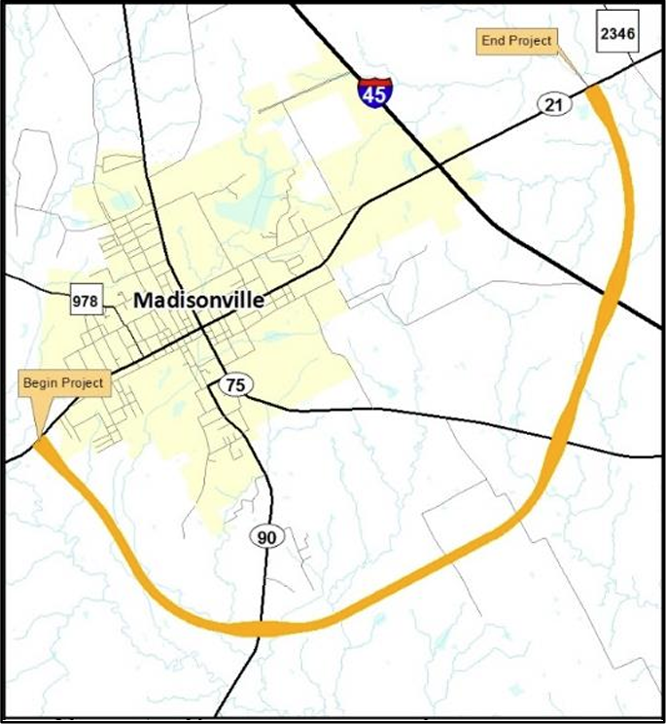
SL 1853 Madisonville Relief Route Project
Check out the Project website for
more information.
Project Website: www.txdot.gov
Search Keywords
“SL 1853 Relief Route”
Refer to Public Hearing held on
May 23, 2023, for latest information
and schematic rolls.
Refer to TxDOT PS&E FTP site for 95%
Plan submittal: BRY/Early Plan Review

Slide 37
Procurement Timeline (Tentative*)
Pre-RFP Meeting | Friday, August 28, 2026
RFP Posted in Euna | September 18, 2026
RFP Closing Date | October 9, 2026
Proposal Evaluation Complete | Late October 2026
Provider Selection | Late November 2026
Finalize & Execute Contract | April 2027
* All dates are subject to change.

Slide 38
Wrap Up and Next Steps
Thank you all for joining the Pre-RFP meeting!
Email all questions from the Pre-RFP meeting to Allison.Kurwitz@txdot.gov by 5:00 p.m. CST, on September 4, 2026.
Subject line: 6543 Pre-RFP Meeting Question
Presentation, attendee list, and relevant questions/answers will be posted to TxDOT website under “Consultant Information Meetings”:
Pre-RFP Meeting–Construction Engineering and Inspection Services, SL 1853–Bryan District
Notes:
The deadline for questions is to allow questions and answers corresponding to this presentation to be posted.
There will be another opportunity after the RFP posting.
Look for postings in the TxDOT Procurement Portal
RFP documents and any additional project documents (Schematic, environmental document, 95% plan set for Phase 1, and 90% plan set for Phase 2 & 3) will be posted in Procurement Portal.
That is all for the Pre-RFP Presentation. Thank you all for joining!
Be safe and well

