Slide 1
Pre-Request for Proposal (RFP) Meeting: Design Division (DES)
Value Engineering Services
Thank you for dialing in.
Phones will be muted.
We will begin shortly.
Solicitation Number 601CT0000006546
RFP 48-7RFP5008
FY 2027 - Wave 1
Alan Gonzalez, P.E.

Slide 2
Housekeeping
  Please note that all correspondence will be muted throughout this presentation.
  There will not be an opportunity to ask questions during the Pre-RFP presentation.
  You will be given an opportunity to ask questions after the presentation via email.

Slide 3
Agenda
1 | Introductions
2 | Brief Project Overview
3 | Contract Selection Process
4 | RFP Information
5 | Avoid Disqualification
6 | Post Award
7 | Anticipated Timeframe
8 | Closing Remarks & Instructions for Questions

Slide 4
Consultant Selection Team
Consultant Selection Team (CST)
Consultant Selection Team consists of three personnel.
Please do not attempt to contact these individuals.
  Please note, CST members’ names will no longer be provided in the Advertisement, and PEPS will not share this information for future waves.

Slide 5
PEPS Service Center for Divisions Team
Table 1: PEPS Service Center for Divisions Team
Procurement Support | Title
Kori Rodriguez, P.E. | Section Director, PEPS Service Center for Divisions
Alan Gonzalez, P.E. | Procurement Engineer, PEPS Central Service Center
Olga Almazova | Contract Specialist, PEPS Service Center for Divisions
  You will be given an opportunity to ask questions after the presentation via email.
  If questions arise after the meeting, please submit to: Alan Gonzalez, P.E. at Alan.Gonzalez@txdot.gov by: Monday, August 31, 2026, at 1 PM, CST
  All relevant questions and responses will be posted by Friday, September 04, 2026.

Slide 6
General Scope of Work
General Scope of Work to be Performed:
The Engineer shall provide Value Engineering (VE) services for the study of transportation-related projects or selected processes by multidisciplinary teams to determine the most cost-effective use of resources to accomplish given functions.

Slide 7
Standard Work Categories and Corresponding Percentages
Table 2: Standard work categories and corresponding percentages
Standard | Work Categories | Percentages (%)
19.2.1 | Value Engineering | 100%
*Work Categories and Percentages Subject to Change Prior to RFP Posting.
Link to Become Pre-Certified

Slide 8
Project Manager Requirements
Project Manager (PM) Requirements:
The prime provider’s PM is required to be a registered Professional Engineer in Texas.

Slide 9
Contract Selection Process
Non-Federal without Interview with VETHUB(HUB) Goal
➢ 80 working days from kick-off to contract execution
Proposal Evaluation
➢ Proposals are scored independently and used as a basis for selection
Selection
Top 3 providers are selected for contracts

Slide 10
Contract Selection Process Continued
Indefinite
Deliverable (ID)
Contracts with
Work Authorizations
  3 contracts
  $4 million each
  5 years maximum contract term with Work Authorizations being issued only in the first 4 years
    The remaining 1 year of the contracts will be utilized to complete work issued previously.
    Managed by Design (DES) Division

Slide 11
Proposal Content
  The proposal will cover “proposal content” in a written format
  CST determines weightings and number of pages allowed for the proposal
Table 3: Evaluation criteria and weightings
Evaluation Criteria | Description | Weight
Technical Approach | Project understanding, innovative concepts or alternatives | XX
Project Manager’s Relevant Experience | Similar or related projects, project management experience | XX
Project Planning & Management | Project staffing and resource management (who, how, and why), communication plan, and quality control procedures. The prime firm’s past experience with utilizing subproviders and meeting program goals (Historically Underutilized Business (HUB) or Disadvantaged Business Enterprise (DBE)) and/or how it plans to utilize subproviders to meet the goals on this contract. | XX
Key Staff’s Relevant Experience | Experience with similar projects | XX
Past Performance Score |  | 5 to 15

Slide 12
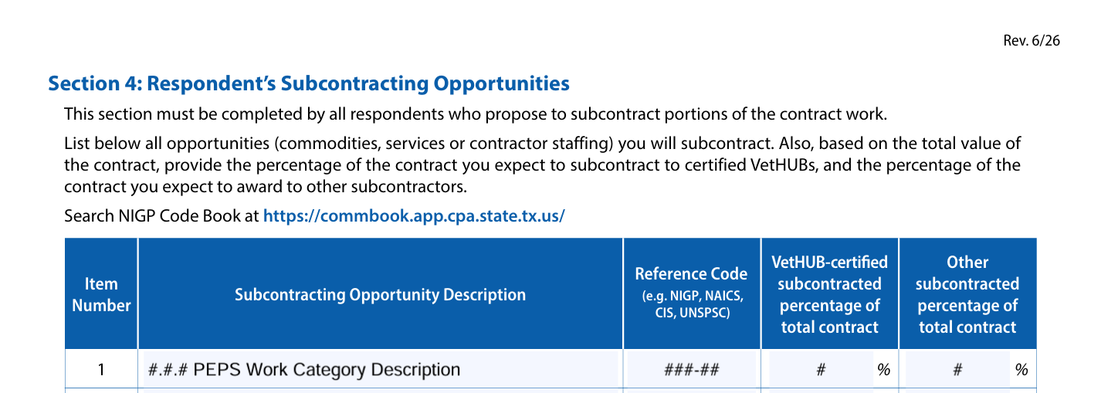
Section 4 - PEPS Example
Example of PEPS Work Category in the Subcontracting Opportunity Description.
  Reference Code example is National Institute of Governmental Purchasing (NIGP) with Class & Item Code
Figure 1- Section 4: Respondent’s Subcontracting Opportunities Example
Notes:
new

Slide 13
Documentation
Requirement (has not changed)
Notification of 7 days (with date) to only two Veteran Heroes United in Business (VetHUBs)
If the respondent replied and you didn’t choose them, highlight why
Document if the VetHUB didn’t respond
Not Required
VetHUB(HUB) Subcontracting Plan Compliance Checklist (from TxDOT)
Extra unrelated correspondence
Extra respondents beyond the required two
Figure 2- Necessary versus Not Necessary Information
Notes:
Talk with Teresita (new slides from what Teresita mentioned)

Slide 14
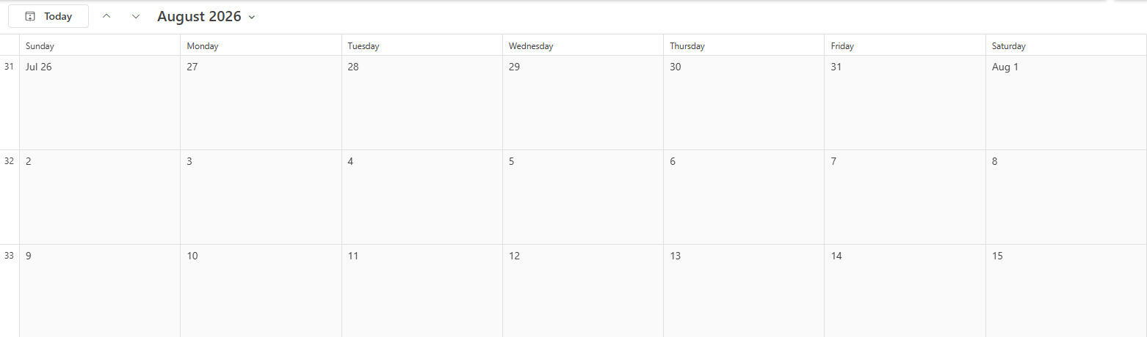
Seven Days
Example if you notify a sub provider on July 30th, your 7th day would be August 10th.
Notify
1
2
3
4
5
6
Bid Due
7
Figure 3- Calendar example

Slide 15
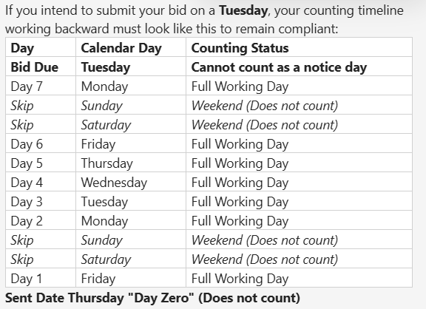
Seven Days cont.
Figure 4- Notification Table

Slide 16
Avoid Disqualifications
Include all mandatory attachments in your package
PEPS Fireside Chat – New process and updated Project Team Composition (PTC) Form - Link Below
Check Task Leaders’ precertifications in standard work categories
Task Leader in the PTC form must match the Task Leader mentioned in the proposal
PM must meet RFP requirements
Link to PEPS Fireside Chat

Slide 17
Avoid Disqualifications Continued
QR Codes and Hyperlinks
  QR codes and hyperlinks are considered additional information. Do not include in your proposal.
Task Leads
  Ensure Task Leads match on PTC and Proposal.
Proposal Cover Sheets
  Do not include extra sheets, such as a cover sheet, in your proposal.
Legal Firm Name
  Use legal firm name and ensure that it matches across all proposal documents.
Read the Cover Page Questionnaire
  Ensure that you are answering the questions in the Cover Page questionnaire truthfully.

Slide 18
Negotiations Process
Contract Award
Job Classification Negotiation with Procurement Engineer (~3 days duration)
  Include firm representative negotiating rates
  Include Subs in the process
  Provide reasoning for additional classification requests
  Provide concurrence with final classifications from prime and subs
  Indicate if classification is in your rate portfolio
Rate Negotiation with PEPS Negotiations Engineer
*If there are issues with legal firm names, Secretary of State, or Comptroller registration for any firm on the contract, negotiations will be delayed

Slide 19
IT Security Requirements
Understand IT Security Requirements for this Contract
  Review Draft Attachment C, Section 1.7, Draft Contract Template, Attachment I, and TxDOT Security Questionnaire (TSQ)
  Review and understand Cybersecurity Requirements associated with the Contract
    TxDOT Cybersecurity Resources Webpage: TxDOT Cybersecurity Resources
    TxDOT Data Classification Policy: TxDOT Data Classification Policy
    TxDOT Security Questionnaire: TxDOT Security Questionnaire
  Utilize the question-and-answer period

Slide 20
Table 4: Tentative procurement schedule
Tentative Procurement | Schedule
Pre-RFP Meeting | 08/25/2026
Request for Proposal (RFP) Posting | Mid September
Proposal Due | Early October
Selection Notification | Late October
Negotiations Complete | Early December 2026
Contract Execution | Late January 2027

Slide 21
Reminders
  Always refer to the RFP
  Use the Proposal Screening Checklist: Proposal Screening Checklist
  Review the Attachments before submitting in Procurement Portal
  Your submittal/proposal can be pulled back for a correction or revision before RFP closes
  If you have questions, follow RFP instructions and ask
  Check for Addenda and questions and answers

Slide 22
Closing Remarks
This presentation will be posted on TxDOT.gov by Friday, August 28, 2026.
Questions regarding this Pre-RFP meeting should be submitted to:
Alan Gonzalez, P.E. at Alan.Gonzalez@txdot.gov
by 1 pm, CST, Monday, August 31, 2026.
Relevant questions received and their responses will be posted on TxDOT.gov by Friday, September 04, 2026.

