Slide 1
PRE-RFP MEETING:​
Houston District (HOU) ​
Bond GEC Services for the
SH 288 System ​
FY 2027, Wave 1​
Solicitation No. 601CT0000006540

Slide 2
Table of Contents
3 | Housekeeping
4 | Ground Rules
5 | Project Overview
6 | GEC Proposal Information
15 | Submittal Reminders
17 | Q&A Contact

Slide 3
Housekeeping
Please note that all correspondence with TxDOT will be muted throughout this presentation. ​
Be sure to provide your contact information. ​
This meeting will not be recorded, and attendees may not use any form of audio or video recording, photography, automated transcription services, or artificial intelligence (AI) based analysis tools.
We will answer questions posted in the chat at the end of the presentation.​

Slide 4
Ground Rules
Do Not contact TxDOT Staff regarding procurement; Refer all questions to PEPS Procurement Engineer.
This presentation is for INFORMATIONAL PURPOSES ONLY.
The advertised RFP will dictate the final work categories. Read and comply with the RFP requirements.

Slide 5
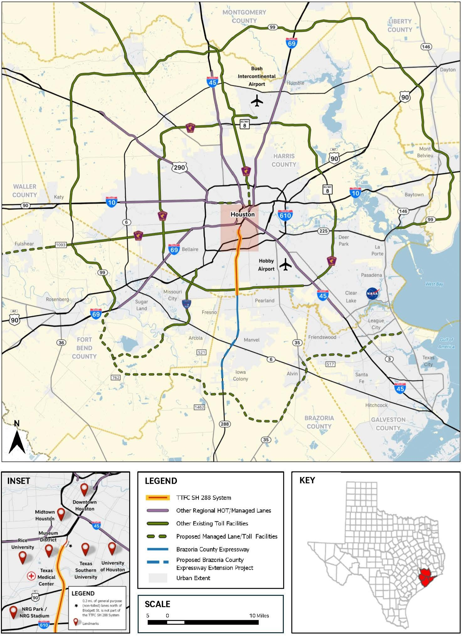
Project Overview
General Engineering Consulting (GEC) Services for the Houston District: SH288 Texas Transportation Finance Corporation (TTFC) Bond GEC.
SH288 from IH69 to Clear Creek within Harris County
Inside of TXDOT ROW
4 manage lanes & 6 general purpose lane.
Heavy directional traffic to and from the Texas Medical Center, especially during peak commute hours.
All toll collection is electronic

Slide 6
GEC PROPOSAL INFO​

Slide 7
Project Manager (PM) & Deputy Project Manager (DPM) Requirements
The PM and DPM are required to be a Texas registered or licensed Professional Engineer by proposal deadline specified in the Solicitation.​
The PM and DPM must be an employee of the prime provider. ​
The PM must be the task leader of 24.1.1 O&M Project Manager (PM) and be pre-certified in that category by the closing date to be considered responsive.​
The DPM may also serve as a task leader.

Slide 8
Work Categories 1 of 3
Cat. No. | Standard Work Categories
1.9.1 | Geographic Information System (GIS) and Data Analysis
2.14.1 | Environmental Document Preparation
3.2.1 | Route Studies & Schematic Design
4.2.1 | Roadway Design
4.5.1 | Constructability Review
5.6.1 | Structural Engineering for Overhead Sign Supports
6.6.1 | Assessment and Preservation of Common Bridge Types
7.5.1 | Intelligent Transportation System
8.1.1 | Signing, Pavement Marking & Channelization
12.4.1 | Pavement Design Services
12.5.1 | Pavement Evaluation
14.1.1 | Soil Exploration
14.2.1 | Geotechnical Testing
Preliminary
Become Pre-certified: https://www.txdot.gov/business/consultants/architectural-engineering-surveying/getting-started/precertification.html

Slide 9
Work Categories Continued 2 of 3
Cat. No. | Standard Work Categories
14.3.1 | Transportation Foundation Studies
14.5.1 | Evaluation & Design of Geotechnical Related Structures
15.3.1 | Aerial Photogrammetry
15.3.3 | Terrestrial LiDAR
18.6.1 | Utility Management & Coordination Oversight
23.4.3 | Debt-based & Equity-based T&R Studies (Modeling & Forecast.)
23.4.4 | Traffic Projections
23.6.1 | Doc. Control Using the Electronic Content Mgmt Syst. (ECMS)
23.7.1 | Project Finance Support
23.8.1 | Claims Analysis and Management
23.10.1 | Public Involvement for Alternative Delivery Projects
23.11.1 | Plan Review
Preliminary
Become Pre-certified: https://www.txdot.gov/business/consultants/architectural-engineering-surveying/getting-started/precertification.html

Slide 10
Work Categories Continued 3 of 3
Cat. No. | Standard Work Categories
24.1.1 | O&M Project Manager (PM)
24.2.1 | Financial Plan Review and Development
24.3.1 | Maintenance Cost Estimating
24.4.1 | O&M Assessment
24.4.2 | O&M Inspection
24.5.1 | Operations and Maintenance Program Support
24.6.1 | Structural Inspection and Assessment
24.6.2 | Toll Elements Inspection and Assessment
24.6.3 | Toll Facilities Inspection and Assessment
24.7.1 | Toll Plaza Design
24.10.1 | Toll Operations Planning Analysis
Preliminary
Become Pre-certified: https://www.txdot.gov/business/consultants/architectural-engineering-surveying/getting-started/precertification.html

Slide 11
Evaluation Criteria
Evaluation Criteria | Included Elements
Technical approach | Project understanding, project approach, innovative concepts or alternatives
Project Manager’s relevant experience | Experience with similar or related projects, including both technical and management experience
Project planning and management | Project staffing and resource management (who, how, and why), communication plan, and quality control procedures. The prime firm’s past experience with utilizing subproviders and meeting commitments, and/or how it plans to utilize subproviders on this contract. Also, may include project scheduling or phasing for SD projects
Key staff’s relevant experience | Experience with similar projects
Past Performance Score | 5-15%
Proposals are independently scored by CST members based on the four evaluation criteria and their corresponding weightings.

Slide 12
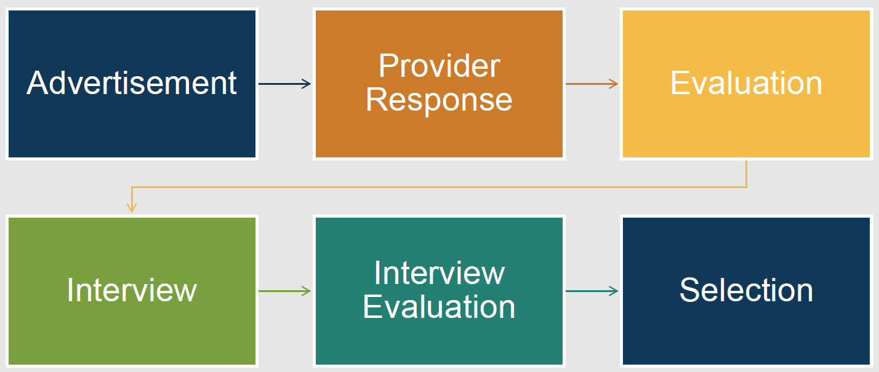
Procurement Process

Slide 13
Tentative Timeline
Selection Complete:
Late November
Contract Execution:
April 2027
RFP Posting:
Early Sept.
Proposals Due:
Late Sept.

Slide 14
Submittal Reminders
Submit before the deadline
QA/QC the submittal by referring directly to the RFP
Check that all mandatory forms are in your submittal
Verify name of project manager and task leaders
Verify Task Leaders are pre-certified in the listed work categories. For NLCs, verify task leaders meet the requirements.
Verify that your sub-providers are pre-certified in the listed work categories
Check DBE participation
Ensure your Administrative Qualifications are up to date

Slide 15

Drive like a Texan English

Slide 16



"HOU / GEC-BOND / Pre-RFP Meeting / Questions"
After this presentation, all questions must be submitted to John Mosaffa at:
John.Mosaffa@txdot.gov
The deadline for questions is August 26, 2026, at 12:00 noon
with the subject line:
Copy of the presentation, questions, and responses will be posted at: https://www.txdot.gov/business/peps/opportunities/meetings.html

