Slide 1
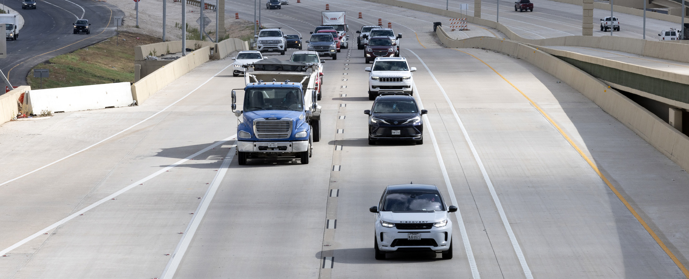
Pre-RFP Meeting
Feasibility Study for the US 75 Corridor in the Dallas District
Solicitation No: 601CT0000006533

Slide 2



Housekeeping
Thank you for coming!
Please be sure to share your contact information in the chat so we can document this for teaming opportunities
Please stay muted during the presentation as we will be taking questions at the end

Slide 3
FY 26 Wave 4 Pre-RFP Meeting Agenda
Topic | Presenters
Introduction & Ground Rules | PEPS – Christopher Franco
Solicitation Process & RFP Requirements | PEPS – Christopher Franco
Dallas District US 75 Details Discuss project needs | PEPS – Grace Lo
Proposed Procurement Timeline | PEPS – Christopher Franco
Wrap-up & Next Steps | PEPS – Christopher Franco

Slide 4
Procurement Team Introduction
  Grace Lo, P.E.
    Transportation Engineer Supervisor, Dallas District Project Delivery Office
  Liang Ding, P.E.
  Transportation Engineer, Dallas District Project Delivery Office
  Breonna DeShazer, P.E. Transportation Engineer, Dallas District Project Delivery Office
TxDOT PEPS Division
Dallas Service Center
Personnel
  Joseph S. Jancuska, P.E., CFM
  Service Center Manager
  Christopher Franco, P.E.
  Lead PEPS Engineer
  Carlitha Womack
  Contract Specialist
  Carol Lee
  Contract Specialist
  Amanda Griffey
  Contract Specialist
  Cheryl Rodriguez
  Contract Specialist
Contract Selection Team (CST) Members:
Do not contact TxDOT CST Members during this procurement.

Slide 5
Solicitation Process- US 75 Feasibility Study
Non-Federal with Interviews
145 working days from RFP kick-off to contract execution
Proposal Evaluation
Short-listed providers move to the interview phase
Interview Evaluation
Selection

Slide 6
Solicitation Process – Specific Deliverable
Key Items
RFP Reminders
Submit to Euna using the correct formats
Submit all applicable information required
Past performance will be captured at the RFP
Avoid Disqualifications
Submit before the deadline
Check that all mandatory forms are in your submittal
QA/QC the submittal by referring directly to the RFP to avoid disqualifications
Verify PM and TLs are matching in PTC and proposal
Make sure to follow the RFP
Verify Task Leaders are pre-certified in standard work categories

Slide 7
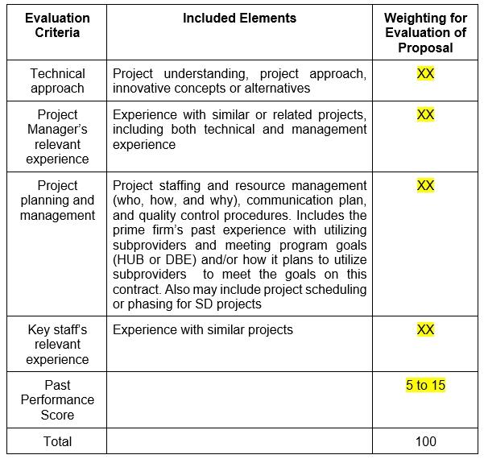
Solicitation Process – Evaluation Criteria

Slide 8
Interview Process
Typical Interview Process
TxDOT Introductions / TxDOT Instructions
CST Break
Consultants begin with a presentation based on the interview content paragraph and scoring criteria percentages they are provided in the ICG
Consultant Response in Q&A Session
Follow-up question development
TxDOT Concluding Remarks
Interview Contract Guide (ICG)
Outlines the interview date, time and location*
Outlines the interview structure
Includes the interview presentation content paragraph
Identifies the evaluation criteria
Includes Attachment B – Services to be provided by the State
Includes Attachment C – Services to be provided by the Engineer
The CST individually scores interviews based on scoring criteria presented during the presentation developed from the content paragraph and the Q & A session.

Slide 9
There will not be any preclusions or core team restrictions on this solicitation

Slide 10
RFP Reminders
Use the Proposal Screening Checklist
Proposal Screening Checklist
Your submittal/proposal can be pulled back for a correction or revision before RFP closes
Always refer to the RFP
Check for Addenda and questions and answers
Familiarize yourself with the VetHUB Process
Civil Rights events calendar
  10

Slide 11
Potential Work Categories & NLCs
Cat. No. | Category Name
1.1.1 | Policy Planning
1.2.1 | Systems Planning
1.3.1 | Subarea/Corridor Planning
1.4.1 | Land Planning/Engineering
1.5.1 | Feasibility Studies
1.7.1 | Traffic Demand Modeling
1.8.1 | Public Involvement
1.9.1 | Geographic Information System (GIS) and Data Analysis
2.1.1 | Traffic Noise Analysis
2.2.1 | Air Quality Analysis
2.3.1 | Wetland Delineation
2.3.2 | Conditional/Functional Assessment
2.7.1 | Sec. 4(F)/6(F) Evaluations
2.7.2 | Historic Sites Sec. 4(f) Evaluations
2.10.1 | Archaeological Surveys, Doc., Excavation, Testing Rpts
2.12.1 | Socio-Economic & Environmental Justice Analysis
2.13.1 | Hazardous Materials Initial Site Assessment
2.15.1 | Historical Research of Extant Bldgs, Struct, Landsc., & Obj.
2.15.2 | Historical Surveys & Doc. of Bldgs, Struct, Landsc., & Obj.
3.2.1 | Route Studies & Schematic Design
3.7.1 | Traffic Operational Analysis
4.4.1 | Freeway Interchanges
4.5.1 | Constructability Review
4.6.1 | 3-D Visualization and Animation Services
4.7.1 | Traffic Safety Analysis
Non-Listed Categories (NLC’s)
None at this time
Information is subject to change.

Slide 12
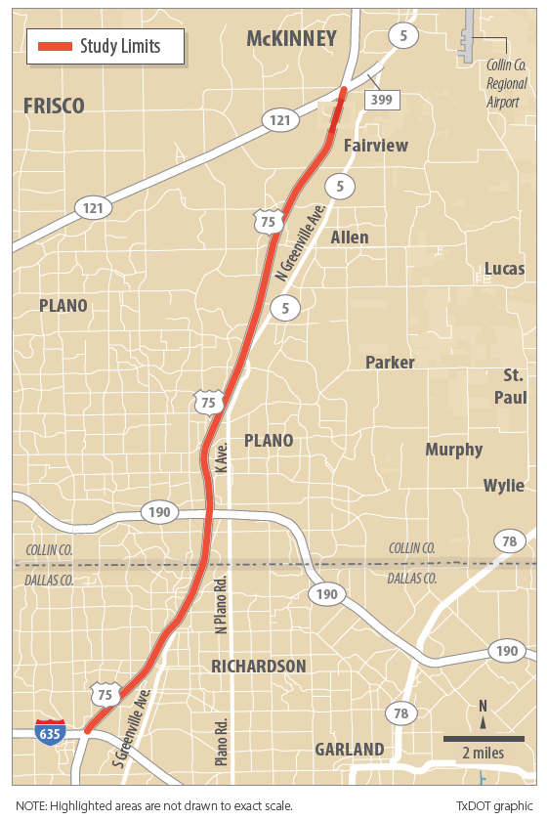
Project Location
US 75 from IH 635 to SH 121 (SRT)

Slide 13
Purpose of Study
  Purpose:
    Study US 75 from IH 635 to SH 121(SRT) to evaluate multiple options that add capacity to the mainlanes of US 75 and improve operations throughout the corridor.
    The District is looking for creativity and innovation to improve the mobility and operation
    All options are on the table
    How can we leverage technology and new design practices to enhance the corridor
    In the interviews the District wants to see what firms can develop that hasn’t been presented before
    Maximum Contract Value Not To Exceed $15M

Slide 14
Existing Constraints
    Congested corridor currently, heavily traveled
    Minimize ROW acquisition and adverse impact on the adjacent properties and businesses while achieving other goals; Corridor is heavily developed
    Maintain and expand on the newly implemented technology lanes on US 75
    Evaluate current and future traffic growth to update traffic projections
    Maintain and enhance the connectivity with existing major interchanges at IH 635, PGBT and SH 121(SRT)
    Stakeholder coordination needed to gain consensus with counties, cities and other major partners along the US 75 corridor

Slide 15
More Information
  All of the information developed and gathered during previously feasibility studies or projects on the corridor can be found at:
  2013 Study
  https://www.keepitmovingdallas.com/projects/us-highways/us-75
  US 75 Technology Lanes (under construction)
  https://www.keepitmovingdallas.com/US75TechLanes
  Historical Studies and Information
  https://txdot.box.com/s/ienfe6sktzpa0z7zunm1okvibmyvbhq7

Slide 16

Tentative Procurement Timeline
Pre-RFP Meeting
July 10, 2026
RFP Posting
Late July 2026
Proposal Due
August 2026
Contract Execution
ICG Sent Out
Late Aug/Early Sept 2026
Selection
September 2026
Complete Negotiations
October 2026
Debriefs to be held after selection
December 2026
Interviews
September 2026
Information is subject to change.

Slide 17

Wrap-Up and Next Steps
Be aware that a Q&A document might be posted and if needed an addendum
Keep current on updates for Fiscal Year 2027 Projected Contract Lists on the TxDOT PEPS website
Business opportunities
Take advantage of PEPS Fireside Chats
Training and events (txdot.gov)
Review the updated Euna Frequently Asked Questions
Frequently Asked Questions (FAQs) For Vendors Using Bonfire (txdot.gov)

Slide 18
Questions

Slide 19

Drive like a Texan English
THANK YOU FOR ATTTENDING THE PRE-RFP MEETING!
Contact Information:
  Christopher Franco, P.E.
  PEPS-Lead Engineer
  PEPS Dallas Service Center
  (214) 320-4405
  Christopher.Franco@txdot.gov
Contact Information:
  Joe Jancuska, P.E., CFM
  Service Center Manager
  PEPS Dallas Service Center
  (214) 320-6187
  Joseph.Jancuska@txdot.gov

