Slide 1
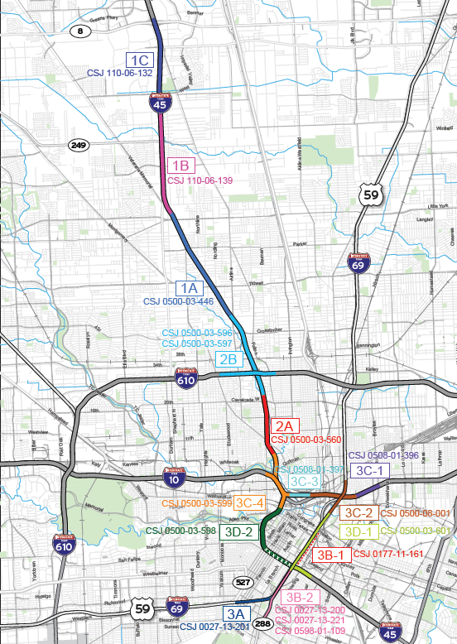
General Engineering Consultant (GEC) Services for
North Houston Highway Improvement Project (NHHIP)
Segment 3D-1
Pre-RFP Presentation

Slide 2
Table of Contents
Introduction
Ground Rules
Project Overview
Tentative Work Categories
Procurement Process & Tentative Timelines
Preliminary Preclusion List
Proposal Reminders
Q & A

Slide 3




Housekeeping
Be sure to provide your information on the sign-in sheet.
Please Silent your phones.
NO recording nor photography of this presentation.
You may ask questions at the end of the presentation.

Slide 4
Presenters
  Houston Districts:
Matthew Connelly, P.E. – Strategic Projects Office Supervisor
  PEPS Houston Service Center:
  Pasha Merrikh, P.E. - Procurement Engineer
  Kimlinh V. Nguyen, P.E. – PEPS Houston Service Center Section Director

Slide 5
Ground rules
Do not contact Houston District staff regarding this procurement. Contact PEPS procurement engineer for questions.
This presentation is for INFORMATIONAL PURPOSES ONLY.
The advertised RFP will dictate the final work categories. Read and comply with the RFP requirements.

Slide 6
NHHIP Seg 3D-1
Overview

Slide 7
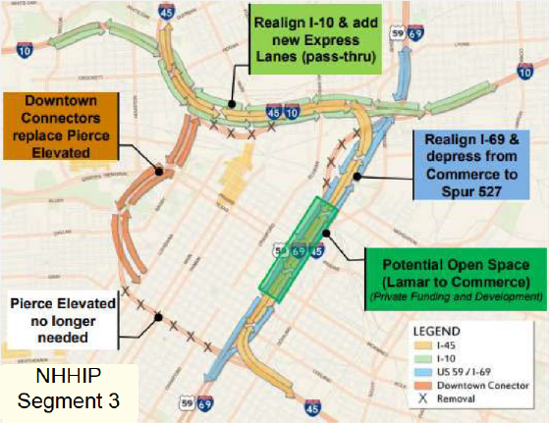
NHHIP Segment 3 Overview
I-45 removed and relocated
I-10/I-45/US 59/I-69 realigned
I-45/US 59/I-69S depressed/tunnel between Lamar St. & Commerce St.
US59/I-69N depressed/tunnel between Polk St. & Commerce St.
Segment 3 Proposed Traffic Flow Diagram

Slide 8
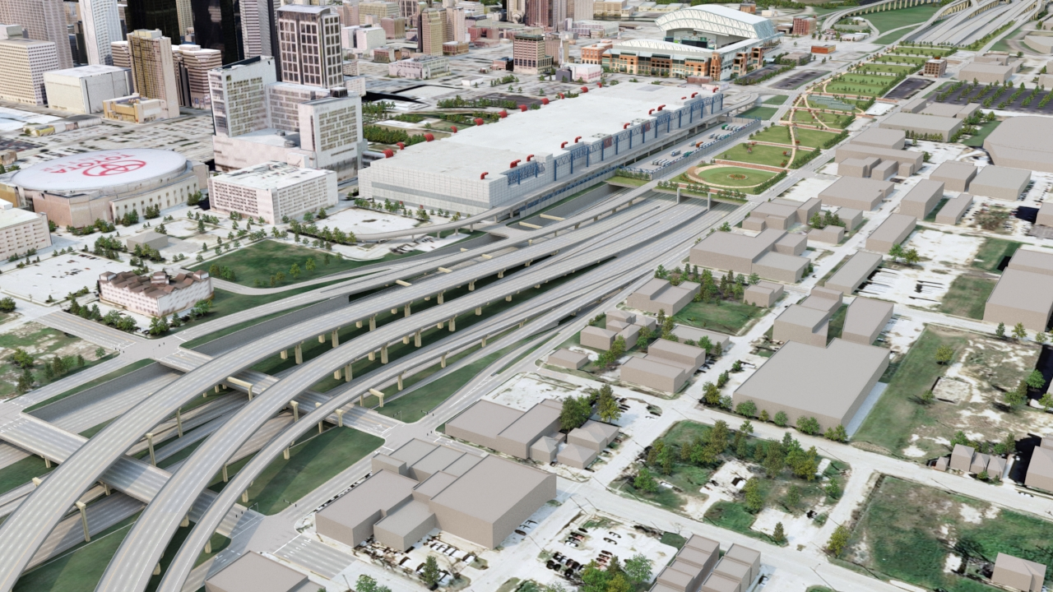


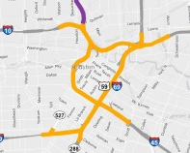
Project Overview – Proposed Recommended Alternative
Minute Maid Park
GRB
Lamar
SOUTH
NORTH
SOUTH
Pease
NORTH
Leeland
Segment 3
PRELIMINARY-SUBJECT TO CHANGE

Slide 9
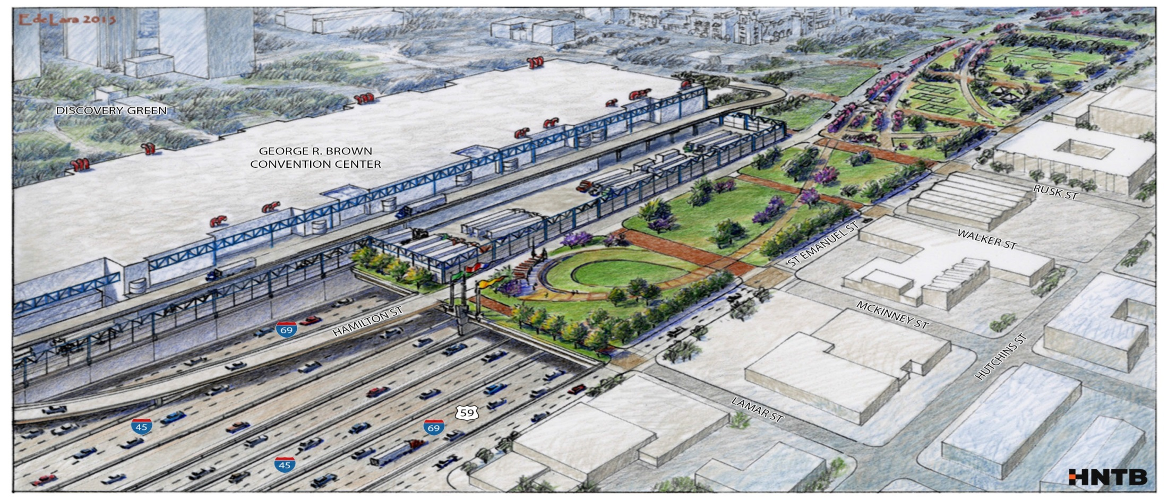
Project Overview - Potential Green Space behind the GRB
MINUTE MAID PARK
GRB OPERATIONS AREA
Segment 3
NOTE: Green space option is conceptual only and would require separate development and funding.
PRELIMINARY-SUBJECT TO CHANGE

Slide 10
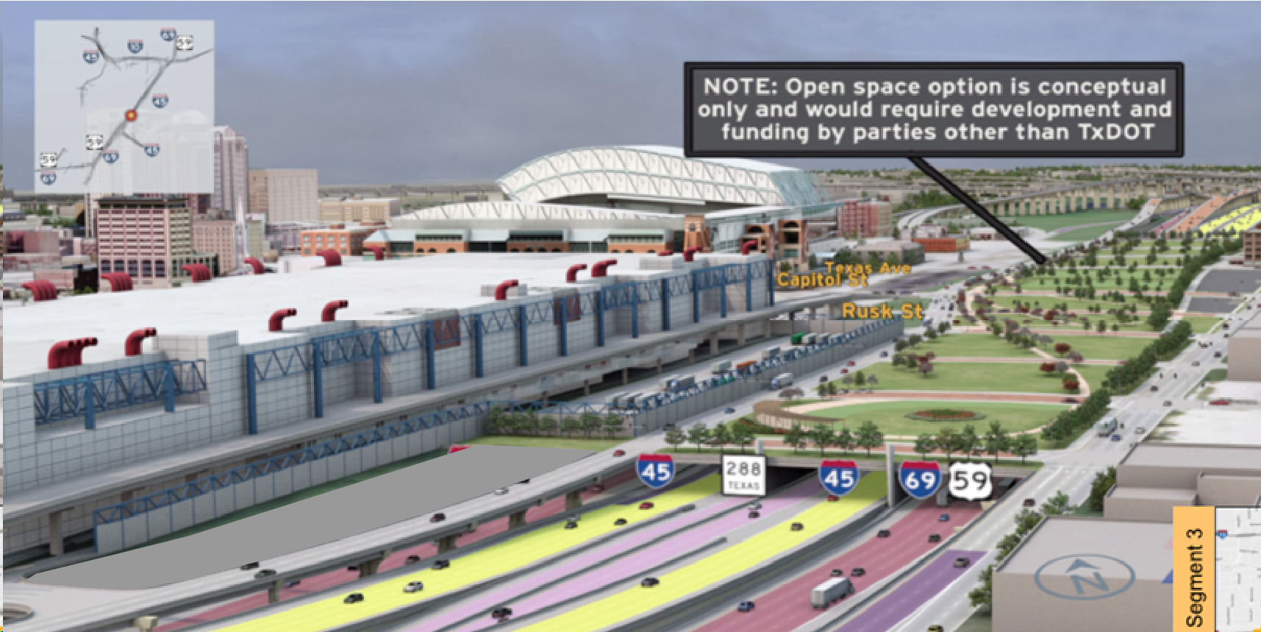
Project Overview – Segment 3

Slide 11
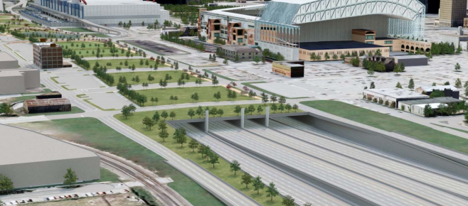
Project Overview – Deck Park behind Minute Maid Park

Slide 12
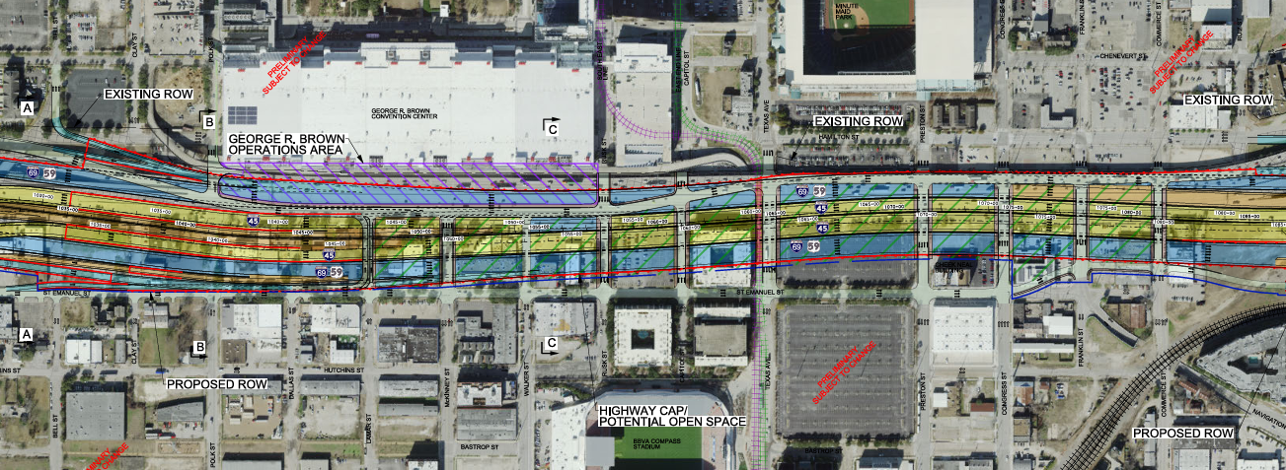
Project Description
  Reconstruct IH 45/IH 69 Interchange: Realign/widen IH 45 from Sauer St. along IH 45 to Runnels St. along IH 69.
Along IH-69
  From: McGowen St.
  To: Runnels St.

Slide 13
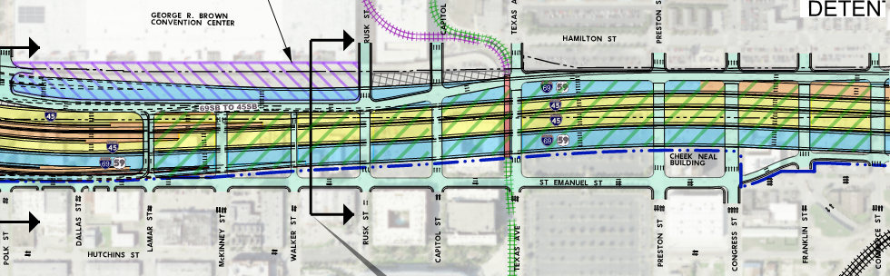
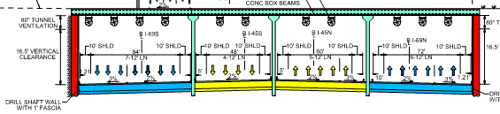
Project Overview
I-45/I-69 Tunnel Between Commerce St. and Lamar St. and Polk St. (I-69S)
Tunnel Lengths:
I-45S/I-45N/I-69N: 3400 ft
I-69S: 4100 ft
I-45/I-69 Tunnel Section

Slide 14
General Procurement GEC Activities
Schematic Refinement
Geotechnical Studies
Survey and Mapping
Environmental Re-evaluations
Drainage Study Updates
Constructability Analysis
Utility Coordination
Stakeholder Coordination
Design Build Procurement Document Prep.

Slide 15
Key NHHIP 3D-1 Specific Activities
Fire Life Safety Design Considerations
CAP/Tunnel Design Considerations
DB/DBB Delivery Method Recommendation
METRO Light Rail Coordination (Green/Purple Lines)

Slide 16

Work Categories

Slide 17
Work Categories 1
Cat. No. | Category Name
1.2.1 | Systems Planning
1.3.1 | Subarea/Corridor Planning
1.5.1 | Feasibility Studies
1.7.1 | Traffic Demand Modeling
1.9.1 | Geographic Information System (GIS) and Data Analysis
2.1.1 | Traffic Noise Analysis
2.4.1 | Nationwide Permit
2.12.1 | Socio-Economic & Environmental Justice Analysis
2.13.1 | Hazardous Materials Initial Site Assessment
2.14.1 | Environmental Document Preparation
3.2.1 | Route Studies & Schematic Design
Preliminary

Slide 18
Work Categories 2
Cat. No. | Category Name
3.7.1 | Traffic Operational Analysis
4.4.1 | Freeway Interchanges
4.5.1 | Constructability Review
4.6.1 | 3-D Visualization and Animation Services
4.7.1 | Traffic Safety Analysis
5.2.1 | Bridge Design
5.5.1 | Bridge & Non-Bridge Class Culvert and Inlet Design
7.1.1 | Traffic Engineering Studies
7.4.1 | Traffic Control Systems Analysis, Design & Implementation
Preliminary

Slide 19
Work Categories 3
Cat. No. | Category Name
7.5.1 | Intelligent Transportation System
9.2.1 | Active Transportation Planning
10.1.1 | Hydrologic Studies
10.2.1 | Roadway Hydraulic Design
10.4.1 | Storm Water Pump Station-Hydraulic Design
10.4.2 | Pump Stations-Electrical
10.4.3 | Pump Stations-Structures
10.7.1 | Riverine Hydraulic Design
10.8.1 | FEMA Regulations and Permits
Preliminary

Slide 20
Work Categories 4
Cat. No. | Category Name
14.2.1 | Geotechnical Testing
14.3.1 | Transportation Foundation Studies
14.4.1 | Building Foundation Studies
14.5.1 | Evaluation & Design of Geotechnical Related Structures
15.1.1 | Right of Way Surveys
15.2.2 | Construction Survey
15.3.3 | Terrestrial LiDAR
15.3.4 | Mobile LiDAR
15.3.5 | Horizontal and Vertical Control
Preliminary

Slide 21
Work Categories 5
Cat. No. | Category Name
15.5.1 | State Land Surveying
17.2.1 | Mechanical Engineering
17.4.1 | Electrical Engineering
18.2.1 | Subsurface Utility Engineering (Utility Eng. Investigation)
18.3.1 | Utility Adjustment Coordination
18.4.1 | Utility Engineering
18.5.1 | Utility Construction Management and Verification
18.6.1 | Utility Management & Coordination Oversight
18.7.1 | Utility Relocation Design
19.2.1 | Value Engineering
19.3.1 | Financial Plan Review and Development (Design-Bid-Build)
Preliminary

Slide 22
Work Categories 6
Cat. No. | Category Name
21.1.1 | Right of Way (ROW) Acquisition Services
23.1.1 | Alternative Delivery Procurement Manager
23.5.1 | Alternative Delivery Cost Estimator
23.6.1 | Doc. Control Using the Electronic Content Mgmt Syst. (ECMS)
23.9.1 | Gen. Eng. Consultant (GEC) Proj. Serv. (Contract Proj. Mgr)
23.10.1 | Public Involvement for Alternative Delivery Projects
NLC-1 | Fire and Life Safety Analysis and Support (Tunnel)
Preliminary

Slide 23
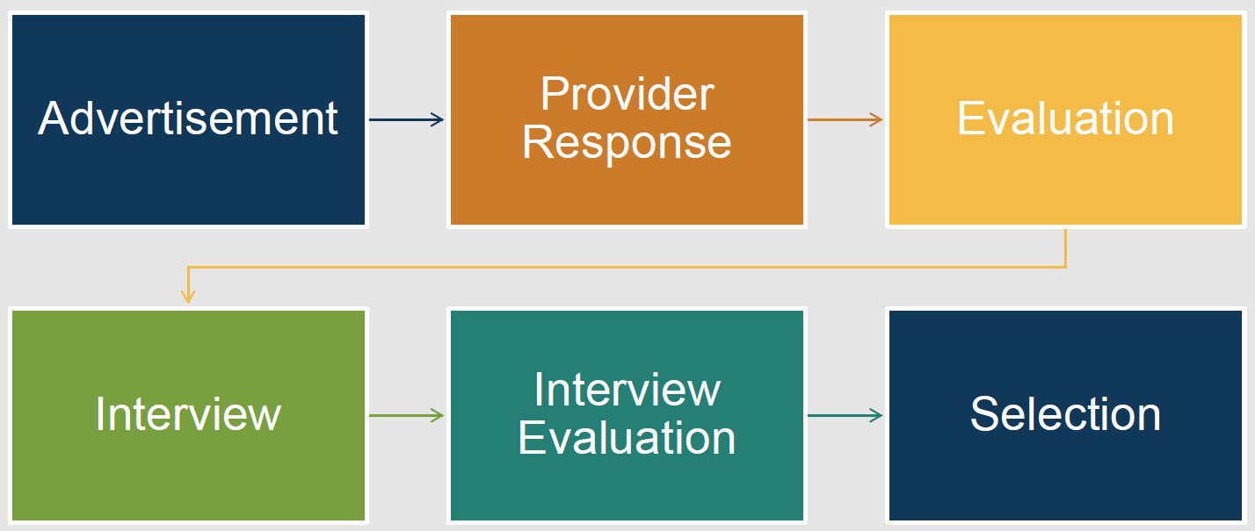
Procurement Process

Slide 24
Evaluation Criteria
Evaluation Criteria | Included Elements
Technical approach | Project understanding, project approach, innovative concepts or alternatives
Project Manager’s relevant experience | Experience with similar or related projects, including both technical and management experience
Project planning and management | Project staffing and resource management (who, how, and why), communication plan, and quality control procedures. Includes the prime firm’s past experience with utilizing subproviders and meeting program goals (DBE) and how it plans to utilize subproviders to meet the goals on this contract. Also, may include project scheduling and phasing for SD projects
Key staff’s relevant experience | Experience with similar projects
Past Performance Score

Slide 25
Tentative Timeline
RFP Posting:
Early June
Proposals Due:
Late June / Early July
Selection Complete :
Early August
Contract Execution:
December 2026

Slide 26
Preliminary Preclusion List

Slide 27
Preclusion List
Legacy Contract No. | PeopleSoft Contract No. | Work Authorization NO. | Prime Provider Name | Subprovider Name | Type of Contract
128SDP5023 | 9495 | 1 | HDR ENGINEERING, INC. |  | GEC
 |  |  |  | Gunda Corporation, LLC
 |  |  |  | VRX, Inc.
 |  |  |  | Foresight Planning & Engineering Services, LLC
Preliminary

Slide 28
Submittal Reminders

Slide 29
Submittal Reminders
Submit before the deadline
QA/QC the submittal by referring directly to the RFP
Check that all mandatory forms are in your submittal
Verify name of project manager and task leaders
Verify Task Leaders are pre-certified in the listed work categories
Verify that your sub-providers are pre-certified in the listed work categories
Ensure your Administrative Qualifications are up to date

Slide 30



Contact information
After this presentation, all questions must be submitted to Pasha Merrikh at:
Pasha.Merrikh@txdot.gov
The deadline for questions is May 28, 2026 at 1:00 p.m.
with the subject line:
"HOU / GEC / NHHIP 3D-1 / Pre-RFP Meeting / Questions"
Copy of the presentation, questions, and responses will be posted at: https://www.txdot.gov/business/peps/opportunities/meetings.html

Slide 31

Questions ?

Slide 32
Appendix A Meeting Sign-In Sheets

Slide 33
Sign-In Sheet 1

Slide 34
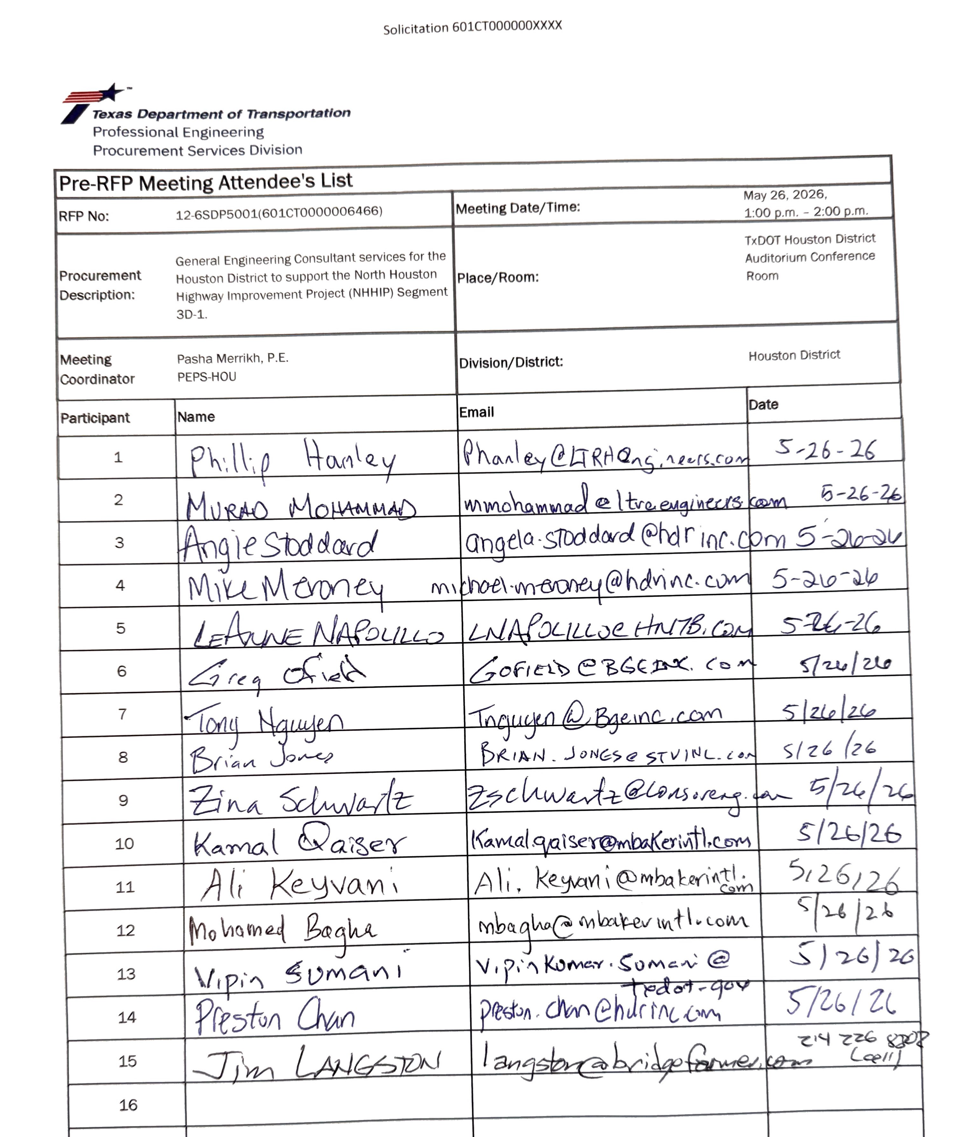
Sign-In Sheet 2

Slide 35
Sign-In Sheet 3

Slide 36
Sign-In Sheet 4

Slide 37
Sign-In Sheet 5

