Slide 1
Pre-Request for Proposal (RFP) Meeting
PS&E Services for US 281/SH 36
Hamilton Truck Relief Route
Waco District
FY 26 Wave 4
Solicitation No. 601CT0000006465; RFP No. 09-6SDP5001
Notes:
Welcome, everyone, to today's Pre-RFP meeting.
My name is Allison Kurwitz. I am the Procurement Engineer with the PEPS Central Service Center assigned to this Waco US 281/SH 36 PSE (Hamilton Truck Relief Route) procurement.
This procurement will follow the federal with interview process.
It is part of the PEPS FY 26 Wave 4 procurements.

Slide 2
Housekeeping
Thanks for joining our virtual meeting!
Be sure your full name is showing up correctly to provide your information on the attendee list.
Please ensure your audio is muted and video turned off.
Note that all correspondence will be muted throughout this presentation.
The meeting will not be recorded, and attendees may not use any form of audio or video recording, photography, automated transcription services, or AI-based analysis tools.
There will not be an opportunity to ask questions during the Pre-RFP presentation.
You will be given an opportunity to ask questions after the presentation via an email request.
Notes:
You may provide teaming information in the chat, such as name, firm representing, prime or sub, specialty, whether looking to team, etc.
Teaming information will not be posted. Only attendance list with email addresses of attendees.

Slide 3
Meeting Agenda
1
Safety Moment
2
Introductions & Ground Rules
3
Procurement Overview & Process
4
Preclusions & Core Team Restrictions
5
Project Overview
6
Procurement Timeline (Tentative)
Wrap Up & Next Steps
7

Slide 4

Drive like a Texan English
Notes:
We can do our part by designing and building safer roadways and by being responsible drivers.
Drive with kindness and courtesy to make every mile a safe one.
When you get behind the wheel buckle up (Seat belts are your first line of defense.);
pay attention and avoid all distractions like phones (Put your phone away or set to “Do Not Disturb”;
never drive under the influence of alcohol or other drugs, including prescription (Plan a sober and safe ride.);
watch your speed, and always drive to the conditions around you (Drive the speed limit, or slower, depending on road or weather conditions. Speed limits are based on normal road and weather conditions.). www.DriveTexas.org for TxDOT Highway Conditions.

Slide 5
Introductions
PEPS Central Service Center Manager (PEPS-LRD)
  Jaime A. Vela, Jr., P.E.
PEPS Central Procurement Engineer (PEPS-BRY)
  Allison Kurwitz, P.E.
PEPS Central Contract Administrator (PEPS)
  Cindy Barajas
Consultant Selection Team (CST) Members: Waco District Employees
Project Overview Presenter
  Abram VanElswyk, P.E. – Structures and Project Delivery Engineer (WAC),
                US 281 Schem/Env PM
PLEASE - Do NOT Contact the Waco District regarding this Contract.
Notes:
Now to introduce the PEPS Staff and Presenter for this procurement.
These are the individuals with the PEPS Central service center that will be assisting with procuring this contract.
I will be overseeing the overall procurement process. Cindy Barajas will process the contract once it’s awarded.
Consultant Selection Team (CST) members are from the Waco District and will not be identified in this meeting or the RFP.
If you need information, please contact me or Jaime Vela.

Slide 6
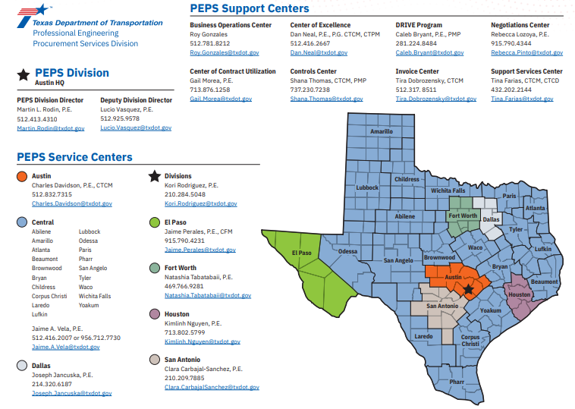
Professional Engineering Procurement Services Centers Map
Notes:
The urban and rural districts highlighted in blue are those supported by the Central PEPS Service Center.
To serve the contracting needs of the department, PEPS has eight service centers located across the state. The service centers works with the districts and divisions to provide advice and oversight throughout the planning, selection, negotiation and contract management processes. Meanwhile the support centers provide specific functions in support of the service centers and of PEPS Division.

Slide 7
Ground Rules
Do not contact the Waco District during the procurement process.
Communication is one-way during this presentation.
Brief Presentation – Information Purposes Only
All questions must be emailed to Allison.Kurwitz@txdot.gov by 5:00 p.m. on Thursday, May 21, 2026.
Subject line: 6465 Pre-RFP Meeting Question
Notes:
Do not contact the Waco District during the procurement process, but you may contact PEPS with questions.
Communication is one-way during this presentation.
This meeting will include a brief overview of the procurement process and the Hamilton Truck Relief project as applicable to the procurement.
This meeting is for informational purposes only. The advertised RFP will provide the requirements that will dictate this contract procurement process.
This presentation, list of attendees, questions and responses will be posted online.
You can contact me with questions after this meeting, and I’ll respond to your emails.

Slide 8
Procurement Overview: Waco District US 281/SH 36 PSE
One procurement - One Specific Deliverable Contract
  Federal with Interviews, DBE
  Plans, Specifications & Estimates (PSE)
  With Work Authorizations (WA)
Amount – To be determined through negotiations
Duration: Approx. 7 years

Slide 9
Procurement Process
One Specific Deliverable Contract with Work Authorizations
Contract Duration: Approx. 7 Years
FEDERAL FUNDS
FEDERAL PROCESS WITH INTERVIEWS
DBE GOAL
0%
Refer to RFP for final %
Solicitation – The Request for Proposal (RFP)
Response – Proposal submitted in Procurement Portal
Short List – Based on proposal scores
Interviews – Provider presentation
Selection – Based on the interview scores
Notes:
This Solicitation is for one specific deliverable contract with work authorizations. It will follow the Federal Process with Interviews.
The Disadvantage Business Enterprise (DBE) Goal is 0% and information will be provided in the RFP.
Solicitation will be posted in the TxDOT Procurement Portal (Euna Solutions), and providers will use the TxDOT Procurement Portal to submit responses.
The Proposal Evaluation will be used to make the Short List for interviews.
The Interview Evaluation will be used to make the selection.

Slide 10
Procurement Process - 2
Post Request for Proposal (RFP)
  Electronic State Business Daily (ESBD): Minimum 21-day posting time for RFP.
  Solicitation will be posted in TxDOT Procurement Portal – Euna Solutions (Formerly named Bonfire).
Submit Responses
  Providers will use Euna Solutions to submit responses to the solicitation.
    Euna Procurement Frequently Asked Questions (FAQs)
    Follow the RFP instructions and submit all completed, applicable documents required.
    Use the latest version of all forms.
Notes:
My goal is to post the request for proposal about June 4th. The RFP will be posted in the Procurement Portal. The 60% Schematic will be available with the RFP.
Euna Solutions is a procurement portal that will allow you to view business opportunities and submit provider response packages digitally.
The RFP will have specific instructions for your submittal. Follow the RFP as outlined in the document to avoid any disqualifications. Please read it carefully.
If you want to review the files that you uploaded as part of your submission, you may use Euna Solutions to navigate to the Submissions page and then use the download button for the document that you want to review. Refer to the FAQ. Can also click “Help” button or email questions to PEPS_COE_Process@txdot.gov

Slide 11
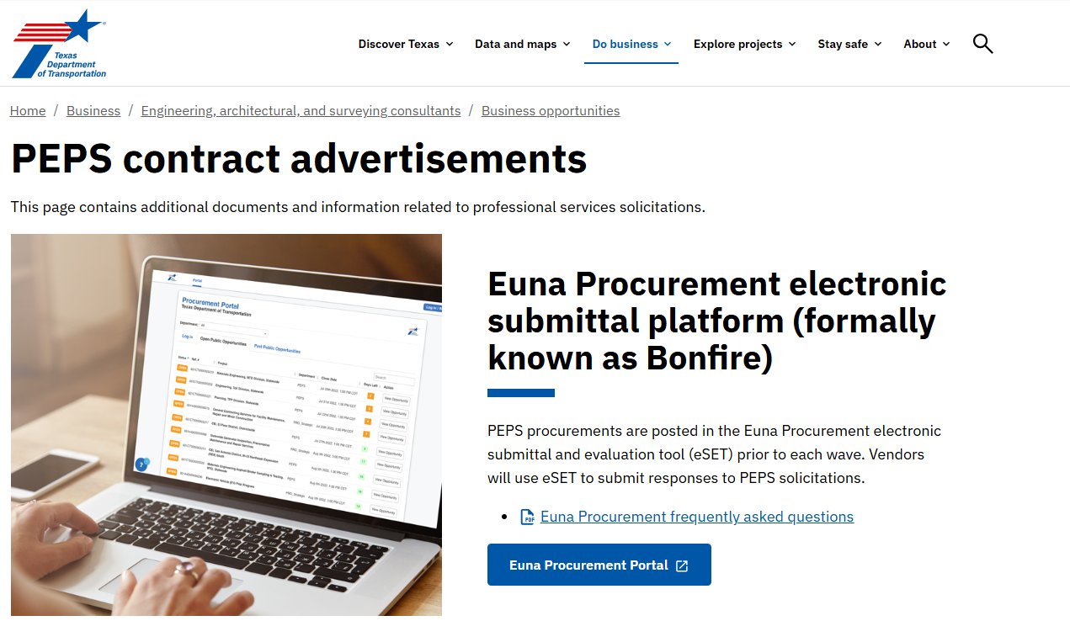
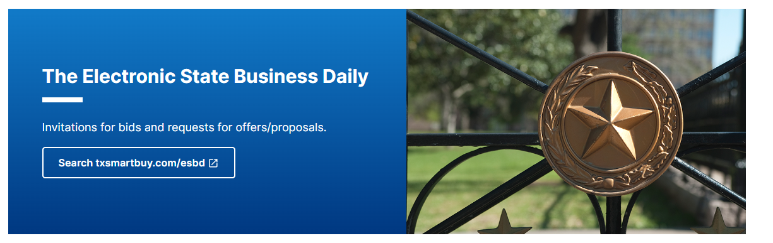
Procurement Process - 3
PEPS Contract Advertisements Link: PEPS contract advertisements (txdot.gov)
Notes:
RFP will be advertised on the Euna Portal (used to be named Bonfire)
Link to the portal is on this page.
Check out the two helpful links put out by PEPS_COE, are included on this page:
Euna Procurement frequently asked questions, as well as the
Electronic submittals presentation presented by PEPS COE

Slide 12
Procurement Process - 4
RFP Screening
  RFP Screening Checklist Architectural, Engineering and Surveying Consultants (state.tx.us)
  All prime and subs providing engineering and design-related services must be Administratively Qualified (AQ); or be determined eligible by TxDOT’s PEPS Division, Business Operations Center - Administrative Qualification Group to use the federal safe harbor rate, by the RFP deadline specified in this solicitation.
  Primes can look up subs on the TxDOT.gov website to check on AQ status. Firms Eligible to Do Business with TxDOT
Proposal Evaluation
  Short list based on proposal scores
Notes:
RFP Screening
Refer to the Proposal Screening Checklist on txdot.gov .
The RFPs will first be screened.
Proposal Evaluation
The CST members will individually score the proposals.
The proposal scoring will be evaluated on a scale of 1 to 5 per criteria.
The individual scores are consolidated to determine the short-listed consultants.
The three highest scoring providers will be short listed to advance to interviews.

Slide 13
Procurement Process - 5
Interview
  Shortlisted firms will receive the Interview Contract Guide (ICG) that outlines the process, presentation topics, and scoring criteria.
  Interviews will consist of Provider presentations, and follow-up questions and answer session.
  Selection based on interview scores.
Negotiations
  Labor Classifications, Hourly Labor Rates, Unit Cost, ODE
  Level of Effort
  Negotiate Scope, budget, and work schedule
Execute Contract
Notes:
Interview:
The shortlisted firms will be interviewed. Those firms will receive an email with instructions and the ICG it will outline the scheduled interview time and date, interview agenda process, interview presentation topics and scoring criteria.
Project Manager and Task Leaders for work categories defined in the RFP are required to attend the interview.
Interviews will consist of Provider presentations and follow-up questions and answer session.
The final selection will be based on interview scores
We are planning for in-person interviews for this procurement. All interviews for a procurement must be held using the same format: if one is virtual, they must all be virtual. If an in-person interview is scheduled, all participants must be in-person.
Negotiations:
For the winning firms, unit costs, ODEs and labor classifications will be coordinated with the Procurement Engineer.
Negotiated rates will be coordinated with PEPS Negotiations Service Center.
Then you will negotiate scope, budget and work schedule with the Procurement Engineer and the Waco District. The district, with assistance from the Procurement Engineer, will negotiate the level of effort.
Once all negotiations are final and documents are ready then we can execute the contract.

Slide 14
Procurement Process – RFP Requirements
    Project Team Composition (PTC) Form (Parts 1, 2, and 3) must include:
    TLs for standard work categories
    DBE firms
    Percentages of work
  Examples of Standard Work Categories
1.8.1 Public Involvement
2.14.1 Environmental Document Preparation
4.2.1 Roadway Design
5.2.1 Bridge Design
8.1.1 Signing,Pavement Marking&Channelization
10.2.1 Roadway Hydraulic Design
  Prime provider shall perform at least 30% of the contracted work using its own work force.
  DBE goal is 0%.
Notes:
PTC will be input to DDCIS.
Task leaders must be pre-certified before RFP closing.
All firms providing Engineering & Design services must be Administratively Qualified or determined eligible to use the federal safe harbor rate, before RFP closing date.

Slide 15
RFP Work Categories (Tentative*)
# | Category
1.8.1 | Public Involvement
2.14.1 | Environmental Documentation Preparation
4.2.1 | Roadway Design
4.4.1 | Freeway Interchanges
4.5.1 | Constructability Review
4.6.1 | 3-D Visualization and Animation Services
5.2.1 | Bridge Design
5.3.1 | Multi-Level Interchange Design
5.5.1 | Bridge & Non-Bridge Class Culvert and Inlet Design
5.6.1 | Structural Engineering for Overhead Sign Supports
8.1.1 | Signing, Pavement Marking & Channelization
8.2.1 | Illumination
8.3.1 | Signalization
10.1.1 | Hydrologic Studies
10.2.1 | Roadway Hydraulic Design
10.3.1 | Bridge Hydraulic Design
10.5.1 | Bridge Scour Evaluations And Analysis
10.8.1 | FEMA Regulations and Permits
* Subject to change. Refer to RFP for list and percentages.
Notes:
Subject to change. Refer to RFP for list and percentages.
The work categories groups:
Transportation Systems Planning – Public Involvement
Environmental Studies – In case of Re-evaluation
Roadway Design
Bridge Design
Traffic Operations Design
Hydraulic Design and Analysis

Slide 16
RFP Work Categories (Tentative*) - 2
# | Category
11.7.1 | Construction Schedule Support- Relating to Scheduling of Roadway Design
12.4.1 | Pavement Design Services
14.1.1 | Soil Exploration
14.2.1 | Geotechnical Testing
14.3.1 | Transportation Foundation Studies
14.5.1 | Evaluation & Design of Geotechnical Related Structures
15.1.1 | Right of Way Surveys
15.2.1 | Design Survey
15.2.2 | Construction Survey
18.2.1 | Subsurface Utility Engineering (Util Engr. Investigation)
18.3.1 | Utility Adjustment Coordination
18.4.1 | Utility Engineering
18.5.1 | Utility Construction Management and Verification
* Subject to change. Refer to RFP for list and percentages.
Notes:
Subject to change. Refer to RFP for list and percentages.
The work categories groups:
Construction Management – Scheduling of Roadway Design
Material Inspection and Testing – Pavement Design
Geotechnical Services
Surveying and Mapping
Utility Engineering

Slide 17
Proposal Evaluation Criteria
CST members will independently score Proposals based on the evaluation criteria and relative importance factors (weightings) provided below. The Past Performance Score is only used in Proposal Evaluation.
Evaluation Criteria | Included Elements | Weighting for Evaluation of Proposal
Technical approach | Project understanding, project approach, innovative concepts or alternatives | XX
Project Manager’s relevant experience | Experience with similar or related projects, including both technical and management experience | XX
Project planning and management | Project staffing and resource management (who, how, and why), communication plan, and quality control procedures. The prime firm’s past experience with utilizing subproviders and meeting program goals (HUB or DBE) and/or how it plans to utilize subproviders to meet the goals on this contract. Also, may include project scheduling or phasing for SD projects | XX
Key staff’s relevant experience | Experience with similar projects | XX
Past Performance Score |  | 5 to 15%
Total |  | 100%
Notes:
The proposal scoring will be evaluated on a scale of 1 to 5 per criteria
There will be 4 criteria evaluated: Technical Approach, Project Manager’s Relevant Experience, Project Planning and Management and Key Staff Relevant Experience. Plus, the provider’s Past Performance Score for the proposal phase. The Past Performance Score is not included for interview scoring.
Refer to the RFP for the actual weighting percentages.

Slide 18
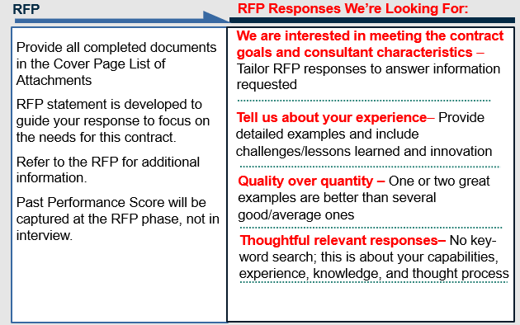
Procurement Process: Proposal
Notes:
TxDOT will provide a clear detailed description of the scope of work, technical requirements and qualifications of consultants necessary for the services to be rendered.
Proposal Statement
Proposal Evaluation Criteria
Proposal Format
Proposal Schedule

Slide 19
Procurement Process: Interview
Interview and Contract Guide (ICG)
Typical Interview process *
TxDOT will provide the following:
Scope of work with technical requirements and qualifications required to provide the services of this contract
Presentation Topics
Identify interview evaluation criteria
Interview format and timetable
Interview schedule date, time and location
TxDOT Introductions/Instructions
Provider presentation based on topics shown in ICG
CST Break
Questions and Answer Session
TxDOT Concluding Remarks
*Interviews in-person: Waco District
The CST members individually score the interviews and then the scores are consolidated to determine the selected provider.

Slide 20
Preclusions & Core Team Restrictions
Precluded Firms*:
Contract 09-0SDP5003 WAs 1-4
Prime: Bartlett & West, Inc. (formerly Civil Associates, Inc.)
Subproviders: Aerial Data Service, Inc.
ERG (formerly AmaTerra Environmental, Inc.)
Bartlett & West, Inc.
HVJ North Texas – Chelliah Consultants, Inc.
Pape-Dawson Consulting Engineers, LLC
The Rios Group, Inc.
White Hawk Engineering & Design, LLC
WSP USA Inc.
* List is subject to change – current as of 4/29/2026
Notes:
The listed Primes and Subs that have worked on the Schematic & Environmental contract for this project, have been identified as precluded from the current Waco US 281/ SH 36 PSE procurement.
A Draft Preclusion Document will be posted with the Pre-RFP presentation.
Refer to the Request for Proposals posting in the TxDOT Procurement Portal for the final precluded list of firms. Some could change.

Slide 21
Preclusions & Core Team Restrictions - 2
Core Team Restrictions: This solicitation does not contain a core team restriction.

Slide 22
Preclusion Appeals Process
Preclusion Appeals Process
  Preclusion document has been developed.
    Email Martin L. Rodin, P.E.
    Include this Solicitation No. 601CT0000006465
    Explain rationale for removal from preclusion list
  After posting procurement
    Formal appeal outlined in Title 43 TAC § 9.7, see for exact details
    Mail letter to Marc D. Williams, include above info
    CC: Martin L. Rodin
    Procurement process is not paused

Slide 23
Project Overview
Waco District – US 281/SH 36
Hamilton Truck Relief Route
Abram VanElswyk, P.E.
Structures and Project Delivery Engineer & US 281 Schem/Env PM
Waco District

Slide 24
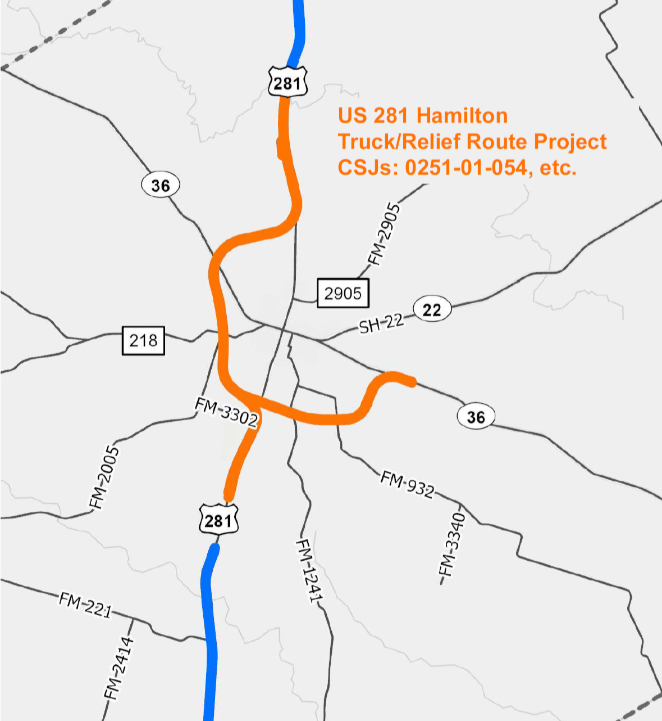
Project Overview
US 281 Hamilton Truck / Relief Route:
~ 15 miles of new location relief route
First of three projects to widen US 281 to four lanes throughout Hamilton County
Key Connectivity Corridor
Fully funded (Cats 4 and 12)
Single PS&E contract

Slide 25
Project Overview - 2
County: Hamilton
Overall Limits:
  CSJ 0251-01-064: US 281 from 1.25 miles north of CR 203 (Leon River) to State Highway (SH) 36
  CSJ 0251-01-050: US 281 from SH 36 to CR 506
  CSJ 0183-03-054: SH 36 from US 281 to SH 36
Proposed Letting Date: FY 2030

Slide 26
Project Overview: Waco District – US 281/SH 36
Schematic:
  60% Schematic is under review and will be available with RFP.
  The 60% Schematic is still subject to revisions.
Environmental:
  Not finalized until Public Hearing in FY 27.
Right-of-way:
  Acquisition mostly not started, except one parcel
Utilities:
  Utility relocations are 0% complete; estimated completion by letting
Notes:
Schematic: 60% under review
Environmental: Not finalized until Public Hearing in 2027
Right of way: Mostly not started (except one parcel)
Utilities: Nothing relocated currently, estimated completion by letting

Slide 27
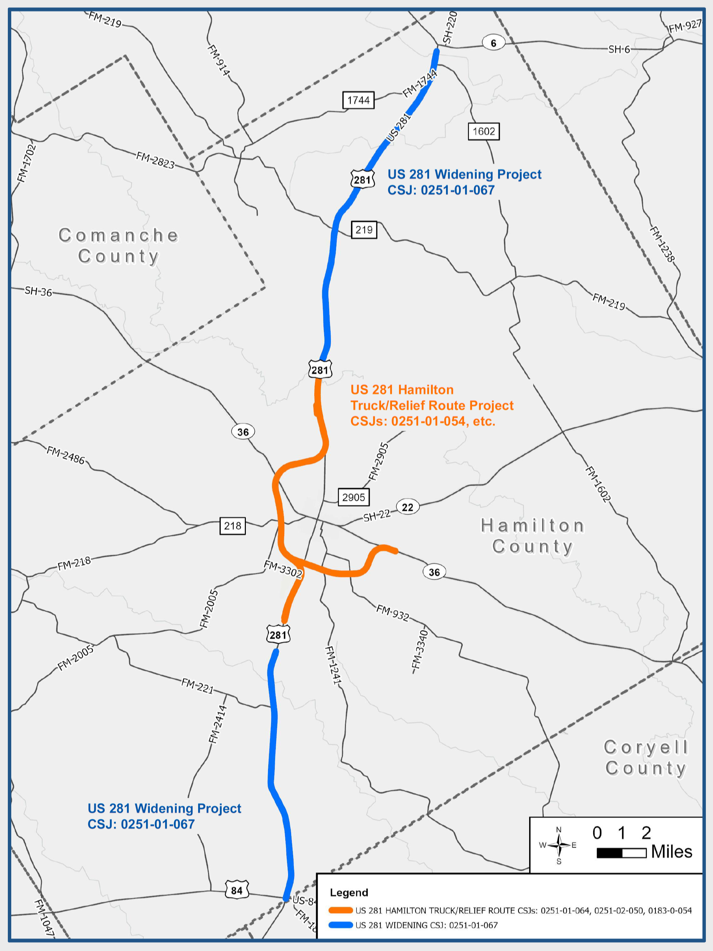
Project Context – Future Proof Design
Design Approach: Future Freeway
Widened sections: Non-access control with wide median to allow for future mainlanes
Relief route: New mainlanes with full control of access; ROW is sufficient to allow for future frontage roads by others
“Interstate Grade” vertical profile
(avoid excessive crest and sag curves)

Slide 28

Project Context – Active Ranching Operations
Proposed alignment bisects active ranches
Overpasses and large culverts for stock and equipment movement
Post-schematic coordination with property owners

Slide 29

Project Context – Economic Development
50 mph DCs onto business routes enable easy return access from Downtown
Potential for streetscape improvements after relief route opens (not part of this project)

Slide 30

Existing US 281 Typical Section
Notes:
Discuss a little about the configuration

Slide 31
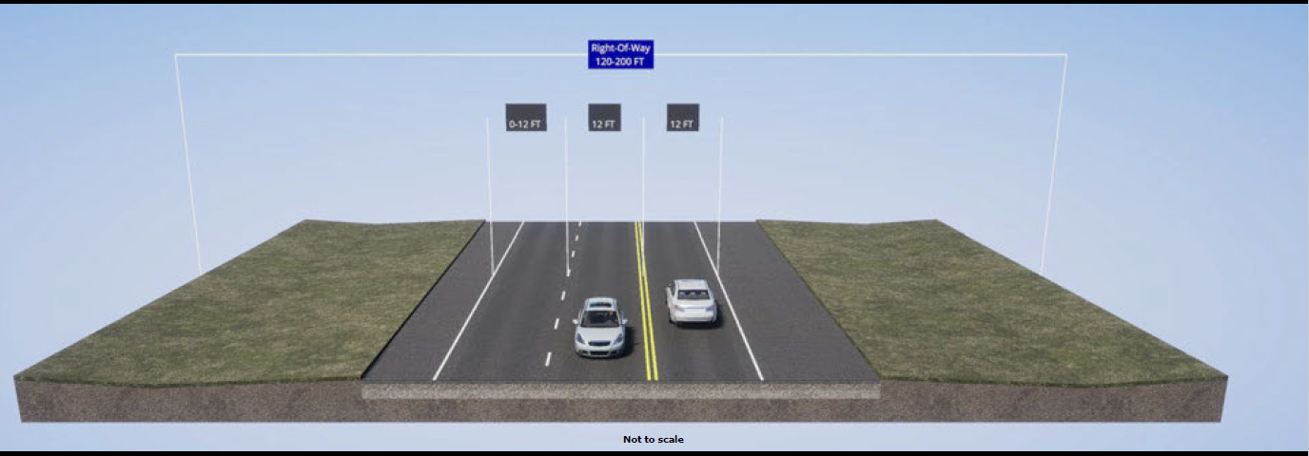
Existing SH 36 Typical Section
Notes:
Discuss a little about the configuration

Slide 32
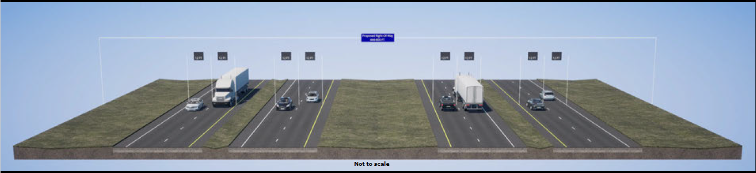
Proposed US 281 Typical Section
Four-lane divided roadway with 12-foot-wide lanes and 10-foot-wide shoulders
Non-continuous two-lane northbound and southbound frontage roads
Access ramps to major interconnecting roadways/cross-streets
Notes:
Discuss a little about the configuration

Slide 33

Proposed US SH 36 Typical Section
Four-lane divided roadway with 12-foot-wide lanes and 10-foot-wide shoulders
Non-continuous two-lane northbound and southbound frontage roads
Access ramps to major interconnecting roadways/cross-streets
Notes:
Discuss a little about the configuration

Slide 34
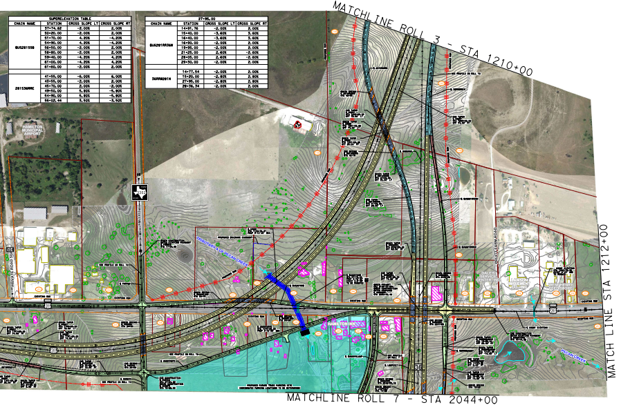
Project Overview: Schematic – US 281/SH 36 at FM 3302
Notes:
Discuss a little about the configuration
US 281 / SH 36 at FM 3302 (south interchange with loop ramp, truck parking, etc)

Slide 35
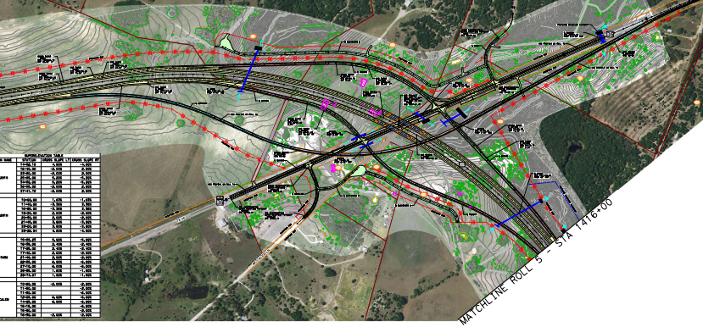
Project Overview: Schematic – US 281 at SH 36 (Northwest)
Notes:
Discuss a little about the configuration
US 281 at SH 36 (Northwest Side)

Slide 36
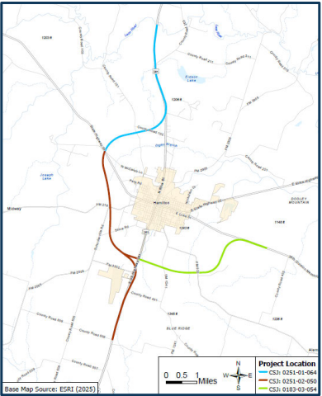
US 281 Hamilton Truck/Relief Route Project
Check out the Project website for
more information.
Project Website: www.txdot.gov
Search Keywords
“US 281 Hamilton”
Refer to Public Meeting held on
February 12, 2026, for latest information
and schematic rolls.

Slide 37
Procurement Timeline (Tentative*)
Pre-RFP Meeting | Wednesday, May 13, 2026
RFP Posted in Euna | June 4, 2026
RFP Closing Date | June 25, 2026
Proposal Evaluation Complete | Mid to Late July 2026
Provider Selection | Mid to Late August 2026
Finalize & Execute Contract | December 2026
* All dates are subject to change.

Slide 38
Wrap Up and Next Steps
Thank you all for joining the Pre-RFP meeting!
Email all questions from the Pre-RFP meeting to Allison.Kurwitz@txdot.gov by 5:00 p.m. CST, on May 21, 2026.
Subject line: 6465 Pre-RFP Meeting Question
Presentation, attendee list, relevant questions/answers, and draft preclusion document will be posted to TxDOT website under “Consultant Information Meetings”:
Pre-RFP Meeting – Hamilton Relief Route – US 281/SH 36 PS&E – Waco District
Notes:
The deadline for questions is to allow questions and answers corresponding to this presentation to be posted.
There will be another opportunity after the RFP posting.
Look for postings in the TxDOT Procurement Portal
RFP documents and any additional project documents (60% Schematic) will be posted in Procurement Portal.
That is all for the Pre-RFP Presentation. Thank you all for joining!
Be safe and well

