Slide 1
New Precertification Categories
PEPS Fireside Chat
July 24, 2026
Amanda Austin, P.E. | R.A.I.D Lead | TxDOT Design Division
Sierra Salinas | Precertification Liaison | PEPS Center of Excellence

Slide 2
Presentation Topics
1
What are the new precertifications?
2
Why does TxDOT need these precertifications?
3
4.8.1 – Roundabout Planning & Operations Analysis
4
4.8.2 – Roundabout Geometric Design & Review - Basic
5
4.8.3 – Roundabout Geometric Design & Review – Complex
8
Questions and Discussion
Precertification Application Recap
6
7
Training Opportunities

Slide 3
What are the new precertifications?

Slide 4
Overview
4.8.1 Roundabout Planning & Operations Analysis
  Traffic analysis of roundabouts – single & multilane
4.8.2 Roundabout Geometric Design & Review – Basic
  Geometric design and review of single & multilane, not complex
4.8.3 Roundabout Geometric Design & Review – Complex
  Geometric design and review of complex roundabouts
  Peer reviews, mentoring, and advanced training

Slide 5
Basic vs. Complex Roundabouts
Basic:
  Single lane – single circulating lane
  Multilane – more than one circulating lane regardless of the number of entry lanes
Complex (single or multilane):
  Unusually shaped
  Interchange
  Near another intersection such that the operation of one may have an impact on the operation, signing, and/or marking of the other

Slide 6
Why does TxDOT need these precertifications?

Slide 7
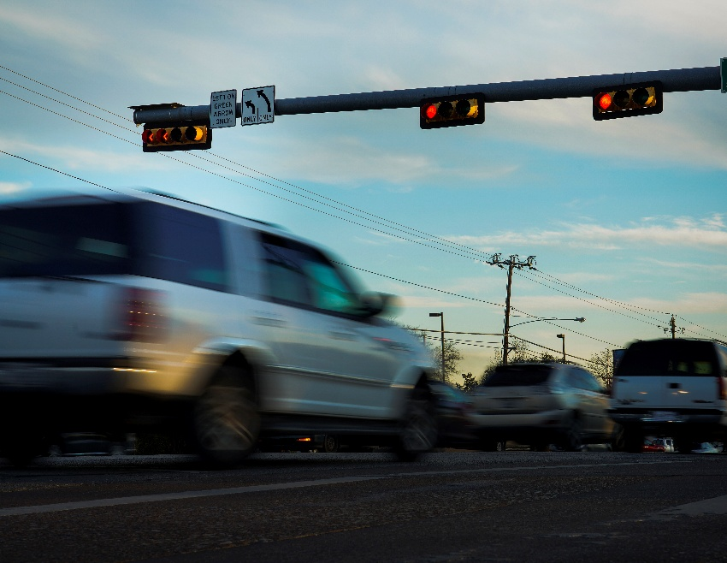

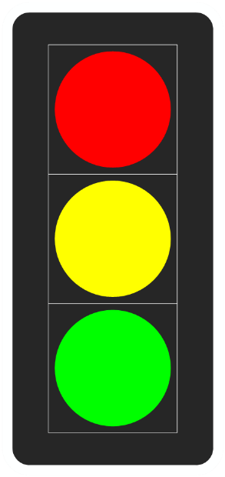

SAFETY
Figure 3 – Vehicles Running Red Light
Figure 2 – Traffic Light
Figure 1 – Stop Sign
32%
Figure 4 – Vehicle Crash

Slide 8
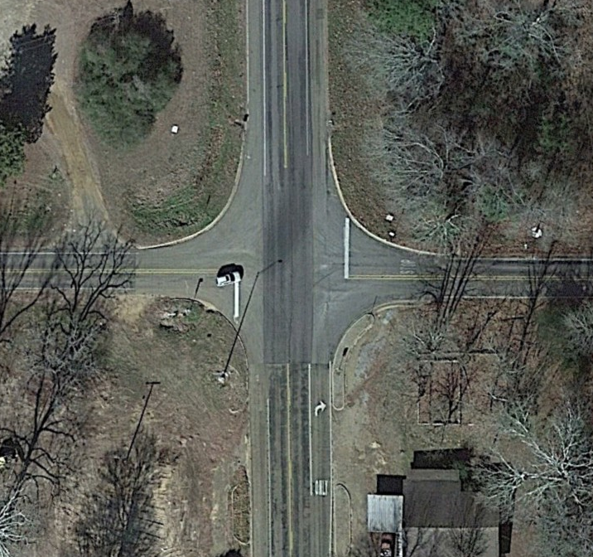
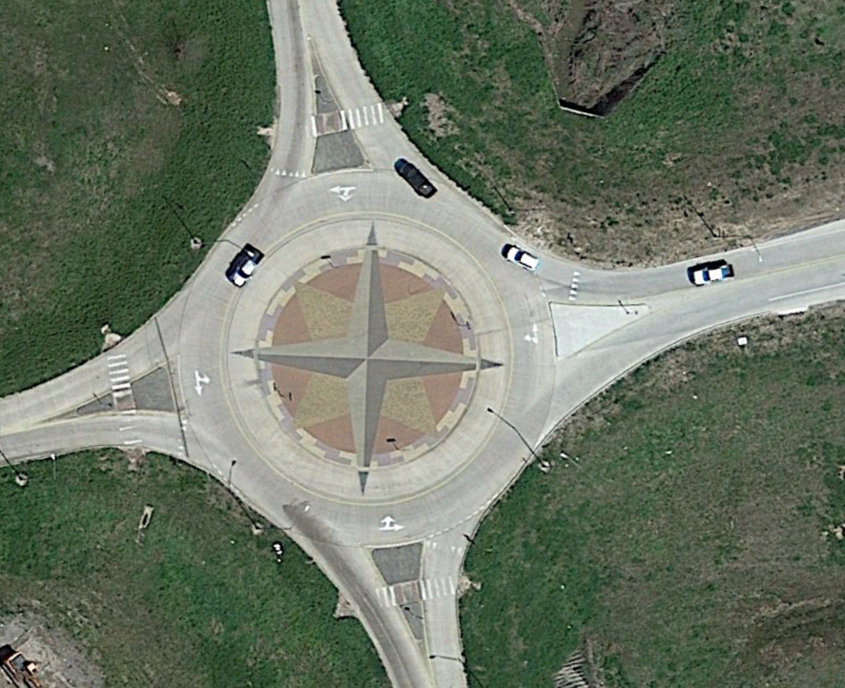
Why Geometry Matters
Figure 5 – 4-way Intersection
Figure 6 – Roundabout

Slide 9
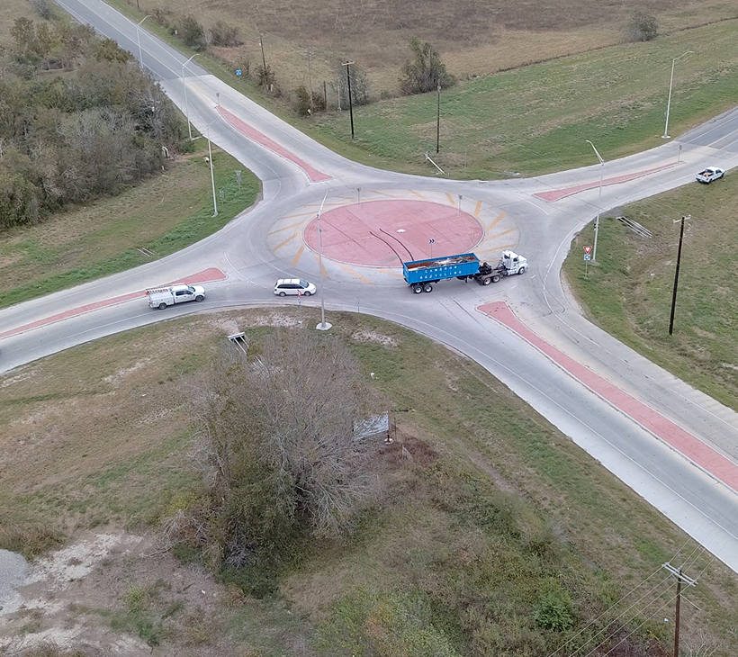
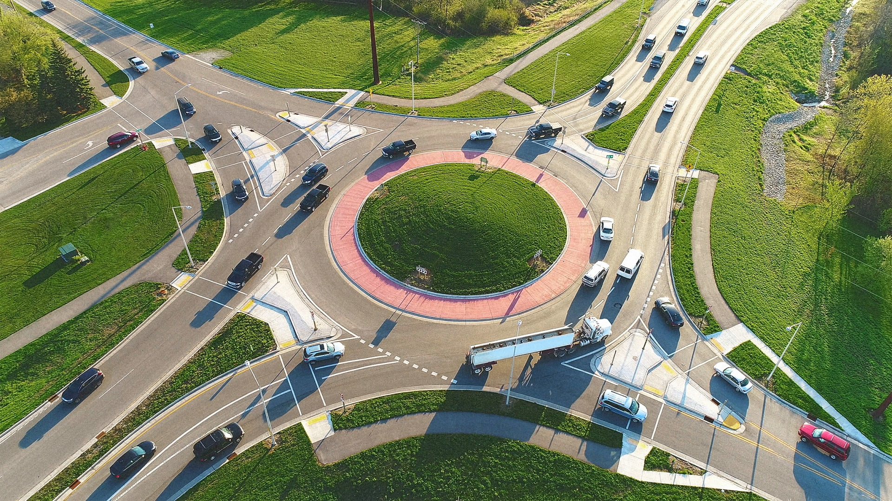
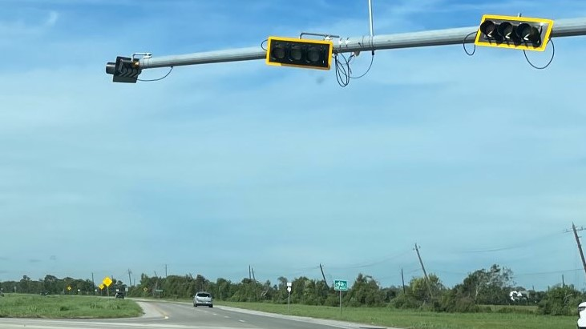
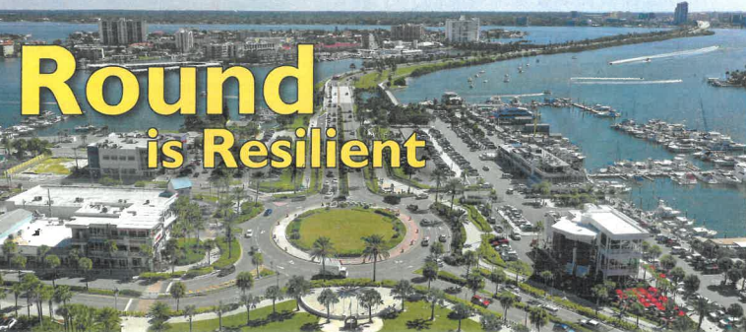
The Data - Roundabouts
Figure 7 – Roundabout – Light Traffic
Figure 8 – Roundabout – Heavy Traffic
82%
90%
Figure 9 – Damaged Traffic Lights
Figure 10 – Roundabout Resilient Design

Slide 10
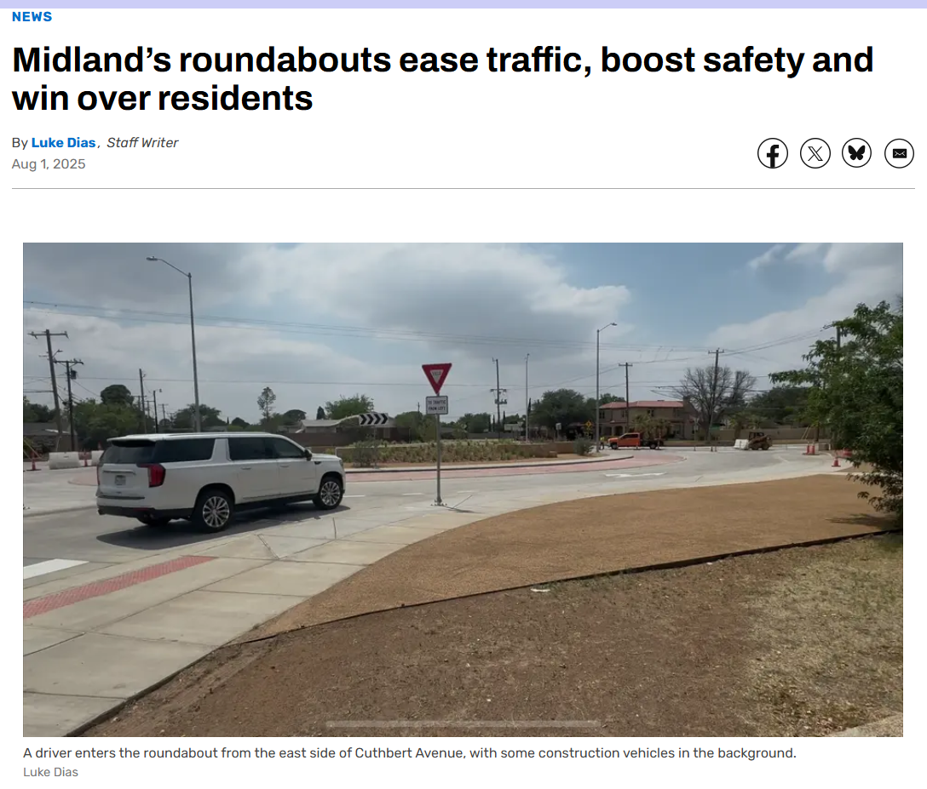
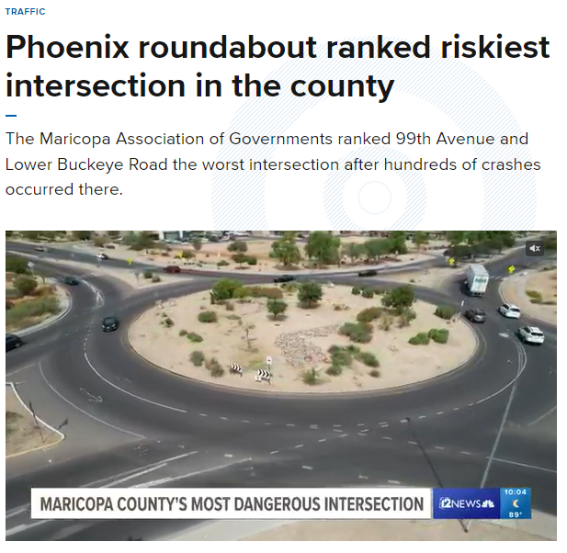
Design Matters
Figure 11 – Phoenix News Article
Figure 12 – Midland News Article

Slide 11
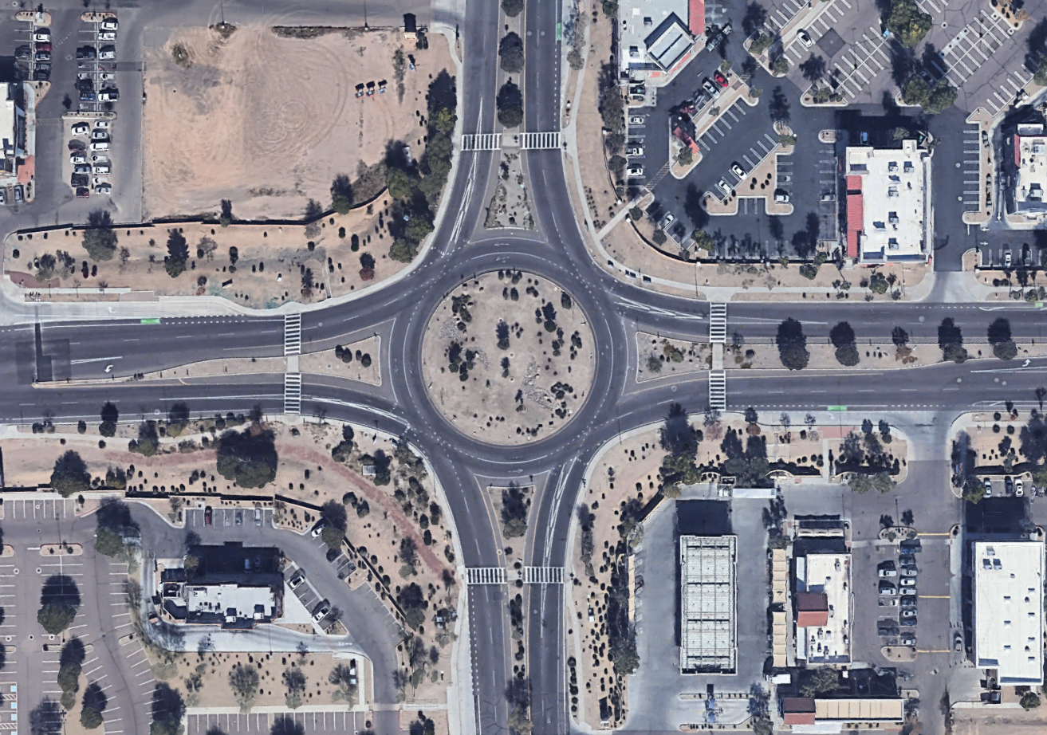
Design Flaw Examples
Figure 13 – Roundabout with Design Flaws
Lane designation striping faded or non-existent
Ped. crossings too far back
ICD = 225’
No deflection on entries
Entry/exit striping conflicting & confusing

Slide 12
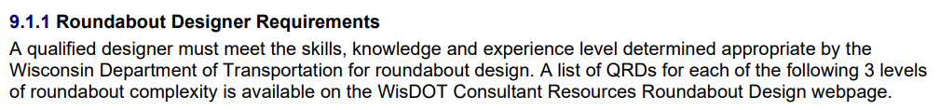
Precedent
TxDOT Pre-Certs
  4.7.1 Traffic Safety Analysis – NHI training requirement
  6.1.1 & 6.4.1 – Bridge Inspection – “tiered” example – one pre-cert building on another
Other states: Wisconsin Department of Transportation (DOT) Qualified Roundabout Designer (QRD) Program
Figure 14 – 9.1.1 Roundabout Designer Requirements

Slide 13
Why? Summary
32% of fatal & serious injury crashes are at intersections
Roundabouts significantly reduce fatal & serious injury crashes
Design matters – poor design can lead to:
  Operational problems
  Increased crash risk
  Lack of community buy-in for future roundabouts

Slide 14
4.8.1 Roundabout Planning & Operations Analysis

Slide 15
4.8.1 Overview & Associated Activities
Overview: the traffic analysis of new roundabouts or the update of existing facilities and includes both single and multi-lane roundabouts and complex roundabouts
Associated Activities:
  the study of the intersection
  study of the intersection as part of a larger corridor project
  operations analysis
  resulting recommended lane configuration.

Slide 16
4.8.1 Certification Requirements
is a Professional Engineer in the state of Texas;
has a minimum of three years of demonstrated experience in the use and application of current traffic modeling software and tools for analyzing roundabout designs (including HCM, Synchro and/or Sidra and VISSIM) and their correlation to the geometric roundabout design, [refer to TxDOT Traffic and Safety Analysis Procedures (TSAP) Manual, Chapter 12 and TxDOT Roadway Design Manual (RDM), Chapter 14] and
has completed roundabout traffic analysis on at least five roundabouts, including at least three multilane and two complex roundabouts.

Slide 17
4.8.2 Roundabout Geometric Design & Review – Basic

Slide 18
4.8.2 Overview & Associated Activities
Overview: design of new roundabouts or the update of existing facilities and includes both single and multilane roundabouts, but not complex roundabouts
Associated Activities:
  geometric design of roundabouts with a thorough understanding of entry and exit path overlap
  determining effects of bypass lanes on the roundabout

Slide 19
4.8.2 Associated Activities (continued)
  developing a roundabout design with appropriate values for geometric parameters (inscribed circle diameter, entry and exit widths, alignment and radii, lane width, and circulatory roadway width)
  designing for appropriate fastest speed paths
  designing for truck turning paths
  PS&E details: signing and pavement marking, landscaping, lighting, drainage, bicycle and pedestrian accommodations, traffic control, construction phasing or staging plans

Slide 20
4.8.2 Certification Requirements
is a Professional Engineer in the state of Texas;
meets the qualifications for Category 4.8.1 Roundabout Planning & Operations Analysis;
has a minimum of three years of demonstrated experience in the horizontal and vertical design and PS&E development of roundabouts, showing clear understanding of principles and elements of the design, consistent with the National Cooperative Highway Research Program (NCHRP) Report 1043 (Guide for Roundabouts);

Slide 21
4.8.2 Certification Requirements (continued)
is a Professional Engineer in the state of Texas;
meets the qualifications for Category 4.8.1 Roundabout Planning & Operations Analysis;
has a minimum of three years of demonstrated experience in the horizontal and vertical design and PS&E development of roundabouts, showing clear understanding of principles and elements of the design, consistent with the National Cooperative Highway Research Program (NCHRP) Report 1043 (Guide for Roundabouts);

Slide 22
What are we looking for?
“showing clear understanding of principles and elements of the design, consistent with the National Cooperative Highway Research Program (NCHRP) Report 1043 (Guide for Roundabouts)” → GOOD GEOMETRY, CONSTRUCTED, PERSONAL INVOLVEMENT
  Good geometry (not limited to):
    fastest paths & natural path
    view angle & path overlap
    lane configuration
  Locations we can look up
  Personally designed the geometry and involved in full PS&E

Slide 23
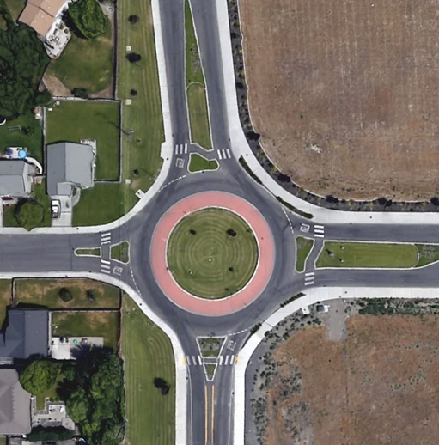
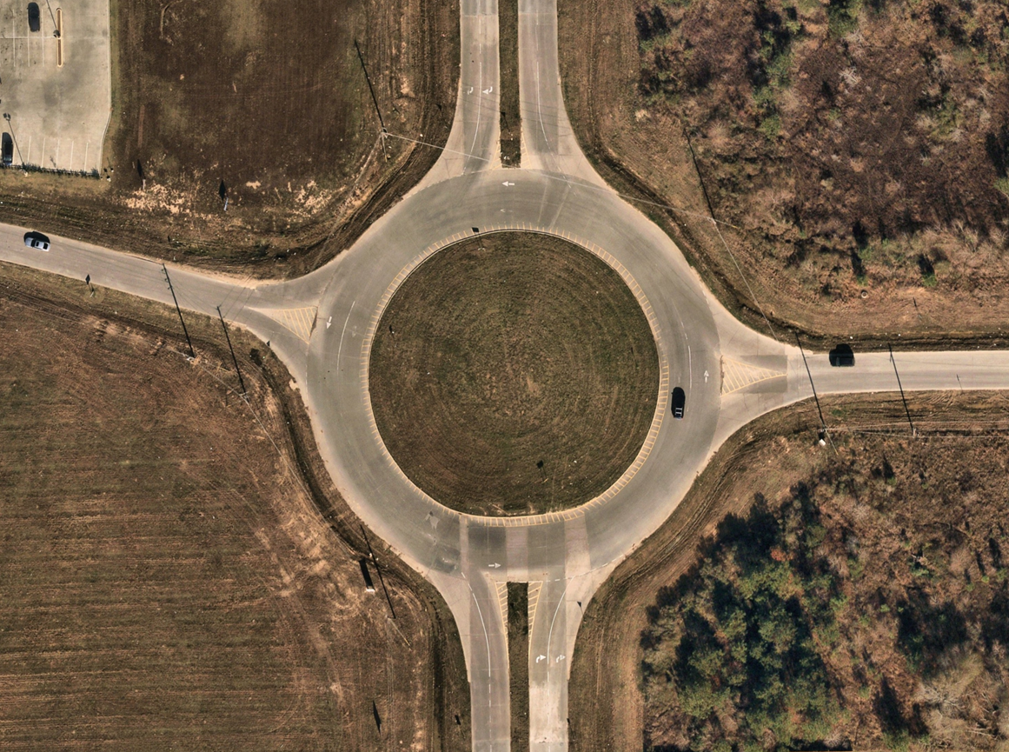
Geometry: what we are not looking for…
Figure 16 – Poor Geometry Design – Example 2
Figure 15 – Poor Geometry Design – Example 1

Slide 24
Locations & Experience
NOT looking for:
  “Project manager oversaw plan development”
  “Completed concept sketches for XX roundabouts”
  “Completed traffic control plans”
Looking for:
  “Completed horizontal & vertical design, performance checks, and PS&E for roundabout located at SH 123 at FM 456”

Slide 25
4.8.2 Certification Requirements (continued 2)
demonstrate the completion of the geometric design of at least seven roundabouts, including at least three multilane, which would include the description and location of each project; and
has, within the last three years:
  attended TxDOT’s DES599 Roundabout Design class; or
  attended a minimum of 12 hours of training for roundabout geometric design.

Slide 26
4.8.3 Roundabout Geometric Design & Review – Complex

Slide 27
4.8.3 Overview
Overview: complex geometric design of roundabouts and those in high-complexity contexts, such as large multilane configurations, constrained urban environments, interchanges, and locations adjacent to other intersections or critical infrastructure
Work under this category demonstrates a high level of expertise in safety, performance, and constructability across a wide variety of traffic and site conditions

Slide 28
4.8.3 Associated Activities
  geometric design of complex roundabouts
  leading design teams
  conducting or responding to peer reviews
  mentoring
  delivering advanced training
REMINDER: “complex” =
Unusually shaped
Interchange
Near another intersection such that the operation of one may have an impact on the operation, signing, and/or marking of the other

Slide 29
4.8.3 Certification Requirements
is a Professional Engineer in the state of Texas; and
meets the qualifications defined for Category 4.8.2 Roundabout Geometric Design & Review – Basic;
has a minimum of seven years of demonstrated design experience in the horizontal and vertical design and PS&E development of roundabouts, showing clear understanding of principles and elements of the design, consistent with the National Cooperative Highway Research Program (NCHRP) Report 1043 (Guide for Roundabouts);

Slide 30
4.8.3 Certification Requirements (continued)
demonstrate the completion of the geometric design of at least five complex roundabouts, which would include the description and location
has, within the last three years completed one or more of the following:
  attended TxDOT’s DES599 Roundabout Design class;
  attended a minimum of 12 hours of training for roundabout geometric design; or
  developed the curriculum for and delivered a minimum 8-hour training class on roundabout geometric design.

Slide 31
Training Opportunities

Slide 32
DES599 Opportunities
VIRTUAL – October 5-8, 2026 – limited seats available
Lubbock – April 13-14, 2027
VIRTUAL – Dates to be determined
  at least one more offering in FY27, possibly two
  minimum three offerings every fiscal year – two virtual, one in-person

Slide 33
Precertification Applications Overview

Slide 34
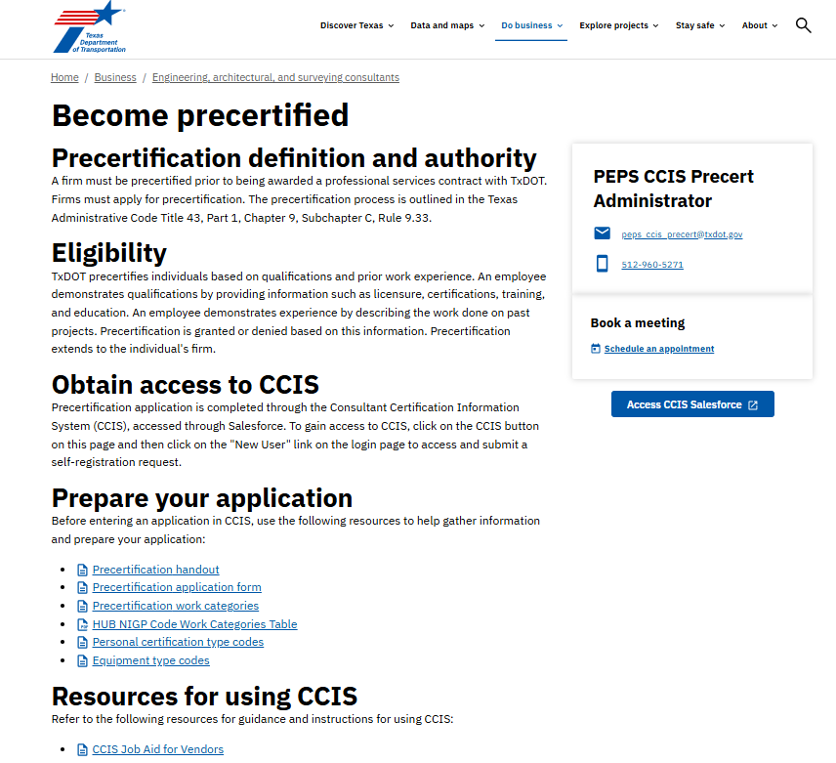
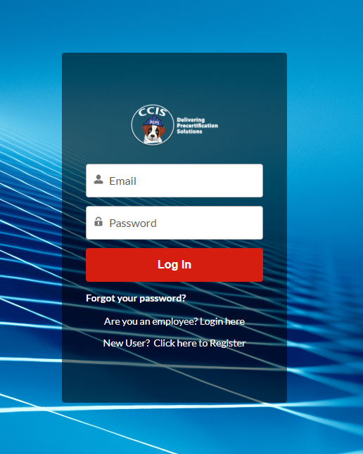
Establish your firm & assign Consultant Certification Information System (CCIS) users
Figure 18 – CCIS Login Screen
Figure 17 – Becoming Precertified Webpage

Slide 35
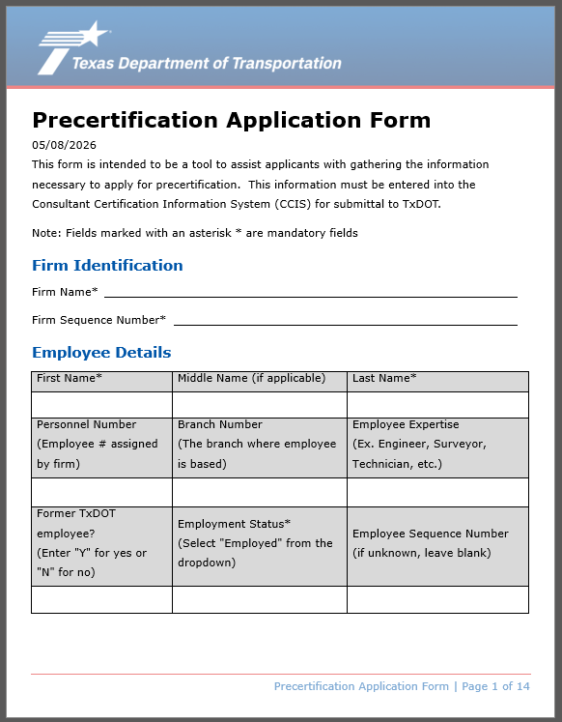
Collect employee information
Select the work categories that align with your qualifications and experience
Describe project experience in first person, clearly outlining your specific role and responsibilities
Submit an individual application for each employee seeking precertification
Figure 19 – Precertification Application Form

Slide 36
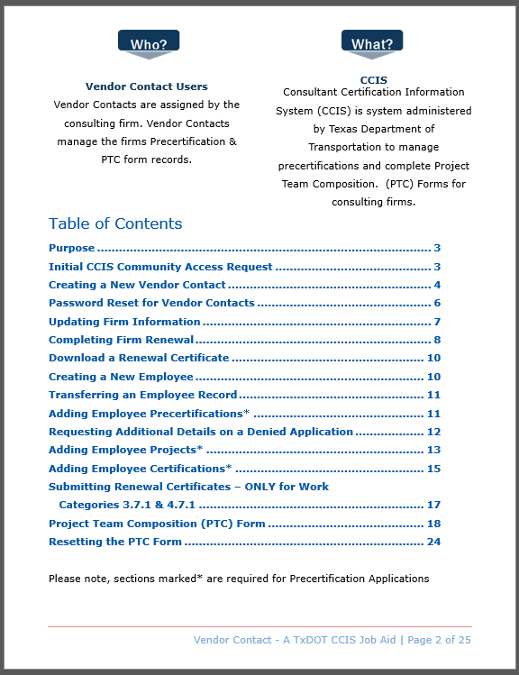
Firms’ assigned CCIS user submits application in CCIS
Create work category records
Create project records
Create certification records
Submit for approval
Figure 20 – CCIS Job Aid for Vendors

Slide 37
Application Review
Initial Review
Applications received are reviewed by the Precert Manager within 2-3 days
Final Review
Upon initial approval, the application is routed to an assigned SME within TxDOT
Time expectation
Typical application processing time is 21 days; however, we must allow 60 days
Notification
Upon approval/denial the submitter will receive an email notification

Slide 38
Questions and Discussion

Slide 39
Contact Information
Amanda Austin, P.E.
Sierra Salinas
R.A.I.D. Lead
PEPS Precertification Liaison
Amanda.Austin@txdot.gov
Sierra.Salinas@txdot.gov
(346) 265-9890
(512) 960-5271

