Slide 1
Title VI
Subrecipient Technical Assistance Workshop
Civil Rights Division

Slide 2
Agenda
1 | Title VI SCAT Overview
2 | Title VI Requirements for Subrecipients
3 | Technical Guidance

Slide 3
SCAT Overview

Slide 4
Why is TxDOT reviewing my Title VI program?
In accordance with 23 CFR 200.9(b)(7), TxDOT is responsible for developing and implementing an effective subrecipient monitoring program that conducts reviews of cities, counties, consultant contractors, suppliers, universities and colleges, planning agencies and other recipients of federal-aid highway funds with whom it does business.
TxDOT’s Subrecipient Monitoring Program is multi-faceted and includes:
Education
Oversight
Consultation
Monitoring
Notes: Why is TxDOT reviewing my organization for Title VI compliance?
In accordance with the Code of Federal Regulations cited in 23 CFR 200.9(b)(7), TxDOT is responsible for developing and implementing an effective subrecipient monitoring program that conducts reviews of cities, counties, consultant contractors, suppliers, universities and colleges, planning agencies and other recipients of federal-aid highway funds with whom it does business. The term subrecipient refers to a recipient that receives federal funds indirectly through TxDOT.
TxDOT’s Subrecipient Monitoring Program is multi-faceted and provides education of Title VI requirements, monitoring and oversight of subrecipient compliance, and consultation upon request.
Notes:
Why is TxDOT reviewing my organization for Title VI compliance?
In accordance with the Code of Federal Regulations cited in 23 CFR 200.9(b)(7), TxDOT is responsible for developing and implementing an effective subrecipient monitoring program that conducts reviews of cities, counties, consultant contractors, suppliers, universities and colleges, planning agencies and other recipients of federal-aid highway funds with whom it does business. The term subrecipient refers to a recipient that receives federal funds indirectly through TxDOT.
TxDOT’s Subrecipient Monitoring Program is multi-faceted and provides education of Title VI requirements, monitoring and oversight of subrecipient compliance, and consultation upon request.

Slide 5
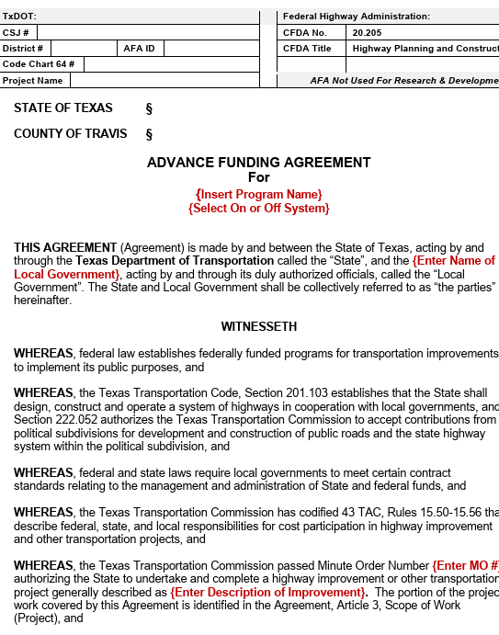
Advance Funding Agreement
TxDOT’s Advance Funding Agreement (AFA) outlines the basic requirements to ensure nondiscrimination in subrecipient transportation projects and is used by TXDOT as a starting point in the process of determining funding eligibility.
Figure 1: Advance Funding Agreement
Notes: TxDOT’s Advance Funding Agreement (AFA) outlines the basic requirements to ensure nondiscrimination in subrecipient transportation projects and is used as a starting point in the process of determining funding eligibility. The AFA outlines the basic requirements to ensure nondiscrimination in subrecipient transportation projects. The Title VI Team works with TxDOT’s Local Government office to identify subrecipients with active Advance Funding Agreements to determine who will be reviewed in the current year.
Notes:
TxDOT’s Advance Funding Agreement (AFA) outlines the basic requirements to ensure nondiscrimination in subrecipient transportation projects and is used as a starting point in the process of determining funding eligibility. The AFA outlines the basic requirements to ensure nondiscrimination in subrecipient transportation projects. The Title VI Team works with TxDOT’s Local Government office to identify subrecipients with active Advance Funding Agreements to determine who will be reviewed in the current year.

Slide 6
How does the Program work?
The Subrecipient Compliance Assessment Tool (SCAT) was developed to assist in the evaluation and verification of information submitted by subrecipients. This allows the Title VI team to:
Ensure compliance with Title VI;
Identify subrecipients requiring immediate Title VI Program technical assistance; and
Monitor Title VI Program compliance which is evaluated every three years.
Learn more about the Program on our website.
Notes: How does the Program work?
The Civil Rights Division developed the Subrecipient Compliance Assessment Tool, or SCAT, to assist in the evaluation and verification of information submitted by subrecipients. This allows the Title VI team to:
1. Ensure compliance with Title VI;
2. Identify subrecipients requiring immediate Title VI Program technical assistance; and
3. Monitor Title VI Program compliance which is evaluated every three years.
The SCAT is not a comprehensive survey for all Title VI requirements, but rather a tool to determine if a subrecipient is meeting the basic requirements of Title VI.
Notes:
How does the Program work?
The Civil Rights Division developed the Subrecipient Compliance Assessment Tool, or SCAT, to assist in the evaluation and verification of information submitted by subrecipients. This allows the Title VI team to:
1. Ensure compliance with Title VI;
2. Identify subrecipients requiring immediate Title VI Program technical assistance; and
3. Monitor Title VI Program compliance which is evaluated every three years.
The SCAT is not a comprehensive survey for all Title VI requirements, but rather a tool to determine if a subrecipient is meeting the basic requirements of Title VI.

Slide 7
Title VI Preliminary Survey
Survey consists of eleven (11) questions. To ensure compliance with Title VI, subrecipients must be able to answer questions related to their agency’s Title VI Program and provide supporting documentation when requested.
The Title VI Compliance Check consists of the same questions as Survey 1. Subrecipients must identify when they are retaking the survey to demonstrate corrective actions.
The Title VI survey and compliance check are located on the subrecipient resources webpage on txdot.gov.
Notes:
The Title VI Preliminary Survey consists of eleven questions. To ensure compliance with Title VI, subrecipients must be able to answer questions related to their agency’s Title VI Program

Slide 8
Title VI Compliance Check
If subrecipients receive an unsatisfactory status on the preliminary survey, they will have 90 days to view this online Title VI workshop, make corrective actions and complete the Title VI Compliance Check.
Notes: The Title VI Compliance Check consists of the same questions as Survey 1. Subrecipients must identify when they are retaking the survey to demonstrate corrective actions.
The Title VI survey and compliance check are located on the subrecipient resources webpage on txdot.gov.
Notes:
The Title VI Compliance Check consists of the same questions as Survey 1. Subrecipients must identify when they are retaking the survey to demonstrate corrective actions.
The Title VI survey and compliance check are located on the subrecipient resources webpage on txdot.gov.

Slide 9



Title VI
Survey
Results
Green Satisfactory Status
Primary questions are answered appropriately
Supporting documents are verified
Other questions are answered appropriately
Yellow Unsatisfactory Status
Primary questions are answered appropriately
Supporting documents are verified
Other questions are answered negatively
Red Unsatisfactory Status
Survey incomplete
Primary questions are answered negatively
Supporting documents not provided
Notes: Surveys are scored using a Green/Yellow/Red Scoring Method:
• Green satisfactory status indicates that all the survey questions have been completed and supporting documentation has been provided and verified. An agency demonstrating satisfactory status does not have to take the survey again for three years.
• Yellow unsatisfactory status indicates that while the primary questions (question 2 through 6) have been appropriately answered with supporting documentation, other questions (questions 7 through 11) in the survey were answered negatively
• Red unsatisfactory status indicates that the survey is incomplete or one or more of the primary questions (questions 2 through 6) are answered negatively.
Notes:
Surveys are scored using a Green/Yellow/Red Scoring Method:
• Green satisfactory status indicates that all the survey questions have been completed and supporting documentation has been provided and verified. An agency demonstrating satisfactory status does not have to take the survey again for three years.
• Yellow unsatisfactory status indicates that while the primary questions (question 2 through 6) have been appropriately answered with supporting documentation, other questions (questions 7 through 11) in the survey were answered negatively
• Red unsatisfactory status indicates that the survey is incomplete or one or more of the primary questions (questions 2 through 6) are answered negatively.

Slide 10
Title VI Review Process
Subrecipient receives initial notification to complete Title VI Survey in Subrecipient Compliance Assessment Tool (SCAT) on CIV’s website.
Subrecipient completes Title VI Survey in SCAT within two-week period and receives satisfactory or unsatisfactory status.
Title VI team will perform review based on subrecipient certification of their Title VI Program and verifies satisfactory versus unsatisfactory status.
Notes: Let’s go through the review process. It begins with the initial email notification sent from the Title VI Compliance Team. Typically, the email notifications are sent out to subrecipients in early May. We send these out to the agency’s Title VI Coordinators and direct them to the Title VI survey on the Civil Rights Division Subrecipient Resources webpage on txdot.gov. Subrecipients have two weeks to complete the Title VI survey and will receive a satisfactory or unsatisfactory status based on the information submitted. The Title VI team will conduct a desk review to verify the information and send subrecipients a confirmation letter of their survey status.
Notes:
Let’s go through the review process. It begins with the initial email notification sent from the Title VI Compliance Team. Typically, the email notifications are sent out to subrecipients in early May. We send these out to the agency’s Title VI Coordinators and direct them to the Title VI survey on the Civil Rights Division Subrecipient Resources webpage on txdot.gov. Subrecipients have two weeks to complete the Title VI survey and will receive a satisfactory or unsatisfactory status based on the information submitted. The Title VI team will conduct a desk review to verify the information and send subrecipients a confirmation letter of their survey status.

Slide 11
Title VI Review Process: Unsatisfactory Status
Subrecipients with unsatisfactory status are required to view the Title VI Workshop. If necessary, the Title VI Team will provide individualized technical assistance for subrecipients with unsatisfactory status.
After viewing the Title VI Workshop, the subrecipient completes the Compliance Check and the Title VI Team performs review to confirm status.
Notes: Within 90 days of receipt of the unsatisfactory status letter, you will need to correct any deficiencies within your program and complete the Title VI Compliance Check. This information is provided in the Title VI Technical Assistance Guide on our Subrecipient Resources webpage on txdot.gov.
Notes:
Within 90 days of receipt of the unsatisfactory status letter, you will need to correct any deficiencies within your program and complete the Title VI Compliance Check. This information is provided in the Title VI Technical Assistance Guide on our Subrecipient Resources webpage on txdot.gov.

Slide 12
Title VI Review Process: Satisfactory Status
Satisfactory status can be achieved through:
  Survey completion
  Compliance check (for unsatisfactory survey completion)
Once satisfactory status is achieved, it is good for three years.
Notes: Once you receive confirmation of satisfactory status, the certification will remain in effect for three years. If you’ve taken the Title VI preliminary survey and received a confirmation letter with yellow or red unsatisfactory status, you are required to view this Title VI Technical Assistance training. If you would like additional technical assistance, you can reach out to the Title VI team by emailing TitleVI@txdot.gov
Notes:
Once you receive confirmation of satisfactory status, the certification will remain in effect for three years. If you’ve taken the Title VI preliminary survey and received a confirmation letter with yellow or red unsatisfactory status, you are required to view this Title VI Technical Assistance training. If you would like additional technical assistance, you can reach out to the Title VI team by emailing TitleVI@txdot.gov

Slide 13
What Happens when a subrecipient is non-responsive or non-compliant?
This is not a “gotcha” situation. The goal is to ensure compliance with Title VI of the Civil Rights Act of 1964.
Failure to complete the SCAT survey will result in the organization being considered non-compliant, potentially risking a pause in federal funding.
Many of you are considering applying for federal funds; compliance with
Title VI is a requirement to receive federal funds. Successful participation in the SCAT program can serve as “proof” of Title VI compliance.
See Advance Funding Agreement sections 25 – 27.

Slide 14
Title VI Requirements for Subrecipients

Slide 15
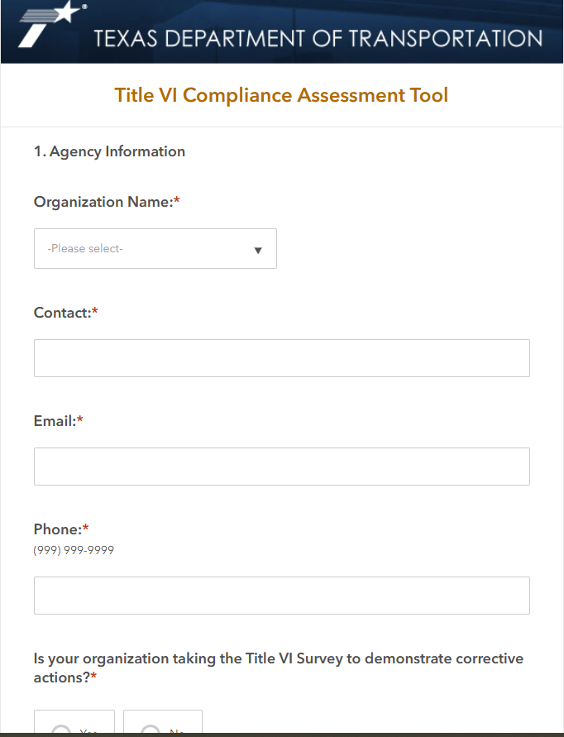
What does the survey entail?
The following slides will review each question on the SCAT review as well as guidance on what is expected to fulfill each requirement.
Figure 1: Title VI Compliance
Assessment Tool

Slide 16
SCAT Title VI, Survey Question #1
Agency Information
The subrecipient must provide agency contact information. If CIV staff need further clarification on answers submitted in the SCAT survey this representative will be contacted.

Slide 17
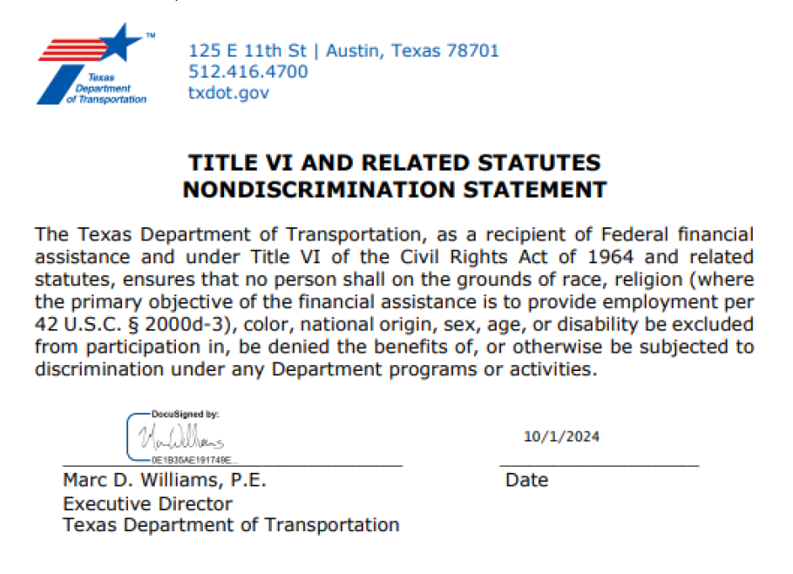
SCAT Title VI, Survey Question #2
Title VI/Nondiscrimination Policy Statement
A subrecipient must provide a statement of its commitment to Title VI and non-discrimination compliance that is signed by its top official and circulated throughout the organization and available to the general public. The policy statement must state that the agency will not discriminate in any program, service, or activity on the basis of race, color, national origin.
Figure 1: TxDOT Title VI Nondiscrimination
Policy Statement
Notes:
The policy statement, signed by the head of the agency, should express the agency’s commitment to the nondiscrimination provisions of Title VI: That no person shall on the grounds of race, color, national origin, be excluded from participation in, be denied the benefits of, or be otherwise subjected to discrimination under any program or activity conducted by the recipient regardless of whether those programs and activities are federally- funded or not.
Title VI Policy Statement should be signed by the subrecipient’s top official, circulated internally and be made available to the general public.
The Statement should be published in languages other than English, where appropriate. TxDOT has a signed policy statement in Spanish. It is located within our Title VI plan which is available online if you would like to use it as a template.
Notes:
The policy statement, signed by the head of the agency, should express the agency’s commitment to the nondiscrimination provisions of Title VI: That no person shall on the grounds of race, color, national origin, be excluded from participation in, be denied the benefits of, or be otherwise subjected to discrimination under any program or activity conducted by the recipient regardless of whether those programs and activities are federally- funded or not.
Title VI Policy Statement should be signed by the subrecipient’s top official, circulated internally and be made available to the general public.
The Statement should be published in languages other than English, where appropriate. TxDOT has a signed policy statement in Spanish. It is located within our Title VI plan which is available online if you would like to use it as a template.

Slide 18
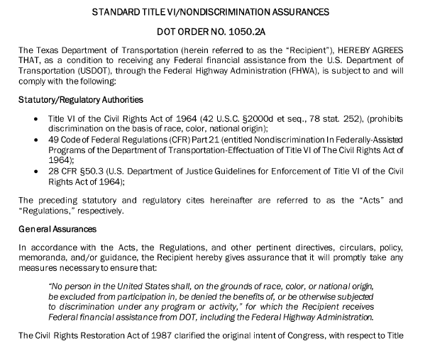
SCAT Title VI, Survey Question #3
Title VI/Nondiscrimination Assurances
A subrecipient In accordance with 23 CFR 200.9(a)(1) and Title 49, CFR part 21 is required to sign a Title VI and related statutes nondiscrimination assurance to certify to FHWA and TxDOT that its program, services, and activities are being conducted in a nondiscriminatory manner.
Figure 1: Standard Title VI/Nondiscrimination
Assurances
Notes: The head of the agency is required to sign the U.S. DOT Standard Title VI Assurances every three years or within 30 days following a change in executive leadership. Signing Title VI and related statutes nondiscrimination assurances certifies to FHWA and TxDOT that its program, services, and activities are being conducted in a nondiscriminatory manner. The Assurances serve two important purposes:
  1) They document agency commitment to nondiscrimination and equitable service to its community and
  2) They serve as a legally enforceable agreement by which the Agency may be held liable for not adhering to.
  The Assurances lists all the Title VI requirements that a local agency agrees to perform in return for receiving FHWA funds from the State, including developing a nondiscrimination policy statement and a discrimination complaint handling procedure.
  It should be noted that construction contractors, consultants, and suppliers are NOT required to sign the U.S. DOT Standard Title VI Assurances and do not apply to contractors or consultants.
The subrecipient is responsible for ensuring that the applicable appendices of the Standard Assurance are included in every contract that includes federal assistance. We have a template available for this requirement should you need it.
Notes:
The head of the agency is required to sign the U.S. DOT Standard Title VI Assurances every three years or within 30 days following a change in executive leadership. Signing Title VI and related statutes nondiscrimination assurances certifies to FHWA and TxDOT that its program, services, and activities are being conducted in a nondiscriminatory manner. The Assurances serve two important purposes:
1) They document agency commitment to nondiscrimination and equitable service to its community and
2) They serve as a legally enforceable agreement by which the Agency may be held liable for not adhering to.
The Assurances lists all the Title VI requirements that a local agency agrees to perform in return for receiving FHWA funds from the State, including developing a nondiscrimination policy statement and a discrimination complaint handling procedure.
It should be noted that construction contractors, consultants, and suppliers are NOT required to sign the U.S. DOT Standard Title VI Assurances and do not apply to contractors or consultants.
The subrecipient is responsible for ensuring that the applicable appendices of the Standard Assurance are included in every contract that includes federal assistance. We have a template available for this requirement should you need it.

Slide 19
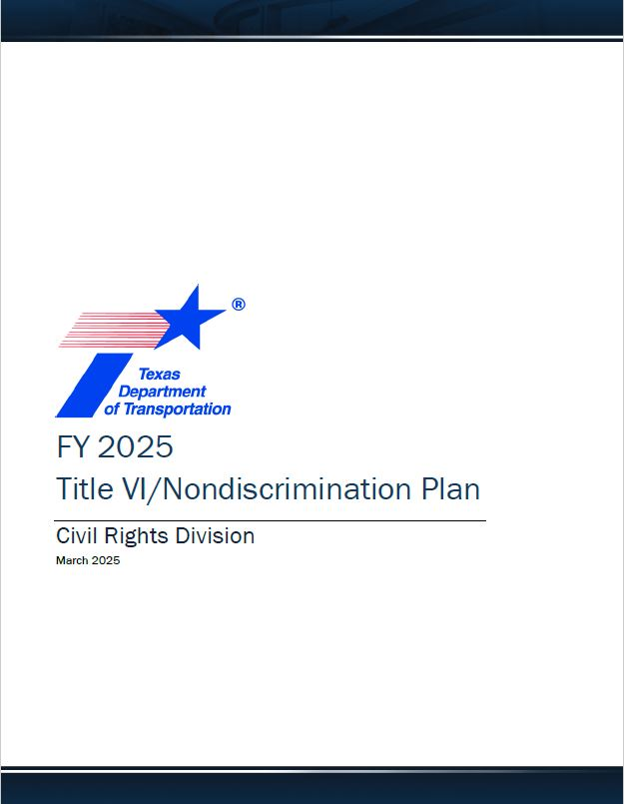
SCAT Title VI, Survey Question #4
Figure 1: FY 2025 Title VI/
Nondiscrimination Plan
Title VI/Nondiscrimination Plan
Every three years, a subrecipient is required to develop a Title VI/Nondiscrimination plan. The plan must include the implementation procedures, strategies, and activities to facilitate and assure nondiscrimination. The implementation plan sets forth the agency’s goals and priorities over a three-year period; and identifies the allocation of staff and resources to accomplish these goals.
Notes:
• Subrecipients must have a Title VI Nondiscrimination plan that communicates how the agency implements its nondiscrimination policies.
• The Title VI/Nondiscrimination Plan should contain procedures, strategies, and activities to facilitate and assure nondiscrimination in federally assisted programs and activities of the agency.
• A Title VI Plan template for subrecipients has recently been added to the Subrecipients resource webpage.
• Contractors, consultants, and suppliers are not required to submit a Title VI Plan.
• We recognize that many agencies also receive funds from FTA (Federal Transit Administration) which requires their own Title VI Plan. While some of the requirements are the same, there are some differences. A joint or combined FHWA and FTA Title VI Plan is not recommended.
Notes:
• Subrecipients must have a Title VI Nondiscrimination plan that communicates how the agency implements its nondiscrimination policies.
• The Title VI/Nondiscrimination Plan should contain procedures, strategies, and activities to facilitate and assure nondiscrimination in federally assisted programs and activities of the agency.
• A Title VI Plan template for subrecipients has recently been added to the Subrecipients resource webpage.
• Contractors, consultants, and suppliers are not required to submit a Title VI Plan.
• We recognize that many agencies also receive funds from FTA (Federal Transit Administration) which requires their own Title VI Plan. While some of the requirements are the same, there are some differences. A joint or combined FHWA and FTA Title VI Plan is not recommended.

Slide 20
SCAT Title VI, Survey Question #5
Title VI Coordinator
Subrecipients are required to identify a Title VI Coordinator and publish/post the Coordinator’s contact information where it is available to the public (including online). In addition, the Coordinator must have unimpeded access to the head of the agency, for the purposes of discussing nondiscrimination issues. There should be a description of the Title VI Coordinator’s responsibilities and an organizational chart showing the Title VI coordinator’s relationship to the head of the agency.
Notes: A Title VI Coordinator in your organization should be able to :
•Conduct the agency's Title VI responsibilities and provide oversight;
• Implement your Title VI Plan;
• Investigate complaints;
• Provide training to staff;
• Document the goals met in your organization’s Title VI/Nondiscrimination Plan; and
• Develop Title VI information specific to your organization and where appropriate accommodate persons who have a Limited English Proficiency.
Notes:
A Title VI Coordinator in your organization should be able to :
•Conduct the agency's Title VI responsibilities and provide oversight;
• Implement your Title VI Plan;
• Investigate complaints;
• Provide training to staff;
• Document the goals met in your organization’s Title VI/Nondiscrimination Plan; and
• Develop Title VI information specific to your organization and where appropriate accommodate persons who have a Limited English Proficiency.

Slide 21
SCAT Title VI, Survey Question #6
Title VI Complaint Handling
Subrecipients are responsible for processing Title VI external discrimination complaints received by the agency. All discrimination complaints received by the agency must be referred to TxDOT Civil Rights Division for further review and action.
Notes: TxDOT processes complaints consistent with FHWA’s Guidance. Within 10 days of receipt of a complaint, TxDOT will inform the FHWA Division Office, which will forward the complaint to the FHWA Headquarters Office of Civil Rights (HCR) for review and further investigation if accepted.
Best practices for complaint handling include:
• Ensuring complaints are handled by personnel trained in compliance investigations.
• Ensuring complaints filed with the subrecipient in which the subrecipient or its lower tier subrecipient is named as the respondent must be forwarded to TxDOT for investigation within 10 calendar days.
• Developing an external discrimination complaint form.
• Distributing written discrimination complaint handling procedures to agency personnel.
• Making the public aware of the procedures for filing a discrimination complaint, such as making the information available on the agency’s Web site or in a brochure.
• Maintaining a complaint log, to include any complaints or lawsuits filed against the agency,
• Maintaining all correspondence related to the complaint.
Please keep in mind, subrecipients should not conduct their own Title VI investigations other than to collect information and work with TxDOT and FHWA to remediate. FHWA will conduct the investigation or direct TxDOT to do so.
A complaint form and procedures template is available for subrecipients on our website.
Notes:
TxDOT processes complaints consistent with FHWA’s Guidance. Within 10 days of receipt of a complaint, TxDOT will inform the FHWA Division Office, which will forward the complaint to the FHWA Headquarters Office of Civil Rights (HCR) for review and further investigation if accepted.
Best practices for complaint handling include:
• Ensuring complaints are handled by personnel trained in compliance investigations.
• Ensuring complaints filed with the subrecipient in which the subrecipient or its lower tier subrecipient is named as the respondent must be forwarded to TxDOT for investigation within 10 calendar days.
• Developing an external discrimination complaint form.
• Distributing written discrimination complaint handling procedures to agency personnel.
• Making the public aware of the procedures for filing a discrimination complaint, such as making the information available on the agency’s Web site or in a brochure.
• Maintaining a complaint log, to include any complaints or lawsuits filed against the agency,
• Maintaining all correspondence related to the complaint.
Please keep in mind, subrecipients should not conduct their own Title VI investigations other than to collect information and work with TxDOT and FHWA to remediate. FHWA will conduct the investigation or direct TxDOT to do so.
A complaint form and procedures template is available for subrecipients on our website.

Slide 22
SCAT Title VI, Survey Question #6 (Continued)
Any person who believes they, or any specific class of persons, to be subjected to prohibited discrimination based on race, color or national origin may file a written complaint individually or through a representative. A complaint must be filed no later than 180 days after the date of the alleged discrimination, unless the discrimination is ongoing, or the time for filing is extended by the FHWA. Complaints related to the Federal-aid highway program may be filed with TxDOT, FHWA Division Office, the FHWA Headquarters Office of Civil Rights (HCR), the USDOT Departmental Office of Civil Rights, or the USDOJ.

Slide 23
SCAT Title VI, Survey Question #7
Solicitation for Bid/Request for Proposal
Subrecipients are required to include the Title VI/Nondiscrimination paragraph from the U.S. DOT Standard Title VI Assurances in all solicitations for bid or Requests for Proposals that include Federal assistance.

Slide 24
SCAT Title VI, Survey Question #7 (Continued)
“The (Recipient), in accordance with Title VI of the Civil Rights Act of 1964, 78 Stat. 252, 42 U.S.C 2000d to 2000d-4 and Title 49, Code of Federal Regulations, Department of Transportation, Subtitle A, Office the Secretary, Part 21, Nondiscrimination in Federally assisted programs of the Department of Transportation issued pursuant to such Act, hereby notifies all bidden that it will affirmatively insure that in any contact entered into pursuant to this advertisement, minority business enterprises will be afforded full opportunity to submit bids in response to this invitation and will not be discriminated against on the grounds of race, color, or national origin in consideration for an award.”

Slide 25
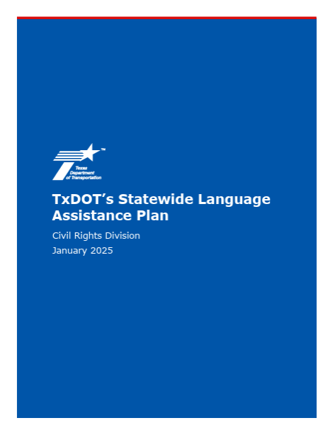
SCAT Title VI, Survey Question #8
Accommodations for Limited English Proficient Persons
Subrecipients must ensure meaningful access to the benefits, services, information, and other important portions of an agency’s programs and activities for individuals who are Limited English Proficient (LEP).
Figure 1: TxDOT’s Statewide
Language Assistance Plan
Notes: Some recommendations include:
• Conduct a language needs assessment considering the following four factors: 1) The number or proportion of LEP persons in the eligible service population 2) The frequency with which LEP individuals come in contact with the agency’s programs or activities 3) The nature of the importance of the program, activity, or services provided by the agency 4) The resources available to the agency and the costs
• Translate written information and outreach materials into regularly encountered languages other than English, particularly vital documents if they contain information that is critical for obtaining services and/or benefits or is required by law
• Develop methods to provide oral interpretation either in person or via telephone and the procedures used by staff to access those services
• Identify LEP populations affected by a project using the most recent Census data and tailor your public outreach accordingly.
• Attend training that focuses on helping staff better communicate with LEP persons
• Post notices detailing the agency’s Title VI obligations and complaint procedures that have been translated into languages other than English
• Notify LEP customers of the availability of language services
• Maintain a list of bilingual staff and the languages they interpret or translate
• Develop an agency Language Assistance Plan that establishes guidelines for providing language services to persons with Limited English Proficiency.
• Translate important information on the agency’s external Website or use Google translate as a basic tool for introductory conversations.
• Continually monitor and evaluate efforts to provide language access
Notes:
Some recommendations include:
• Conduct a language needs assessment considering the following four factors: 1) The number or proportion of LEP persons in the eligible service population 2) The frequency with which LEP individuals come in contact with the agency’s programs or activities 3) The nature of the importance of the program, activity, or services provided by the agency 4) The resources available to the agency and the costs
• Translate written information and outreach materials into regularly encountered languages other than English, particularly vital documents if they contain information that is critical for obtaining services and/or benefits or is required by law
• Develop methods to provide oral interpretation either in person or via telephone and the procedures used by staff to access those services
• Identify LEP populations affected by a project using the most recent Census data and tailor your public outreach accordingly.
• Attend training that focuses on helping staff better communicate with LEP persons
• Post notices detailing the agency’s Title VI obligations and complaint procedures that have been translated into languages other than English
• Notify LEP customers of the availability of language services
• Maintain a list of bilingual staff and the languages they interpret or translate
• Develop an agency Language Assistance Plan that establishes guidelines for providing language services to persons with Limited English Proficiency.
• Translate important information on the agency’s external Website or use Google translate as a basic tool for introductory conversations.
• Continually monitor and evaluate efforts to provide language access

Slide 26

SCAT Title VI, Survey Question #9
Public Participation Process
Subrecipients must provide an opportunity for public involvement and access to the transportation decision making process to all segments of the population, including minority communities and populations who are not proficient in English.
Figure 1: TxDOT’s Strategic Public Engagement
Guidance
Notes: Recommendations include:
• Develop an agency Public Participation Plan. Include maps of the identified minority and LEP populations based upon the most recent Census data.
– The Title VI/Nondiscrimination Coordinator should actively participate in the development and update efforts and should be included in the approval process. They should also monitor how the agency implements the plan.
• Public involvement and participation procedures should detail how the agency notifies the public regarding the development of transportation plans and improvement programs and how it solicits and addresses the public’s comments.
• It’s important to conduct early and continuous public involvement through stages of project development and provide timely information to the public and in languages other than English.
• Document efforts to utilize demographic data or knowledge of the community to perform outreach to specific populations.
• Seek out and consider the needs of minority, low-income, or other non-traditional stakeholders.
• Maintain a stakeholders list with contact information for organizations and individuals.
• Periodically review and evaluate the public participation processes/procedures.
• Ensure the processes/procedures are compliant with the Title VI/Nondiscrimination requirements.
Notes:
Recommendations include:
• Develop an agency Public Participation Plan. Include maps of the identified minority and LEP populations based upon the most recent Census data.
– The Title VI/Nondiscrimination Coordinator should actively participate in the development and update efforts and should be included in the approval process. They should also monitor how the agency implements the plan.
• Public involvement and participation procedures should detail how the agency notifies the public regarding the development of transportation plans and improvement programs and how it solicits and addresses the public’s comments.
• It’s important to conduct early and continuous public involvement through stages of project development and provide timely information to the public and in languages other than English.
• Document efforts to utilize demographic data or knowledge of the community to perform outreach to specific populations.
• Seek out and consider the needs of minority, low-income, or other non-traditional stakeholders.
• Maintain a stakeholders list with contact information for organizations and individuals.
• Periodically review and evaluate the public participation processes/procedures.
• Ensure the processes/procedures are compliant with the Title VI/Nondiscrimination requirements.

Slide 27
SCAT Title VI, Survey Question #10
Data Collection and Analysis
Subrecipients must develop procedures for the collection of statistical data (race, color, national origin) of participants and beneficiaries of an agency’s programs (e.g., relocatees, impacted citizens and affected communities).
Notes: There are several ways to meet this requirement, some of which include:
• Demographic maps showing the racial composition of affected neighborhoods may be used to develop a community profile.
• Develop forms, surveys, and other data collection methods designed to obtain a description of community boundaries, racial/ethnic make-up, income levels, tax base, or access to community services, schools, hospitals and shopping directly from the community
• Engage and track historically under represented populations and businesses in the planning, project development, and maintenance processes.
• Send correspondence to community leaders, community-based organizations, or local data-collecting agencies requesting their assistance in identifying the demographics of the population affected by the agency’s programs and activities.
Notes:
There are several ways to meet this requirement, some of which include:
• Demographic maps showing the racial composition of affected neighborhoods may be used to develop a community profile.
• Develop forms, surveys, and other data collection methods designed to obtain a description of community boundaries, racial/ethnic make-up, income levels, tax base, or access to community services, schools, hospitals and shopping directly from the community
• Engage and track historically under represented populations and businesses in the planning, project development, and maintenance processes.
• Send correspondence to community leaders, community-based organizations, or local data-collecting agencies requesting their assistance in identifying the demographics of the population affected by the agency’s programs and activities.

Slide 28


SCAT Title VI, Survey Question #11
Title VI Program Visibility
Subrecipients are required to identify how it advises the public of nondiscrimination policies, procedures and other related information. Electronic or web-based posting of Title VI program information alone is insufficient. The agency must post in publicly accessible locations, such as main lobbies, town halls, community centers and other public facilities.
Figure 1: Title VI Poster, English
Figure 2: Title VI Poster, Spanish
Notes: Where appropriate, display in languages other than English.
If your agency doesn’t already have a Title VI Poster, consider using TxDOT’s as a template. TxDOT’s poster is available on the Title VI program webpage on txdot.gov.
Notes:
Where appropriate, display in languages other than English.
If your agency doesn’t already have a Title VI Poster, consider using TxDOT’s as a template. TxDOT’s poster is available on the Title VI program webpage on txdot.gov.

Slide 29
Technical Guidance
Notes:
Next we will discuss requirements for subrecipients

Slide 30
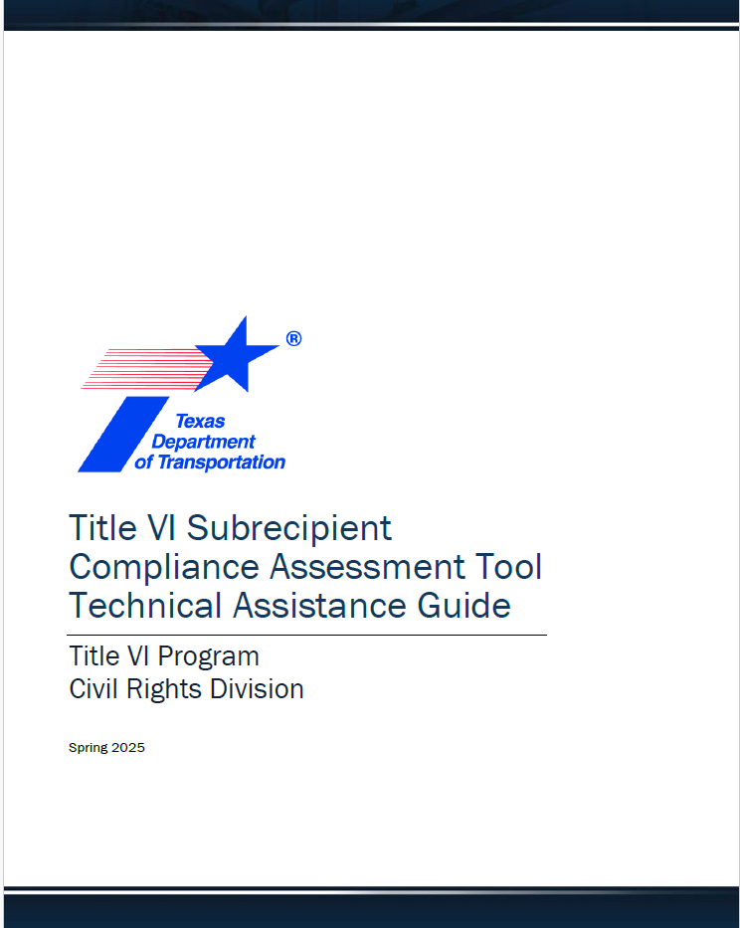
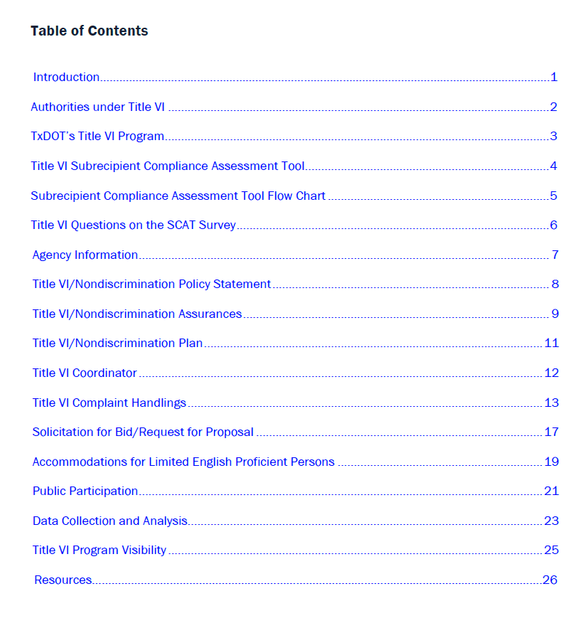
Title VI SCAT Guide
The Title VI SCAT Guide is available on-line as a reference.
Figure 1: Title VI SCAT Technical Assistance Guide
Figure 2: Title VI SCAT Technical Assistance Guide table of contents

Slide 31
Title VI SCAT Templates
Title VI Appendices
Title VI Assurances
Title VI Complaint Form
Title VI Complaint Procedures
Title VI Nondiscrimination Policy Statement
Title VI/Nondiscrimination Plan
All templates and the technical assistance guide are available online.

Slide 32
Technical Assistance
Contact the Title VI team at 512-416-4700 or email TitleVI@txdot.gov

