Slide 1
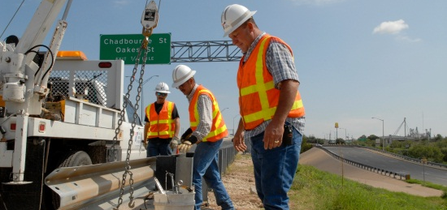
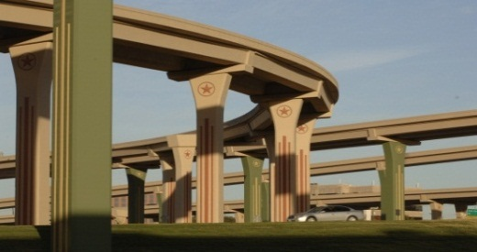
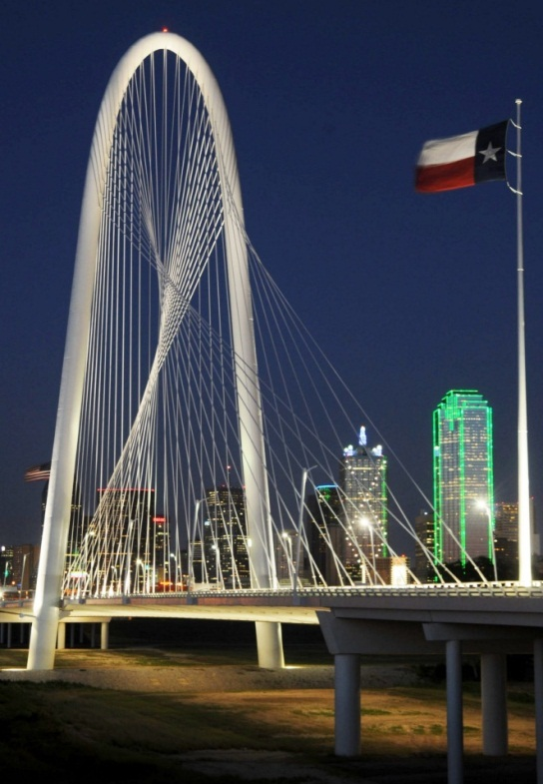
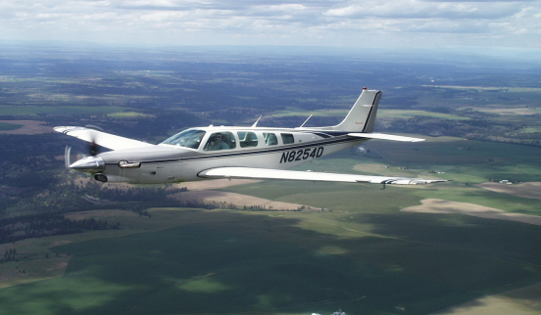
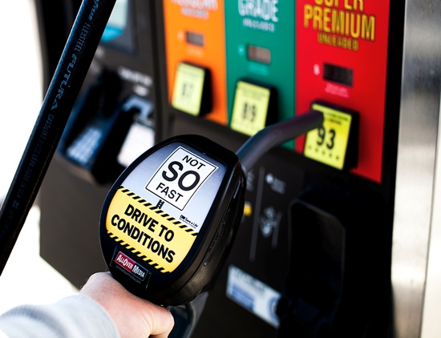
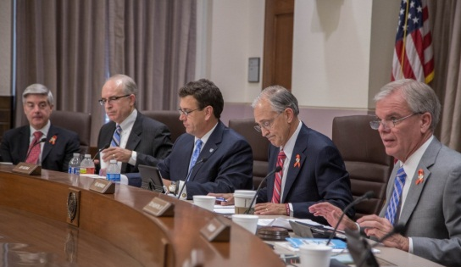
SOCIAL MEDIA MATCH, FY 2018

Slide 2
Social Media Match
Fiscal Year-2018
All TxDOT Traffic Safety sub-grantees may use social media when calculating earned media value for match.

Slide 3
Social Media Match
What’s New in FY18?
STEP Grants may submit their data reports for all the months covered by a mobilization period at one time instead of doing reports monthly.
Digg, Reddit, and StumbleUpon have been removed from the program due to changing platforms.

Slide 4
Social Media Match
In Order to Participate
1) Read the instructions for TxDOT’s Social Media Match Program on the eGrants Help Page –titled “Earned Media Value Index for Social Media–FY18”
2) Attend a TxDOT webinar training
3) Notify your TxDOT grant manager of your plans to participate
4) Agree to submit monthly documentation with RFRs

Slide 5
Social Media Match
What Items Qualify For Social Media Match?
Only social media items outlined in TxDOT’s approved program will be eligible for match
Refer to the list included in TxDOT’s program instructions accessible on the eGrants Help Page

Slide 6
Social Media Match
What Qualifies For Social Media Match?
Earned Media
Paid (bought) Media
Owned Media

Slide 7
Social Media Match
In Order to Qualify: All Social Media Postings
Must be about the Texas grant program in question – and must mention it in the post or visually represent an event with signage included.
Initial postings on a company or agency-owned account do not qualify because they are “owned media”, but all comments, likes, and shares qualify.
Third-party posts qualify, as well as their comments, likes, and shares.

Slide 8
Social Media Match
Use Only the Approved Items & Values
Earned media actions originating as a free social media postings | Value
Independent Blog (not owned by TxDOT, contractor, or sub-grantee) | $853.00
Facebook “like, love” or any other emojis | $1.60
Facebook 3rd-party posts and mentions | $10.17
Facebook comments | $10.17
Facebook shares and re-posts | $10.17
Facebook unique video views to 95% or more | $3.25
Facebook live event & webcast views to 30 seconds or more | $1.00
Twitter 3rd party tweets and mentions | $5.00
Twitter comments/replies, likes, and re-tweets | $5.00
Twitter “follow” | $2.25
Twitter video views | $.50
YouTube 3rd-party posts | $10.17
YouTube video views | $7.50
YouTube likes | $5.00
YouTube shares | $5.00
YouTube comments | $5.00
Instagram 3rd party posts | $10.17
Instagram likes/loves | $1.60
Instagram comments | $10.17
Instagram shares | $10.17
Instagram video views | $.50

Slide 9
Social Media Match
Other Social Media Do Not Qualify
(But May be Added in Future)
LinkedIn
Pinterest
SnapChat
Google+

Slide 10
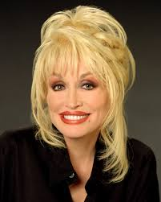
Social Media Match
Additional Value Considerations
Postings by “Influencers” are eligible for
extra value

Slide 11
Social Media Match
Who Qualifies as an Influencer?
An individual or organization not invested in the grant
Number of followers (over 2,000) --verification must be provided with a screen capture. Due to privacy issues, Twitter is the only platform which makes this information easily accessible.
Increased value formula for influencers:
# of followers – divided by 1,000 – multiplied by the unit value for social media action shown in the TxDOT Value Index

Slide 12
Social Media Match
Additional Considerations
Only “positive” initial posts qualify
Great Program!

Slide 13
Social Media Match
Additional Considerations
Only “positive” initial posts qualify
But all comments under a positive initial post will be counted even if they are “negative”

Slide 14
Social Media Match
Reporting Social Media Match
Documentation of social media match must be submitted monthly with RFRs
STEP grants may submit all months at one time for mobilization period.
Sub-grantees must use the approved summary coversheet available on eGrants Help

Slide 15
Social Media Match
FY18 Social Media MATCH: Tracking Summary Sheet
SUB-GRANTEE NAME: _____________________________________________________________
GRANT NAME or NUMBER: ________________________________________________________
REPORTING PERIOD: Social Media Posting Dates (one calendar month only): From _____________ to _______________
TOTAL SOCIAL MEDIA MATCH Claimed For This Reporting Period: ________________
 | TOTAL Social Media Value This Reporting Period
Facebook
Twitter
YouTube
Instagram
OTHER
Influencer(s)
TOTAL
Facebook
 | 3rd Party Posts & Mentions | Unit Value: $10.17 | Video Views (95%) | Unit Value: $3.25 | Live Video Views (30/sec) | Unit Value: $1.00 | Likes, Loves, Sad, etc. | Unit Value: $1.60 | Com-ments | Unit Value: $10.17 | Shares | Unit Value: $10.17 | Facebook Total Value ALL
Tracking Software
Screen Captures
Sub-Total
TOTAL Value

Slide 16
Social Media Match
Tracking & Documentation
As with all earned media, social media must be tracked, verified, and documented.
Back-up documents must be submitted every month along with your Social Media Match Coversheet . Include it with your RFR.
STEP programs are the exception – and may submit a single report for all the months of a mobilization.

Slide 17
Social Media Match
Tracking & Documentation
One or a combination of the following:
Use analytic reports (spreadsheets) created by using your free Facebook, Twitter or YouTube tracking programs
Analytic reports (spreadsheets) created by special tracking software such as Hootsuite
Screen captures

Slide 18
Social Media Match
Tracking & Documentation
Please submit your reports on a monthly basis even if your social media match is “0”.
Do not include more than one month of social media reporting.
Only include posts for the current reporting period/month.
STEP mobilization periods are the exception.

Slide 19
Social Media Match
Tracking & Documentation
Analytic Spreadsheets –Sample
Posting Date | Type | Permalink URL | Likes, Loves, etc. | Shares or Re-Tweets | Comments or Replies | Video Views | Follows
4/1/16 | Post | https://www.facebook.com/UtheDriver1411622 | 25 | 15 | 10 |  | 15
4/06/16 | Video | https://www.facebook.com/UtheDriver15513635 | 50 | 55 | 35 | 30 | 55
4/11/16 | Photo | https://www.facebook.com/UtheDriver15513635 | 22 | 4 | 3 |  | 4
4/15/16 | Link | https://www.facebook.com/UtheDriver15513635 | 6 | 1 | 5 |  | 1
4/18/16 | Post | https://www.facebook.com/UtheDriver15513635 | 10 | 11 | 4 |  | 11
4/21/16 | Video | https://www.facebook.com/UtheDriver15513635 | 6 | 6 | 5 | 12 | 6
 |  |  | 119 | 92 | 62 | 42 | 92

Slide 20
Social Media Match
Documenting Video Views
Video Views are Special
Facebook & YouTube video views are given a higher value, so they need to be documented using a special spreadsheet.
Twitter & Instagram video views are given a lower value so they do not require a special spreadsheet.

Slide 21
Social Media Match
Additional Considerations (video views)
Facebook “video views” will be accepted if 95-100% of video is viewed by unique viewers.
Facebook Live “event views & video views” will be acceptable if 30% of video is viewed.
YouTube must use only USA for video views
Twitter & Instagram video views – all viewscount

Slide 22
Social Media Match
Additional Considerations (video views)
All Facebook “video views” will require documentation through free Facebook tracking program called Facebook Insights – Choose “Video Data” as the export type.
All YouTube “video views” will require documentation through their free tracking program
Instructions can be found on eGrants Help

Slide 23
Social Media Match
Facebook Example: Screen Capture
Source: Facebook
Initial Posting Date: 02/07/2016
Initial Posting by: Christy’s Kids
Calculated Earned Media Value:
33 Shares x $10.17 = $335.61
51 Likes x $1.60 = $81.60
TOTAL = $417.21

Slide 24
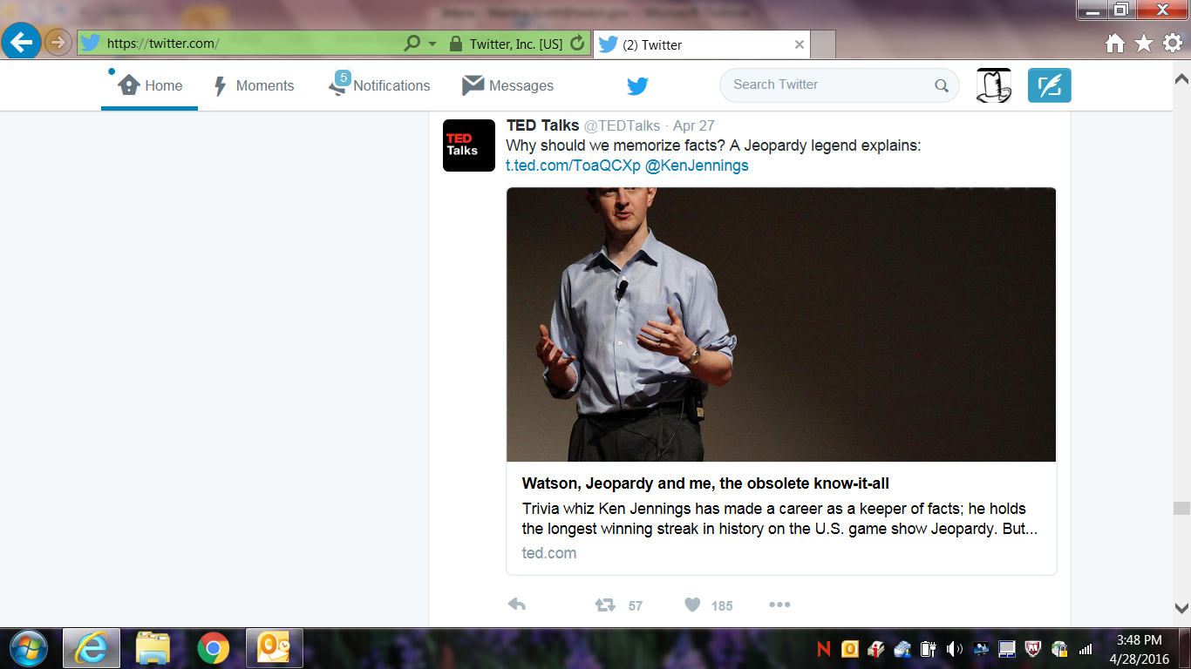
Social Media Match
Twitter Example: Screen Capture
Source: Twitter
Initial Posting Date: 04/27/2016
Initial Posting by: @TedTalks
Calculated Earned Media Value:
57 Retweets x $5.00 = $285.00
185 Likes x $5.00 = $925.00
TOTAL = $1,210.00

Slide 25
Social Media Match
Next Steps
Notify your grant manager of your agreement to participate
Go to eGrants Help:
Read instructions
Download approved cover sheet to use for your monthly reporting

Slide 26
Social Media Match
It’s a Cinch by the Inch
If you’re new to this program, start with just one social media program.
After you get the hang of it, you can add more.

